Slide 1
The Case for UHF-Band MU-MIMO
Naren Anand
Ryan E. Guerra
Dr. Edward W. Knightly
MobiCom 2014

Slide 2
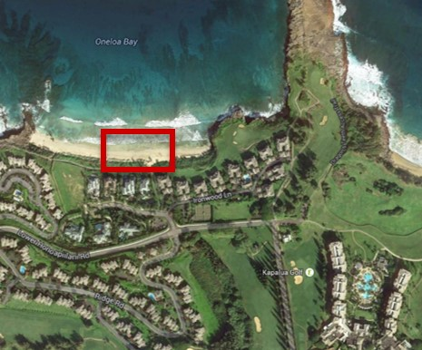
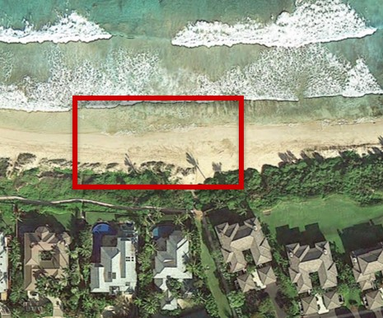
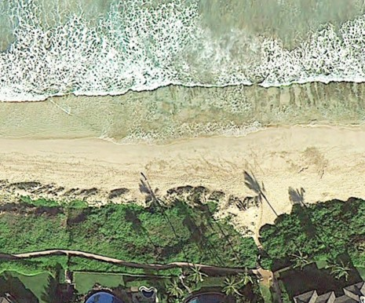
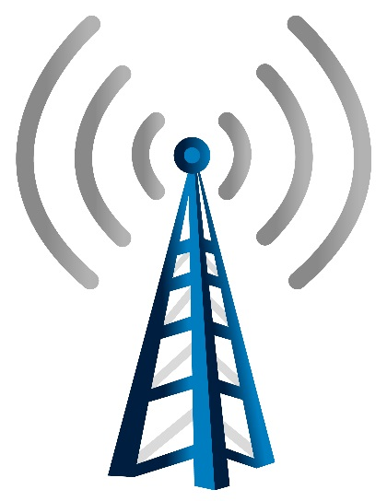
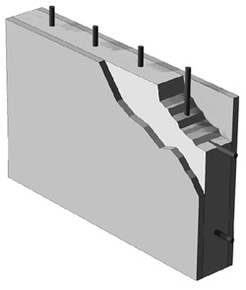
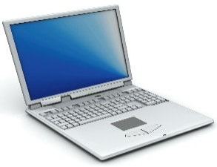

Introduction
UHF
2.4GHz
5.8GHz
f
(GHz)
0
1
2
3
5
6
Maui – 144 MHz
Houston – 6 MHz
TVWS are “beachfront property” of the RF Spectrum
– FCC 2010
-x dB/km
-x dB
Oneloa Bay, Maui
UHF
Better Propagation | Limited Spectrum
-x-10 dB/km
-x-20 dB/km
-x-7 dB
-x-33 dB

Slide 3

Introduction
MU-MIMO: Precoding technique that enables multi-antenna devices to transmit parallel streams
Properties of the UHF band uniquely benefit MU-MIMO transmissions while providing their own challenges
∠
∠
Receiver Separability
We demonstrate that UHF combined with MU-MIMO can compensate for these challenges and overcome the spectral limitations of the UHF band.
Channel Variability

Slide 4
Outline
MU-MIMO Background
Testbed Design and Integration
OTA Measurements and Analysis

Slide 5

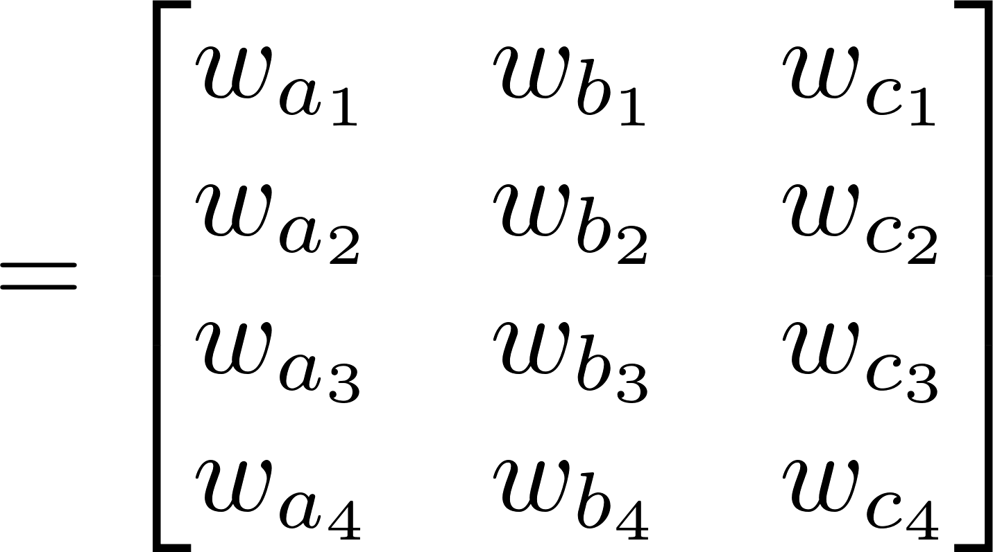
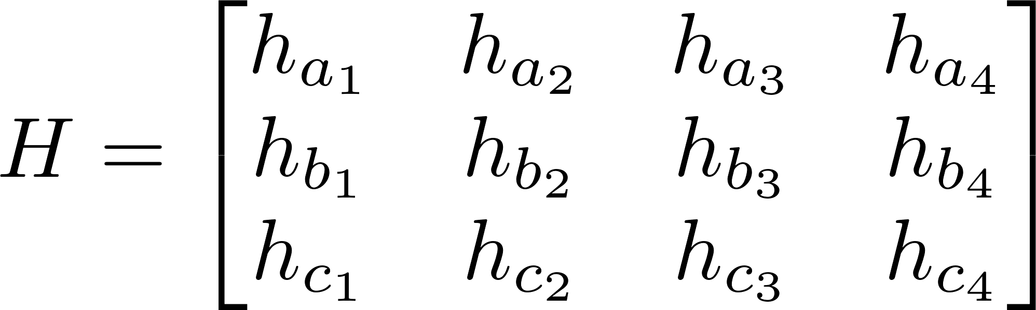
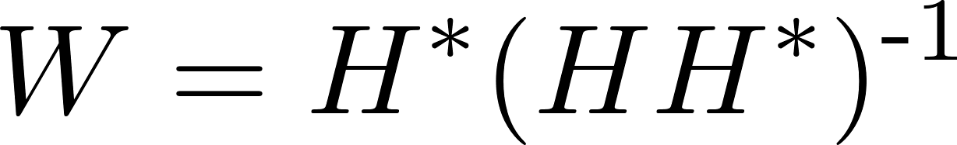
MU-MIMO Background
MU-MIMO: linear precoding method that allows a multi-antenna AP to transmit multiple parallel data streams to groups of clients
  Precoding: Applying complex magnitude and phase offsets (steering weights) to each data stream through the transmitting antenna array
  Steering Weights: W matrix computation based on measured magnitude and phase offsets for each Tx->Rx antenna path (CSI Matrix)
    e.g., Zero-forcing Beamforming
Rx A
Wa·Da
Data-a
Tx
Data-b
Wb·Db
Rx B
Data-c
Wc·Dc
Rx C

Slide 6
MU-MIMO Tx Procedure
Two step process:
  SOUND – Measure channel between Tx and Rx antennas
  TRANSMIT – Transmit parallel streams to multiple users
Rx A
a
Tx
b
Rx B
c
Rx C

Slide 7
MU-MIMO Performance
Two Key Performance-Determining Factors
∠
∠
Receiver Separability
Channel Variability
How much do the users (or their environments) move?
How temporally correlated are the users’ channels?

Slide 8


Receiver Separability
How close are the users’ channels?
  Linear dependence of H matrix rows
  NOT necessarily dependent on physical location
2.4 GHz
How to Quantify?
Demmel Condition Number
  [35] C. Zhong, et. al. 2011
  Based on Linear dependence
  Thus, invertibility
  Reliably predicts performance
    eg., use for MCS
  [1,∞] : 1 -> perfectly separable (orthogonal) channels
?
5.8 GHz
UHF?
Rx A
∠
∠
∠
Tx
∠
Rx B
∠
∠
?
Rx C

Slide 9







Channel Variability
How much do the users (or their environments) move?
  Between SOUNDING and TRANSMISSION
  How “fast” is the user/environment changing?
SOUNDING
and
TRANSMISSION
m/s
λ/s
Rx A
13m/s
a
How to Quantify?
elem(H) autocorrelation
  Measures change of each antenna path
  [0,1] : 1-> identical for given lag
  Rate of decay w.r.t. lag:
    Slow decay, sound less
    Fast Decay, sound more
Tx
b
Rx B
c
1.5m/s
Rx C
4.5m/s
λ
X
UHF
60cm
x
2.5
7.5
21
2.4 GHz
12cm
5x
λ/s
13
38
108
5.8 GHz
5cm
12x
30
90
260

Slide 10
MU-MIMO: UHF vs 2.4/5GHz
Channel Variability
Receiver Separability
MU-MIMO
Channel Models
5.8 GHz
Indoor
[27] Poutanen 2011
?
?
300 MHz
Outdoor
[36] Zhu 2013
?
?
OTA Characterization

Slide 11
MU-MIMO Channel Models
COST 2100 -> MU-MIMO modelling framework
Parameterized for 300 MHz outdoor and 5 GHz indoor through exhaustive OTA measurements
Models tell us:
  UHF MU-MIMO users are harder to separate than 5GHz
  UHF MU-MIMO channels are less variable than 5GHz
5.8GHz
5.8GHz
300MHz
300MHz
Order of magnitude

Slide 12
MU-MIMO: UHF vs 2.4/5GHz
Channel Variability
Receiver Separability
MU-MIMO
Channel Models
5.8 GHz
Indoor
[27] Poutanen 2011
More
Variable
Easier to Separate
300 MHz
Outdoor
[36] Zhu 2013
Less
Variable
Harder to Separate
OTA Characterization
2.4/5.8 GHz Indoor
[9] Aryafar 2010
More
Variable
Easier to Separate
UHF
In/Outdoor
?
?
[*] Anand 2014

Slide 13
Outline
MU-MIMO Background
Testbed Design and Integration
OTA Measurements and Analysis

Slide 14
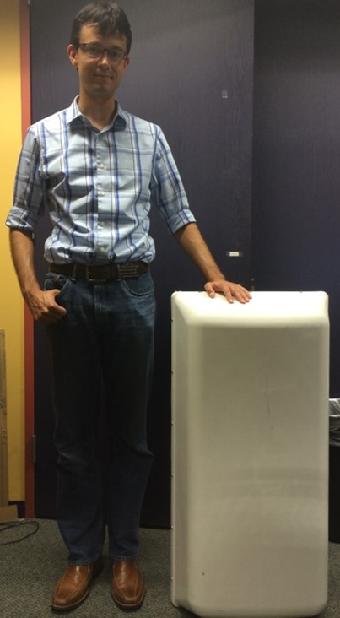
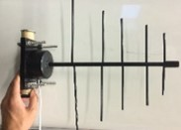
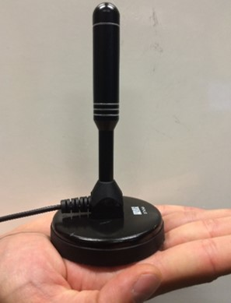
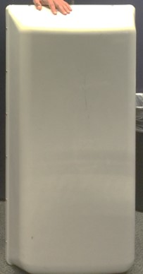
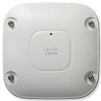


WURC Array
How do you build a UHF MU-MIMO array?
Common UHF Antennas are cumbersome -> especially for indoor deployments
Ryan
Log-periodic
35cm
40cm
45cm
λ/2=30cm
Sector
Omni
25cm
100cm
12cm
185cm
12cm
UHF array achieves MU-MIMO gains even with SFF antennas -> Indoor WLAN sized
Enterprise AP and
WARP SDR
7cm
50cm

Slide 15
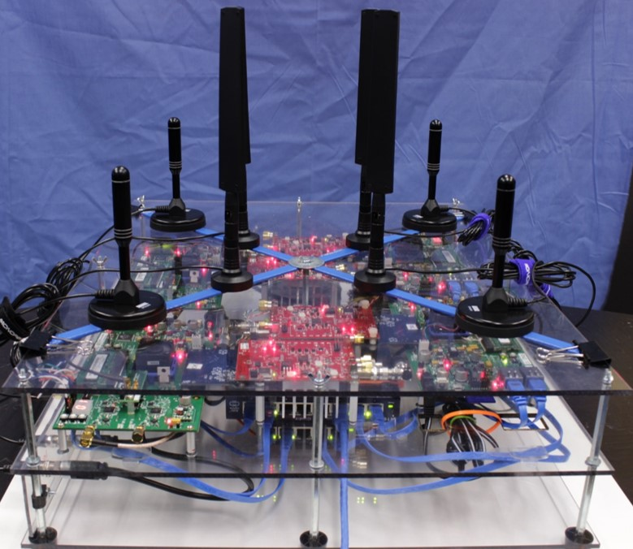
WURC Array
Open UHF MU-MIMO development platform
  d
Side by side comparisons of 2.4/5Ghz and UHF band
4 WARP + 4 WURC
Clock and trigger sync. - > coherent transmitter
UHF Antenna
Dual-Band WiFi Antenna
λ/2=6cm
λ/2=30cm

Slide 16
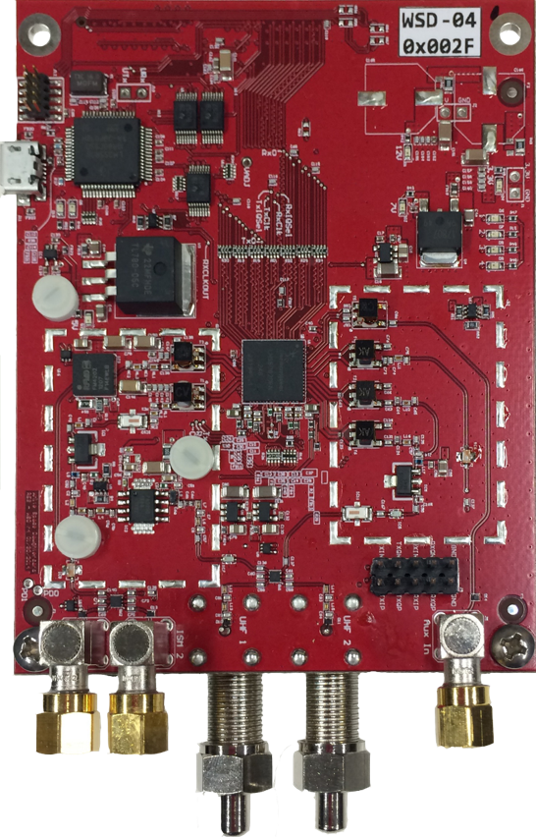




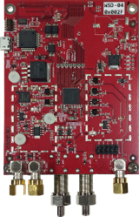






WURC
Open
Fairwaves UmTRX
Rice WARP
Digital I/O
Power
dist.
Microsoft SORA
µCtlr
Carlson RuralConnect
High Power
Myriad RF
Ettus USRP
Adaptrum
Rx
LNA
WURC
Tx
PA Chain
TRX
Nuand BladeRF
Frequency-Agile
Wideband UHF Radio Card
Nutaq SFF-SDR
Nutaq PicoSDR
High power, Multi-band radio front end
  Custom design - built with LMS6002D
  Up to 1 Watt Tx power with custom PA chain
  Demo: An Open-Source Development Platform for Long-Range UHF-Connected WiFi Hotspots
2.4 GHz
DPDT
UHF
DPDT
Wideband
Rx

Slide 17
Outline
MU-MIMO Background
Testbed Design and Integration
OTA Measurements and Analysis

Slide 18

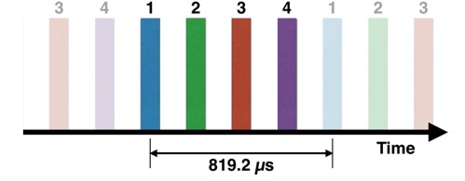
OTA Measurement Methodology
Exhaustively characterize the channel
Zero-forcing Beamformer
  Based on WARPLab design flow
    [9] Aryafar 2010, Shepard 2012, Anand 2012
  MATLAB Centric PHY layer prototyping platform
  Allows for less complex implementation of Zero-forcer
    measure SINR -> Aggregate Shannon Capacity
  High communication latency.
  Topology restricted by cabling.
High speed WARP-based channel sounder
  Based on WARP-802.11 Reference Design
    Allows for MU-MIMO channel sounding
    with a relatively low cost set of SDRs
  LTS for OFDM channel estimation
  Provides high speed channel snapshots
  not actual beamforming

Slide 19


Indoor Scenario
Typical, challenging Indoor Environment
  Environmental mobility from office
  Industrial building: Concrete and steel propagation environment
  Non-Line of Sight
  Close colocation of receivers
Will UHF propagation allow for user separation?
Does the UHF MU-MIMO channel actually stay stable?
Rx
Rx
Rx
Rx
Rx
Rx
Walkway
Concrete
Tx

Slide 20
Indoor Scenario
Sum capacity peaks at 4x3
  [9] Aryafar 2010
Propagation of 5.8 GHz diminishes performance
Recall UHF user separability
  Propagation through obstacles should reduce multi-path
Equivalent capacity to 2.4GHz
Increasing Tx Distance would show larger performance gain over 2.4GHz
UHF
2.4GHz
5.8GHz
No spectral efficiency penalty for lower frequency

Slide 21
Indoor Scenario
Will UHF propagation allow for user separation?
  Previous capacity results confirm
  Verify with Condition Number
  Similar H matrix conditioning yields similar capacity
  Models: Indoor 5.8 GHz and Outdoor UHF
UHF
2.4GHz
5.8GHz
User separability is Environment Dependent, not band dependent

Slide 22
Indoor Scenario
Does the UHF MU-MIMO channel actually stay stable?
  Successful BF confirms
    Atleast for WARPLab latency
  Verify with Temporal Correlation
  UHF: low channel variability even at 802.11 Beacon Interval
  Models: Indoor 5.8 GHz and Outdoor UHF
UHF
2.4GHz
5.8GHz
Channel variability is band dependent

Slide 23
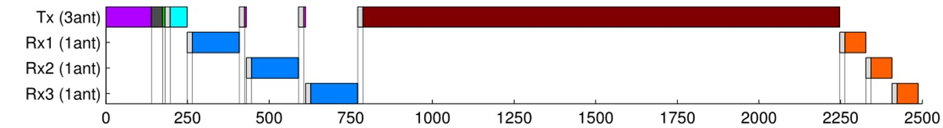
Indoor Scenario
Relevance of MU-MIMO channel stability for protocol design
  MU-MIMO provides spectral efficiency
  Setup/overhead for transmission?
  Less channel variability -> less per packet sounding
SOUND
(500us)
TRANSMIT
(1300us)
UHF allows for the gains of MU-MIMO with significantly less protocol overhead

Slide 24
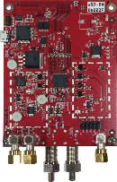
Conclusion
Design open UHF-MU-MIMO platform for side-by-side comparisons of UHF/2.4GHz/5GHz bands
WURC:
Our experiments confirm that UHF-band MU-MIMO exhibits decreased channel variability; however, they show that user separability is equivalent to 2.4/5GHz.
  Channel Variability-> Band dependent
  User Separability-> Environment dependent
Thus, UHF-MU-MIMO leverages benefits of decreased channel variability (lower sounding rate) without suffering from decreased user separability

