Slide 1



Mode and User Selection for Multi-User MIMO WLANs without CSI
Narendra Anand
Jeongkeun Lee
Sung-Ju Lee
Edward W. Knightly

Slide 2
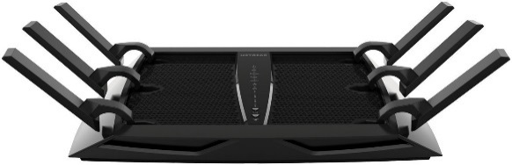


MU-MIMO WLANs
SISO
MIMO
Tx
Rx
Tx
Rx
Tx
Rx
Tx
Rx
increases throughput with antenna arrays at TX and RX
However, real world client devices have fewer antennas than APs due to cost and space
MU-MIMO
Tx
Rx A
Rx B
Rx C
NETGEAR
AC3200
allows APs to leverage antennas belonging to a group of nodes

Slide 3

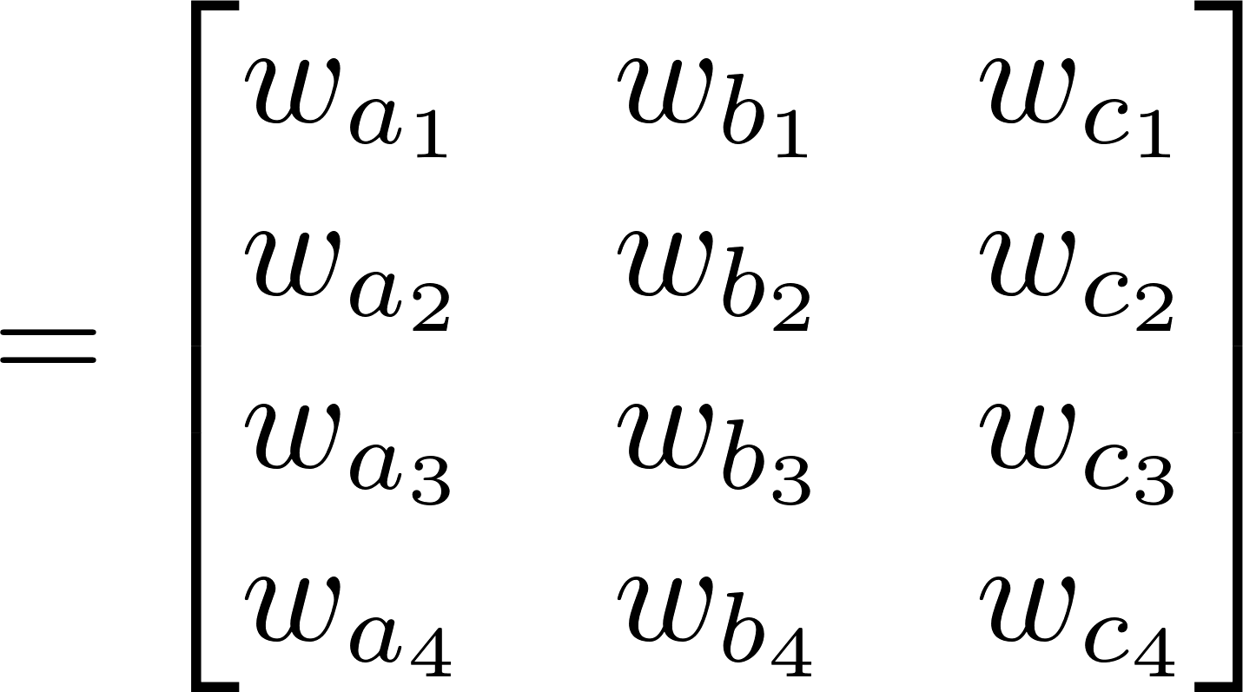
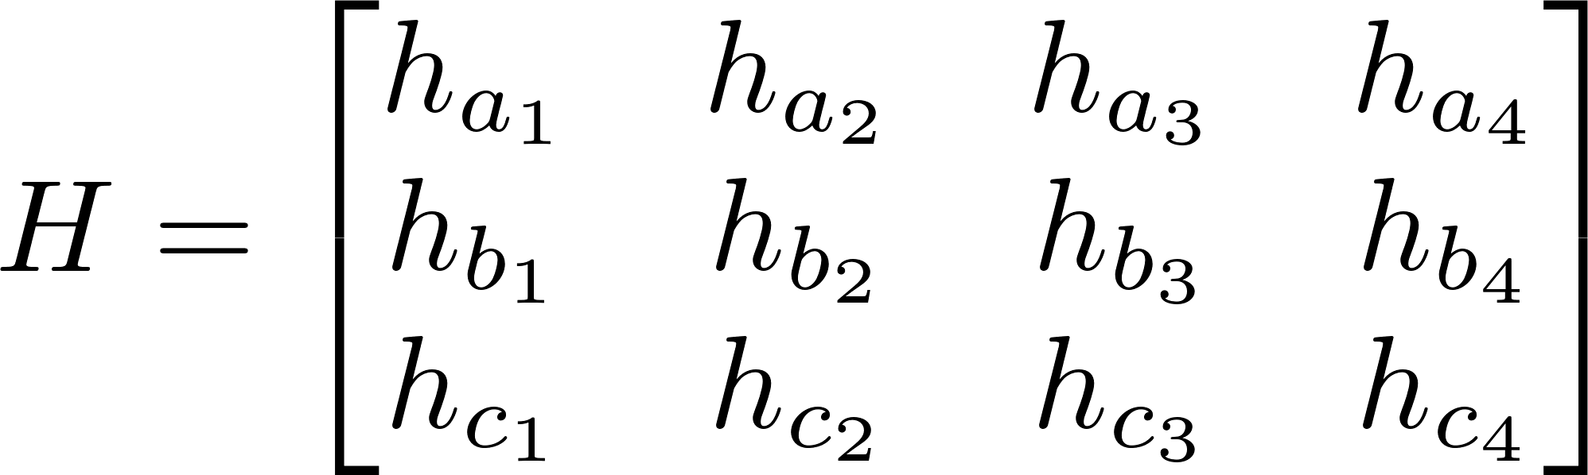
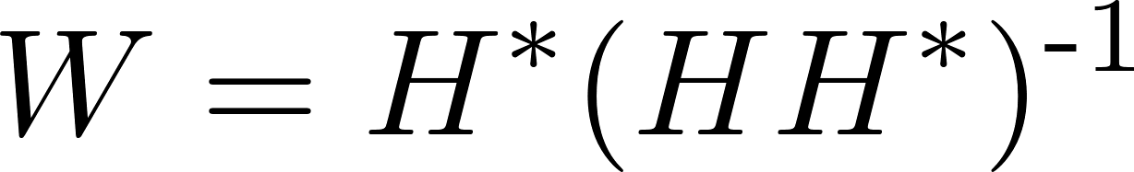



MU-MIMO Precoding
MU-MIMO: precoding method that allows a multi-antenna AP to transmit multiple parallel data streams to groups of clients
  Precoding: Applying complex magnitude and phase offsets (steering weights) to each data stream through the transmitting antenna array
  Steering Weights: W matrix computation based on measured magnitude and phase offsets for each Tx->Rx antenna path (CSI Matrix)
    e.g., Zero-forcing Beamforming
Rx A
Data-a
$W_{a}∙D_{a}$
Tx
$$W_{b}∙D_{b}$$
Data-b
Rx B
Data-c
${ W}_{c}∙D_{c}$
Rx C

Slide 4
Motivation
Basic process for MU-MIMO transmission protocol:
Rx A
Group Selection
  #Rx Ant. ≤ #Tx Ant
“Sound” channel
  Send training sequence
  Acquire measurements serially
Transmit in parallel
  TX based on channel sounding
    Sounding gives CSI matrix H
  Transmit precoding with steering matrix W
Rx A
Rx A
Tx
Rx B
Rx B
Rx A
Rx C
Rx C
TX Timeline
Tx
Pilots
Data
CSI
ack
Rx A
CSIT A
CSI
ack
Rx B
CSIT B
CSI
ack
Rx C
CSIT C

Slide 5
Motivation
Basic process for MU-MIMO transmission protocol:
Rx A
The MU-MIMO Tradeoff
Channel Sounding Overhead
  Scales with #Tx/Rx Antennas “Mode”
  802.11ac: 1.6-329kb/user (base rate)
  MU-MIMO protocols must efficiently amortize feedback overhead
MAC-layer Decisions – User Selection
  Full characteristics of associated user set only known after sounding - [16], [17], [18]
  (Per-user overhead) x (# Associated users) => Post-sounding methods unfeasible
  Pre-sounding method is required!
PUMA: Pre-sounding User and Mode Selection Algorithm
  MAC-Layer Decisions using only information available before sounding
Rx A
Tx
Rx B
Rx A
PUMA
Rx C
TX Timeline
Tx
Pilots
Data
Data
CSIT A
CSIT B
CSIT C
CSIT D
CSIT E
CSIT F
CSIT …
CSIT X
CSI
ack
Rx A
CSIT A
ack
CSI
ack
Rx B
CSIT B
ack
CSI
ack
Rx C
CSIT C
ack

Slide 6
Outline
Algorithm Description
802.11ac Integration
Evaluation
Methodology
Available Pre-sounding Information
Per-user Datarate Inference
Predicting User Specific MU-MIMO Datarate
Computing Expected Aggregate Throughput
Aggregate Throughput Calculation
Numerical Analysis of Mode/User Selection w/ 11ac
Datarate Inference Accuracy
PUMA vs Full CSI Knowledge Scheme
Mode/user selection performance

Slide 7
Outline
Algorithm Description
802.11ac Integration
Evaluation
Methodology
Available Pre-sounding Information
Per-user Datarate Inference
Predicting User Specific MU-MIMO Datarate
Computing Expected Aggregate Throughput
Aggregate Throughput Calculation
Numerical Analysis of Mode/User Selection w/ 11ac
Datarate Inference Accuracy
PUMA vs Full CSI Knowledge Scheme
Mode/user selection performance

Slide 8
Available Pre-Sounding Information
System State
  Max available Tx Antennas (M)
  Total number of associated users and receive antennas (K)
Queue State
  Available packets to transmit per client (backlog)
Link State
  Per-user Omnidirectional SNR gathered from periodic beacon messages and updated from received packets
Using more antennas results in increased data transmission and sounding overhead.
Higher backlog results in increased packet aggregation (b) further amortizing sounding overhead.
Omni SNR used to estimate per-user achievable datarate. Metric need not be instantaneous.

Slide 9
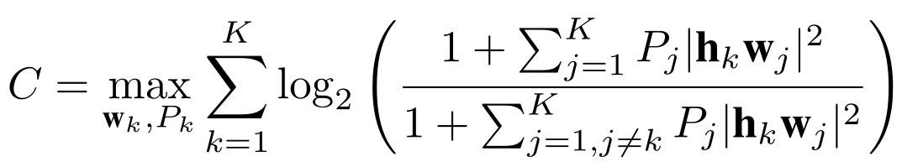
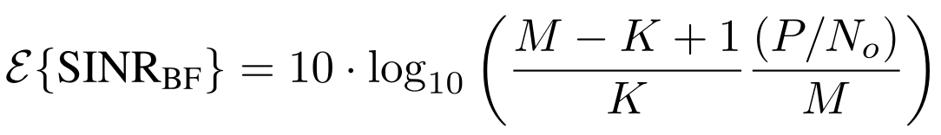
Predicting User Specific MU-MIMO Datarate
Full CSI Knowledge, Post-sounding method
Pre-Sounding (without H) – PUMA
  Leverage theoretical properties of MU-MIMO system scaling
Shannon Capacity
Signal
Basis of prior work:
[16]
[17]
[18]
Interference
Per-User Omnidirectional SNR
Expected Per-User MU-MIMO SINR
Degrees of Freedom
Ratio to number of receive antennas
Split among transmit antennas

Slide 10
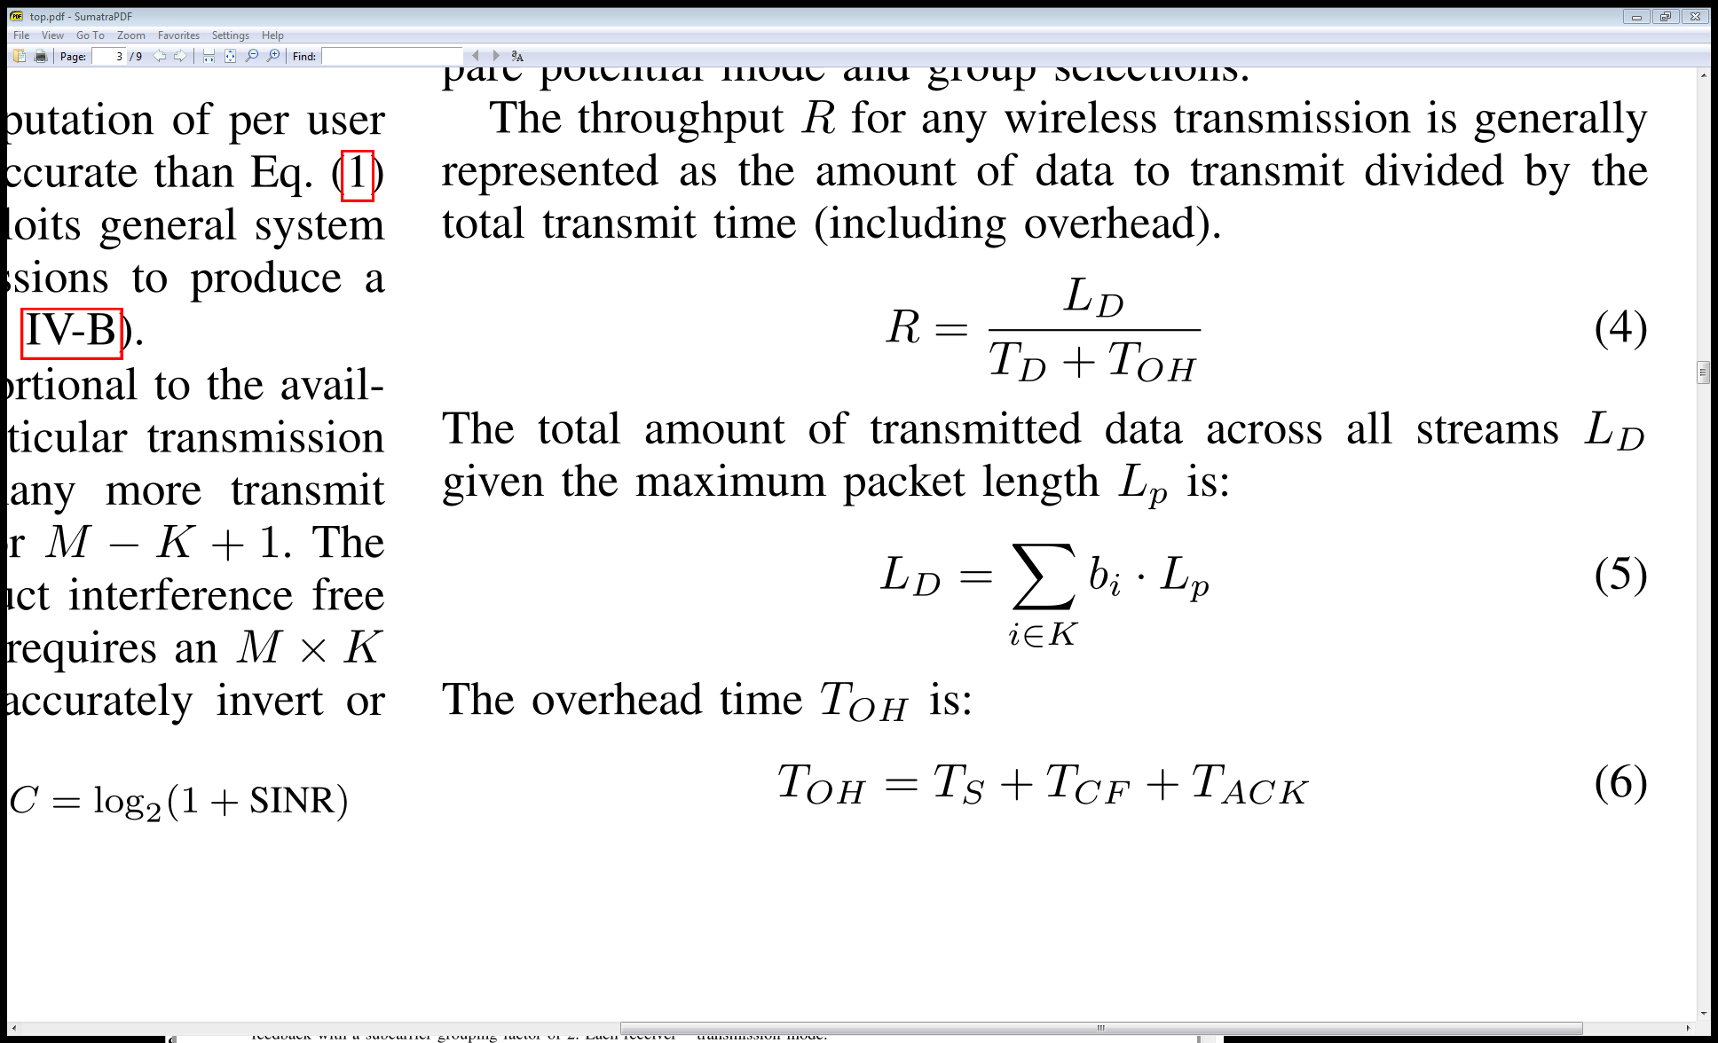
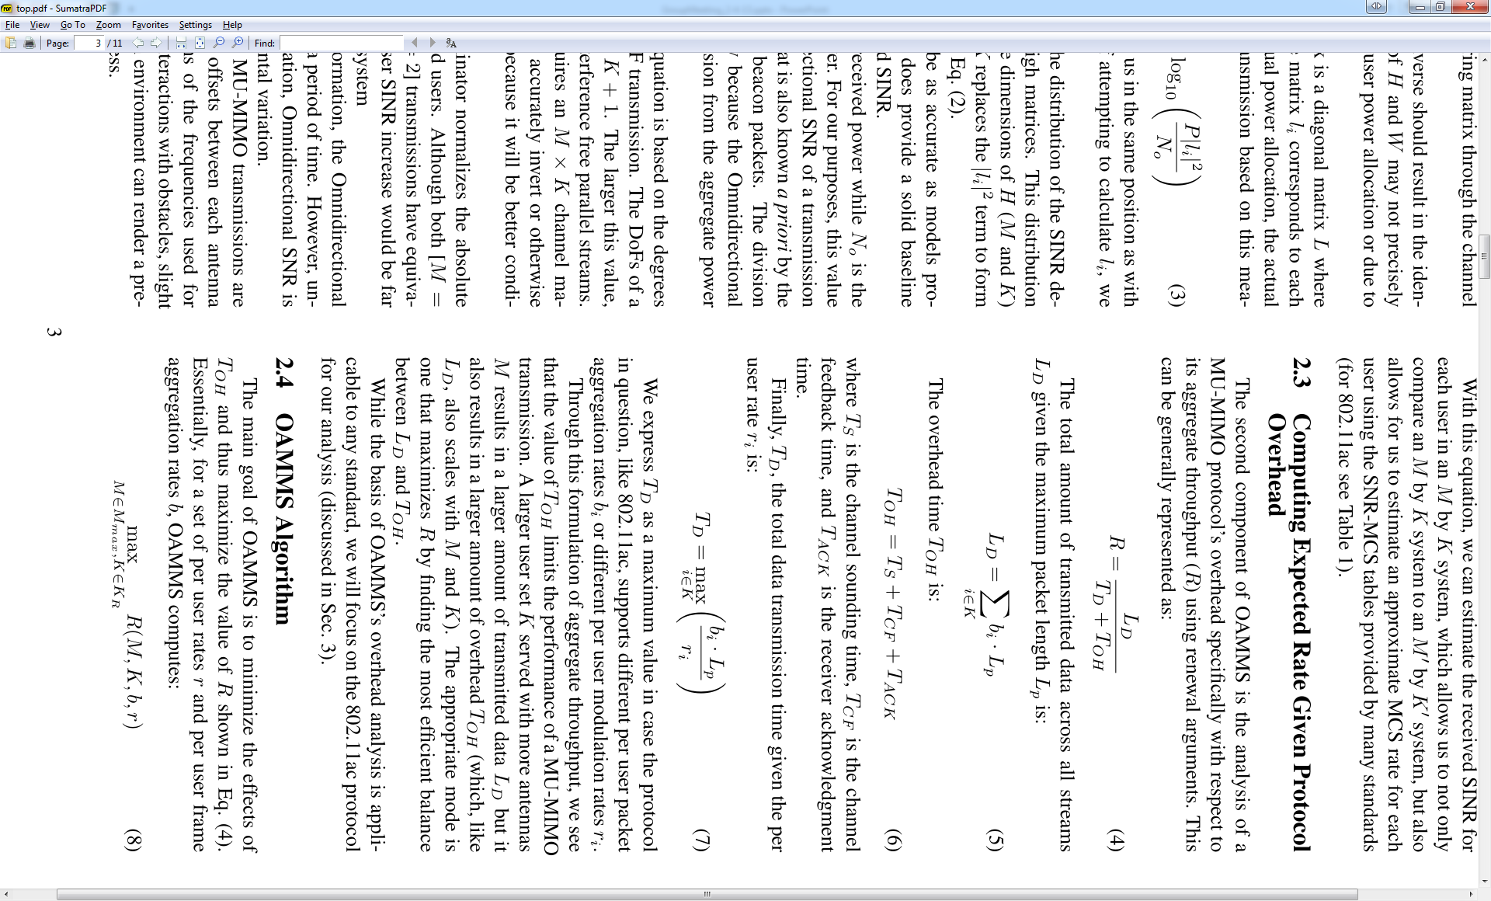
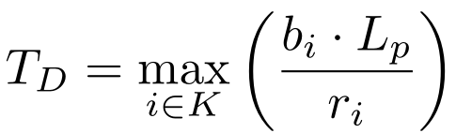
Computing Expected Aggregate Throughput
∴

Slide 11
Outline
Algorithm Description
802.11ac Integration
Evaluation
Methodology
Available Pre-sounding Information
Per-user Datarate Inference
Predicting User Specific MU-MIMO Datarate
Computing Expected Aggregate Throughput
Aggregate Throughput Calculation
Numerical Analysis of Mode/User Selection w/ 11ac
Datarate Inference Accuracy
PUMA vs Full CSI Knowledge Scheme
Mode/user selection performance

Slide 12
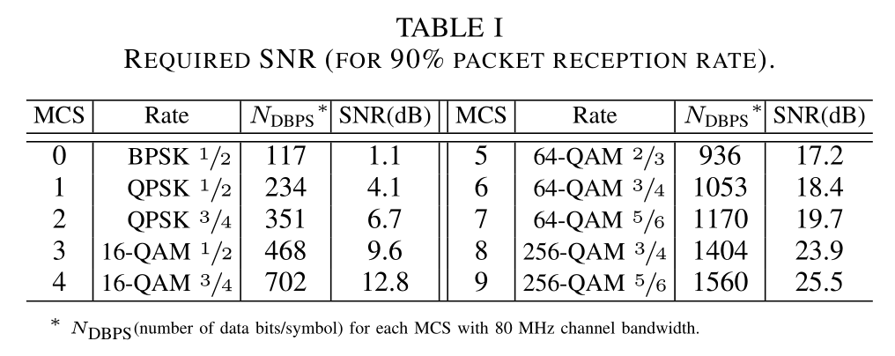
Per-User Datarate Inference
Per user Omni SNR
mode
≤
≤
Expected SINR allows for estimation of achievable modulation rate (and thus datarate).

Slide 13
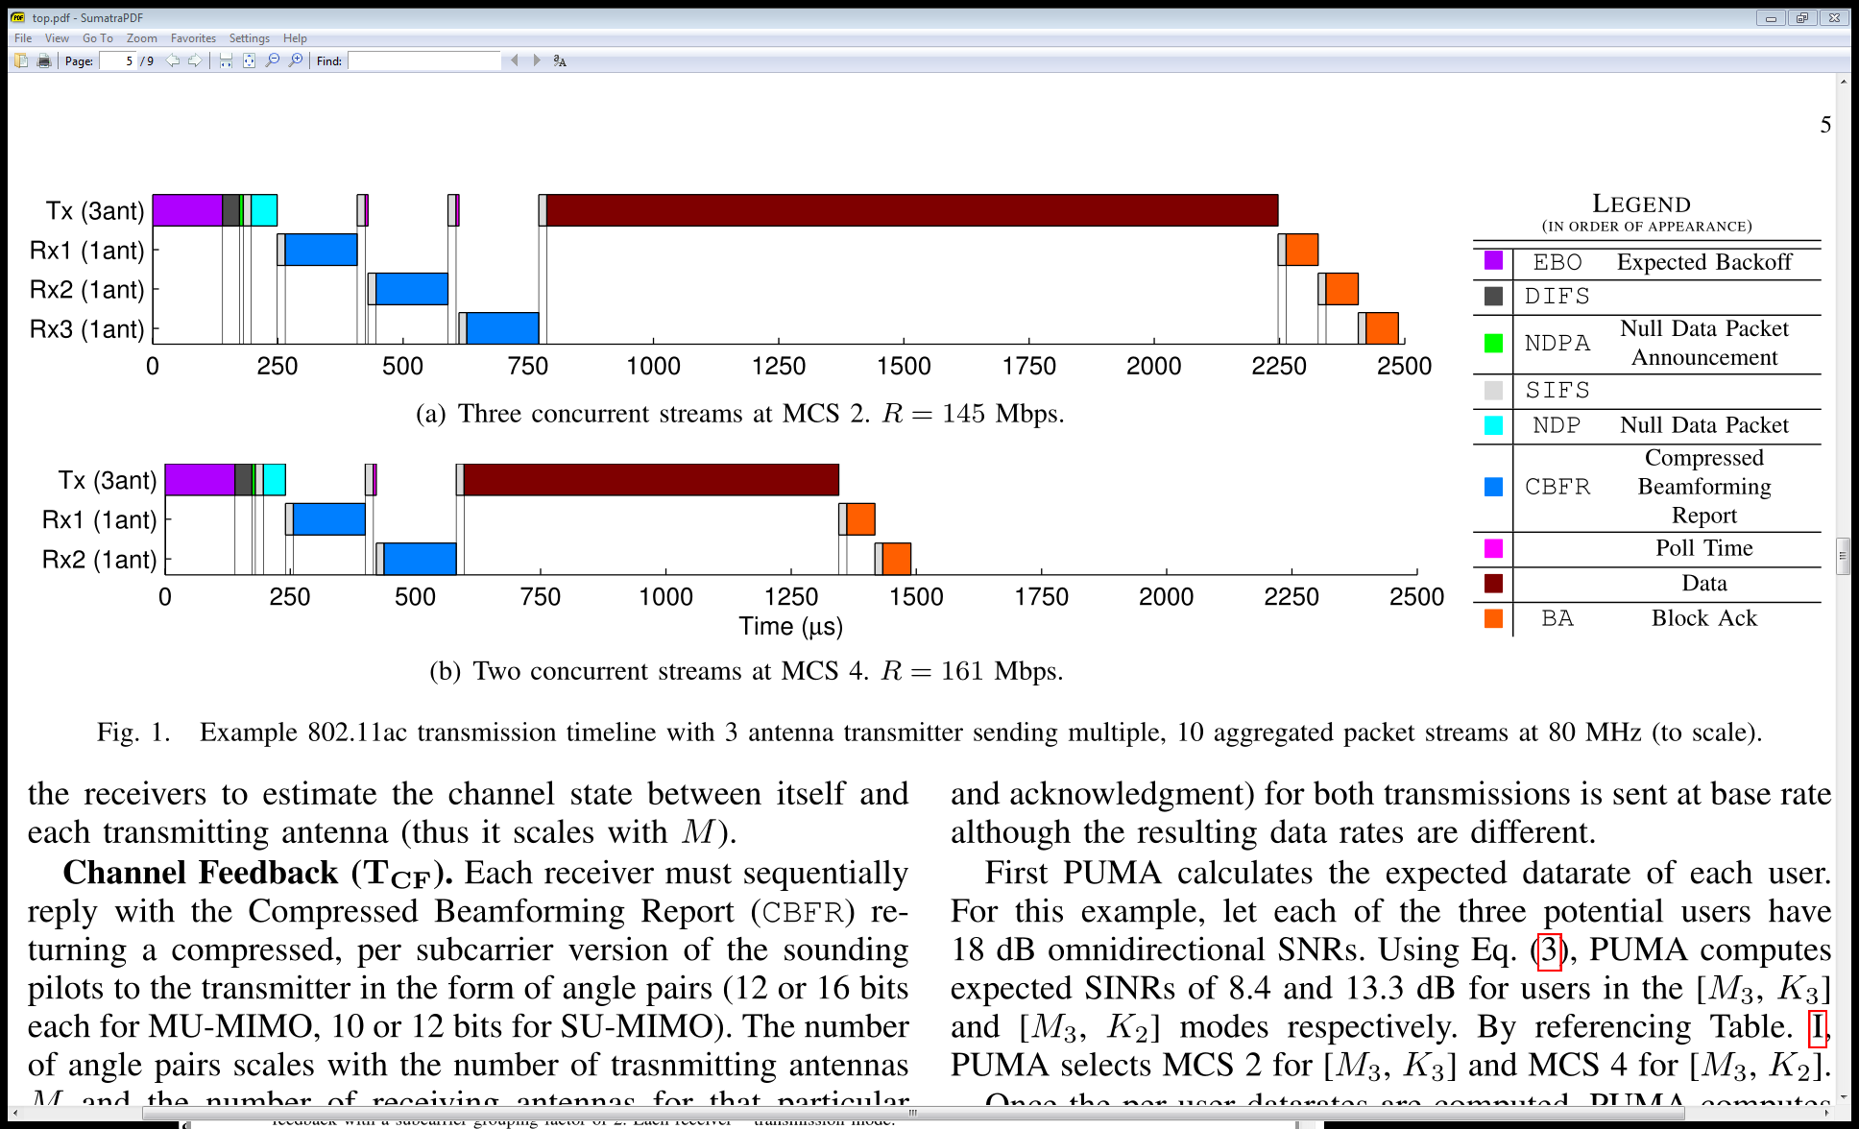
Aggregate Throughput Calculation
Numerical Analysis – M=4, b=64 (fully backlogged)
4x2 -> 9dB
4x3 -> 15 dB
4x4 -> 30 dB
Model computes per-user SINR
  (a) 8.4 dB
  (b) 13.3 dB
Corresponding MCS:
  (a) 2 : QPSK ¾ - 351 DBPS
  (b) 4: 16-QAM ¾ - 702 DBPS
Counterintuitively, selection of maximum mode or user set size will not always increase throughput.

Slide 14
Outline
Algorithm Description
802.11ac Integration
Evaluation
Methodology
Available Pre-sounding Information
Per-user Datarate Inference
Predicting User Specific MU-MIMO Datarate
Computing Expected Aggregate Throughput
Aggregate Throughput Calculation
Numerical Analysis of Mode/User Selection w/ 11ac
Datarate Inference Accuracy
PUMA vs Full CSI Knowledge Scheme
Mode/user selection performance

Slide 15
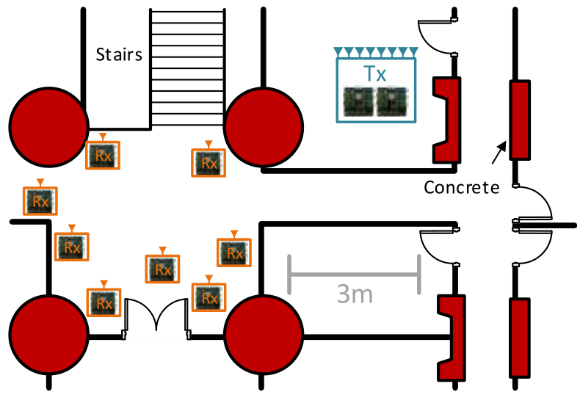
Evaluation Methodology
OTA Experimentation
  WARPLab MU-MIMO Testbed
  8 antenna transmitter, 8 single antenna receivers
  Nodes placed in varying locations (LOS and NLOS)
  Every combination of M=1:8 and K=1:8 transmission measured
  Measurement database consisting of MU-MIMO SINRs and Omni SNRs
Channel-Trace Driven Simulation
  Model incoming packets as Poisson process
  For simplicity with 11ac standard, M=4, K=1:4 subset of 8
  Simultaneous channel traces for comparison
    Post-sounding: Measured MU-MIMO SINR
    Pre-sounding: Model with Omnidirectional SNR
Further details can be found in paper

Slide 16
Model Error
Per user Omni SNR
mode
Error:
  µ=0.36 dB
  σ=2.43 dB
Note: Required SINR values per MCS change are ~3 dB
What effect does MCS table “rounding” have on this error?

Slide 17
PUMA vs Post Sounding
Post-sounding search: best case algorithm with full knowledge of all users’ channel states
  Computed from traces of measured MU-MIMO SINRs
  Does not consider effect of additional sounding overhead
Even given model error σ=2.43 dB, MCS table rounds model result effectively reducing the error effect

Slide 18
PUMA vs. Fixed Modes
Comparison of PUMA (dynamic mode selection) and fixed modes.
Does larger MK result in higher throughput?
For this scenario, 3 tx antennas achieves highest throughput—fix the mode?
PUMA’s dynamic mode selection is key to throughput gain
  In certain instances, selecting largest mode or user set will not always result in higher throughput
  PUMA’s selection of the correct mode at the correct time results in throughput that surpasses the maximum of any fixed mode (30% at saturation)

Slide 19
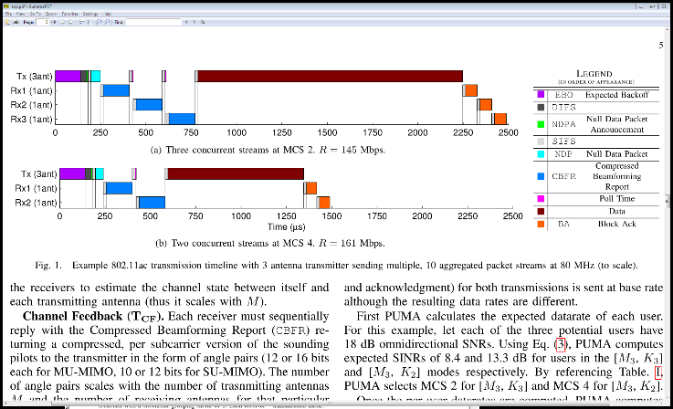
Conclusion
Mode and User Selection is necessary for efficient overhead amortization and increasing overall MU-MIMO system throughput
  Larger MxK does not always result in better performance
Leveraging theoretical MU-MIMO system scaling properties, PUMA can accurately quantify the potential of a user set before channel sounding
Through dynamic mode selection PUMA provides a 30% throughput increase over any fixed mode policy.

