Slide 1
Design and Experimental Evaluation of Multi-User Beamforming in Wireless LANs
Ehsan Aryafar
Rice
Narendra Anand
Rice
Theodoros Salonidis
Technicolor
Edward Knightly
Rice
ACM MobiCom 2010

Slide 2
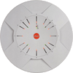

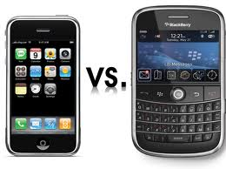
MIMO LANs
MIMO increases throughput with antenna arrays at transmitter and receiver
However, real world client devices have fewer antennas than APs due to cost and space
MUBF allows for APs to leverage antennas belonging to group of nodes
We present the design and experimental evaluation of the first MUBF platform for WLANs
Xirrus 16 ant AP
Tx
Tx
Rx
Rx
Rx
Rx
Rx
Rx
Ehsan Aryafar
Rice Networks Group

Slide 3
Crash Course on Beamforming
AP
p2
p1
Omni
  Fixed vs ant selection
Notes:
Lets start on a quick background of how you can serve multiple people. In this figure we have an AP with two antennas and two clients each with one antennas.
[animate] The traditional way of communicating with these users, is to serve one user at a time in a TDMA fasion.
There are many different ways for the access point to use its multiple antennas. One of the simplest methods currently used by many Aps is use of a fixed antenna (or rando selection) by AP and transmit in an omni-directional way.
Figure at the left shows the radiation pattern for this method. In the basic approach no feedback from clients is received.
Off course, Aps could benefit from the available antenna diversity. There are several papers that have shown you can obtain huge gains by selecting the appropriate antenn.
An alternative way for AP to benefit from its antennas is through switched beam. Here, the AP has an antenn array. The signal that is fed to each antenna is shifted with specific phases, such that the resulting beam has high directionality in a specific direction. The AP can then switch between a set of pre-defined beams. Compared to the Omni transmission, this scheme allows for higher received SNR at the receiver and also higher coverage.
A user can further increase its received SNR by sharing its channel information to the AP and through adaptive beamforming scheme. If AP has a user’s channel information, it can construct its beam such that it points towards that specific user. This scheme can further increase received SNR and coverage with the additional feedback of channel information for each antenna.

Slide 4
Crash Course on Beamforming
AP
p2
p1
Omni
  Fixed vs ant selection
Adaptive Beam (SUBF)
  Higher coverage
  Higher SNR
Notes:
Lets start on a quick background of how you can serve multiple people. In this figure we have an AP with two antennas and two clients each with one antennas.
[animate] The traditional way of communicating with these users, is to serve one user at a time in a TDMA fasion.
There are many different ways for the access point to use its multiple antennas. One of the simplest methods currently used by many Aps is use of a fixed antenna (or rando selection) by AP and transmit in an omni-directional way.
Figure at the left shows the radiation pattern for this method. In the basic approach no feedback from clients is received.
Off course, Aps could benefit from the available antenna diversity. There are several papers that have shown you can obtain huge gains by selecting the appropriate antenn.
An alternative way for AP to benefit from its antennas is through switched beam. Here, the AP has an antenn array. The signal that is fed to each antenna is shifted with specific phases, such that the resulting beam has high directionality in a specific direction. The AP can then switch between a set of pre-defined beams. Compared to the Omni transmission, this scheme allows for higher received SNR at the receiver and also higher coverage.
A user can further increase its received SNR by sharing its channel information to the AP and through adaptive beamforming scheme. If AP has a user’s channel information, it can construct its beam such that it points towards that specific user. This scheme can further increase received SNR and coverage with the additional feedback of channel information for each antenna.

Slide 5
Multi-User Beamforming: Throughput Increase
desired signal
AP
+
+
s1
s2
inter-user interference
MUBF sends the contents to both receivers at the same time
Each user’s data stream is weighted at the transmitter
Appropriate weights can reduce or eliminate the amount of inter-user interference
Notes:
The best way for throughput maximization, however is to transmit to multiple receivers simult. This is accomplished by transmitting to both receivers at the same time and frequency channel, however by limiting the amount of inter-user interference.
There are multiple ways to serve the users concurrently. In MUBF, each users data stream is multiplied by an appropriate weight vector and the sum of all streams is transmitted through the AP. For a user k, the received signal is ….
The weigth vectors are selected according to each user’s specific channel information and can be selected to reduce or eliminate inter-user interference.
The top-right figure shows an example of two receivers with zero inter-user interference.
Apart from weights, the received signal also depends on the power allocated to each data stream …

Slide 6
Multi-User Beamforming: Throughput Increase
desired signal
AP
+
s1
s2
inter-user interference
0
Zero-Forcing beamforming (ZFBF)
  weights are selected such that the amount of inter-user interference is zero
Notes:
The best way for throughput maximization, however is to transmit to multiple receivers simult. This is accomplished by transmitting to both receivers at the same time and frequency channel, however by limiting the amount of inter-user interference.
There are multiple ways to serve the users concurrently. In MUBF, each users data stream is multiplied by an appropriate weight vector and the sum of all streams is transmitted through the AP. For a user k, the received signal is ….
The weigth vectors are selected according to each user’s specific channel information and can be selected to reduce or eliminate inter-user interference.
The top-right figure shows an example of two receivers with zero inter-user interference.
Apart from weights, the received signal also depends on the power allocated to each data stream …

Slide 7
Multi-User Beamforming: Interference Reduction
Client 2
Client 1
User affected by AP’s
interference
AP
Channel Information
A user can obtain an interference-free channel by sharing its channel information
Notes:
One of the other benefits of ZFBF is that a user can obtain an int …
Connsider as an example an undesired user that is affected by tranmission from the AP.
[animate] The undesired user may not even share the same standard as the rest of network, however, if it can somehow provide feedback on its channel, AP can serve its users while suppressing interference that goes towards the undesired user
We can explain how this works through our received signal channel formula …

Slide 8
Outline
Background
System Implementation
Experimental Evaluation
Conclusion

Slide 9
Methodology
Unified Implementation Platform
  First Implementation and experimental evaluation of different beamforming algorithms on a common platform
Experimental Characterization of System Performance
  Compare against single-user TDMA schemes
  Use repeatable controlled channels and
  Real-time indoor channels
Evaluation Metric
  SNR or the corresponding Shannon capacity

Slide 10
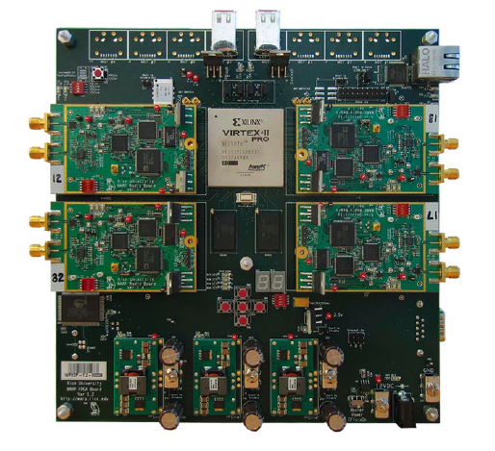
WARPLab Research Framework
WARP is clean-slate MAC and PHY
  Off-the-shelf platforms: Limited programmability/observability
WARPLab brings together WARP and MATLAB
  Manage network communication of up to 16 WARP nodes
  Baseband signals are generated in MATLAB and downloaded to WARP nodes
  WARP nodes send/receive the RF signals
Virtex-II Pro FPGA
Notes:
We have used the WARP platform for our implementation.
WARP is developed by the graduate students at Rice. The most important component of the platform Is the vertex 2 processor. It has two power pc cores that provides an environment in which you develop MAC and higher layer protocols in C. The physical layer algorithms are also implemented in FPGA, making the system real-time. It also has for slots for dauther cards, allowing for 4*4 MIMO
This platform is especially suitable for cross layer design, where you can easily obtain any information among different layers. In addition, due to high programmability, you can easily implement different MAC/PHY algorithms.
While WARP is suitable for implementation of different PHY algorithms, changing the framework for advanced physical lay ..
WARPLab is a framework for rapid impl of advanced physical layer algorithms and brings together the benefits of WARP and MATLab.
In this frameowk

Slide 11
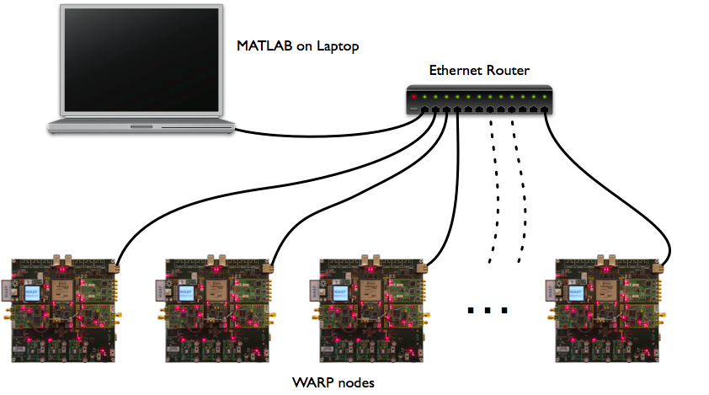


Implementation
1
H Matrix and Weight Calculation
Log RSSI Data (End of Cycle)
8
5
4
( )
Rx RSSI Readings
BF Weights
Training
For more information about our testbed and implementation please attend our demo!
7
Rx Training Feedback
Rx
Rx
Rx
Tx
3
MUBF Data (OTA)
6
Training (OTA)
2

Slide 12
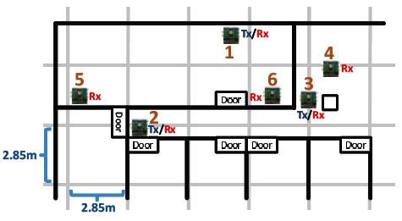
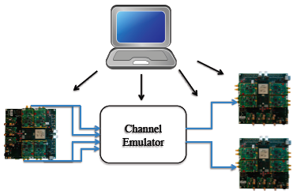
Experimental Design
Multiplexing Gain
  Receiver separation distance
  User selection algorithm
  User population size
Channel Variation
  Environmental variation
  User mobility
Spatial Reuse
  Location based interference
  Multi-point interference reduction
  Network throughput

Slide 13
Impact of Receiver Separation
Issue: How does receiver separation distance affect spatial multiplexing gain?

Slide 14
Impact of Receiver Separation
Issue: How does receiver separation distance affect spatial multiplexing gain?
R₁
R₂

Slide 15
Impact of Receiver Separation
Issue: How does receiver separation distance affect spatial multiplexing gain?
ZFBF doubles capacity compared to Omni
Similar capacity up to λ/2 Separation distance
ZFBF at λ/4:
  6 dB decrease in per-link SNR
Location ID: 2 3 4(λ) 5(λ/2) 6(λ/4) 7
Location ID: 2 3 4(λ) 5(λ/2) 6(λ/4) 7

Slide 16
Experimental Design
Multiplexing Gain
  Receiver separation distance
  User selection algorithm
  User population size
Channel Variation
  Environmental variation
  User mobility
Spatial Reuse
  Location based interference
  Multi-point interference reduction
  Network throughput

Slide 17
User Mobility
Issue: Evaluate impact of outdated channel information due to user mobility

Slide 18
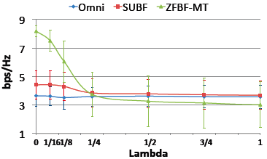
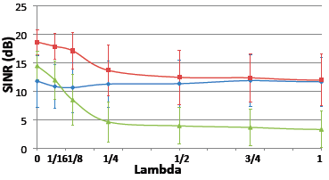
User Mobility
Issue: Evaluate impact of outdated channel information due to user mobility
Repeatable channel conditions
  802.11n Task Group channel model
Required channel update rate
  Channel must be updated at (λ/8) movement
  Equal to 10 msec update rate for a typical pedestrian speed (3 mph)
Aggregate Capacity
bps/Hz
Similar experiments can be done for static receivers (in paper). The required channel rate for a typical residential environment is 100 msec.
Per-link SNR
SNR (dB)

Slide 19
Experimental Design
Multiplexing Gain
  Receiver separation distance
  User selection algorithm
  User population size
Channel Variation
  Environmental variation
  User mobility
Spatial Reuse
  Location based interference
  Multi-point interference reduction
  Network throughput

Slide 20
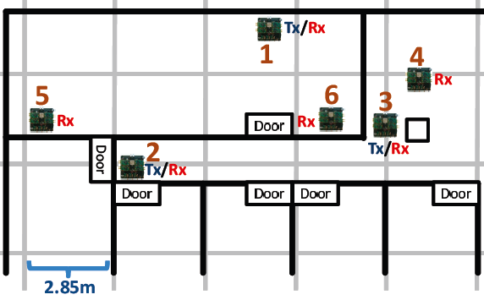
Multi-Point Interference Reduction
Issue: Evaluate a sender’s ability to reduce transmission footprint at multiple locations
  Interference reduction at unintended receivers
  Impact on the QoS of the served user
p1
Interference Reduction Points

Slide 21
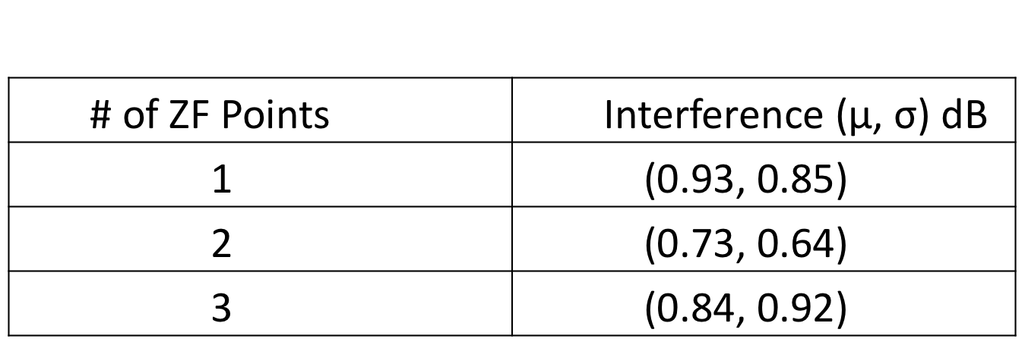
Multi-Point Interference Reduction
Issue: Evaluate a sender’s ability to reduce transmission footprint at multiple locations
Interference Reduction:
  Interference reduction capability does not depend on the location/number of unintended receivers

Slide 22
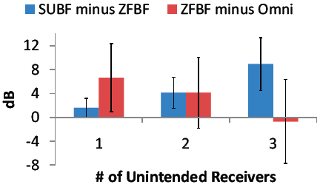
Multi-Point Interference Reduction
Issue: Evaluate a sender’s ability to reduce transmission footprint at multiple locations
Interference Reduction:
  Interference reduction capability does not depend on the location/number of unintended receivers
Increase in number of unintended receivers, can significantly drop the QoS of the currently served users
SNR difference at the intended receiver

Slide 23
Prior Work
Theoretical Work on MU-MIMO
  DPC (Costa’83) and its optimality (CS’03)
  ZFBF (YG’06 and WES’08)
Practical Protocols
  IAC (GPK’09) and SAM (TLFWZCV’09)
We present the design and experimental evaluation of a MUBF platform for wireless LANs
Notes:
There is a rich body of work on MU-MIMO

Slide 24
In Summary
Design and implementation of the first MUBF platform for WLANs and found via experimental evaluation:
Users can simultaneously receive data down to a half of wavelength from one another
ZFBF can tolerate channel variations due to environmental variation, however, is strongly affected by user mobility
ZFBF can efficiently eliminate interference at undesired locations. This does not depend on the location/number of unintended receivers, however, can significantly reduce the QoS for the currently served users
  WARP: http://warp.rice.edu
  RNG: http://networks.rice.edu

Slide 25
Back Up

Slide 26
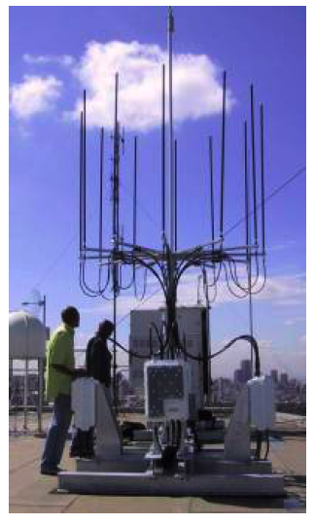
iburst
Patented technology for concurrent transmission
Suitable for outdoor channels

Slide 27
Crash Course on Beamforming
AP
p2
p1
Omni
  Fixed vs ant selection
Switched Beam
  Fixed beam
  High coverage
Adaptive Beam
  Higher range
  SUBF
Notes:
Lets start on a quick background of how you can serve multiple people. In this figure we have an AP with two antennas and two clients each with one antennas.
[animate] The traditional way of communicating with these users, is to serve one user at a time in a TDMA fasion.
There are many different ways for the access point to use its multiple antennas. One of the simplest methods currently used by many Aps is use of a fixed antenna (or rando selection) by AP and transmit in an omni-directional way.
Figure at the left shows the radiation pattern for this method. In the basic approach no feedback from clients is received.
Off course, Aps could benefit from the available antenna diversity. There are several papers that have shown you can obtain huge gains by selecting the appropriate antenn.
An alternative way for AP to benefit from its antennas is through switched beam. Here, the AP has an antenn array. The signal that is fed to each antenna is shifted with specific phases, such that the resulting beam has high directionality in a specific direction. The AP can then switch between a set of pre-defined beams. Compared to the Omni transmission, this scheme allows for higher received SNR at the receiver and also higher coverage.
A user can further increase its received SNR by sharing its channel information to the AP and through adaptive beamforming scheme. If AP has a user’s channel information, it can construct its beam such that it points towards that specific user. This scheme can further increase received SNR and coverage with the additional feedback of channel information for each antenna.

Slide 28
Weight Selection Algorithms
Zero-Forcing beamforming (ZFBF)
  Condition: =>
  Heterogeneous link qualities through power allocation
Regularized Channel Inversion
  Increase system performance
  Does not easily allow for heterogeneous link qualities due to non-zero inter-user interference
Notes:
An alternative way to ZFBF is to allow some amount of inter-user interference by removing the zero-interference condition.
This approach is termed reg ….
The benefit of this approach is that it increases the overall system performance.
However, there is not a closed form solution for providing different link qualities through power allocation.
The focus of this talk is on ZFBF
This is beacuase

Slide 29
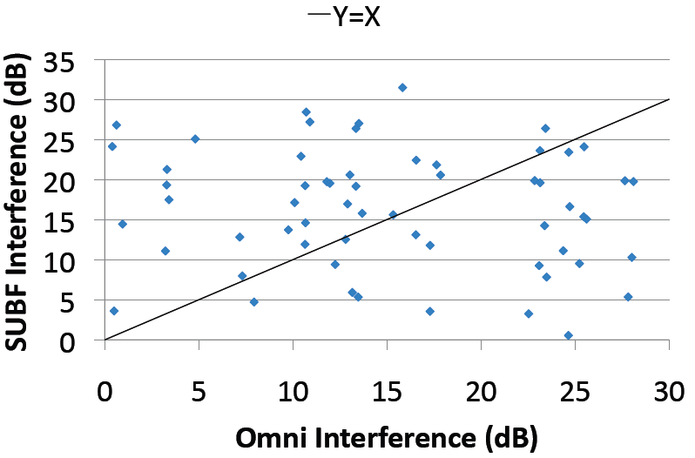
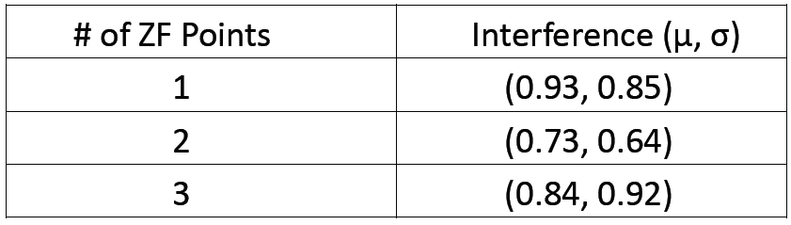
Multi-Point Interference Reduction
Issue: Evaluate a sender’s ability to reduce transmission footprint at multiple locations
Interference Reduction:
  SUBF’s interference could be significantly higher/lower than Omni
  ZFBF’s interference reduction capability does not depend on the location/number of unintended receivers

Slide 30
Weight Selection
Zero Forcing Beamforming (ZFBF)
Assume 4 Tx Antennas and 3 single-antenna receivers
hk's – H for each recv.
Calculate weights with pseudo-inverse
wj's
“Zero Interference” Condition
Notes:
Single user – Hconj/Norm(H)
Zero Interference
This is a mathematical representation of the zero-interference condition—ensures that if I have weights for R1, the resulting gain of stream 1 at R2 and R3 is zero.
Now, lets move on to how we implemented this in hardware.

Slide 31
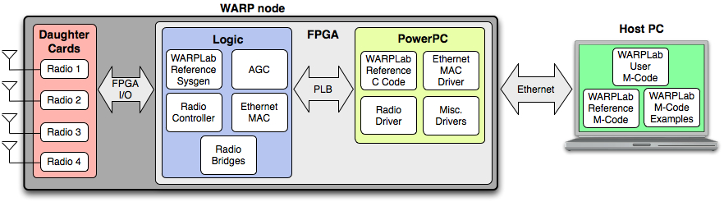
Implementation - WARPLab
All baseband processing performed on Host PC
Processed signals are downloaded to buffers in FPGA on transmitting WARP node
HostPC sends Transmit/Receive trigger signals to WARP nodes
Data is transmitted over the air, stored in buffers on receiving node’s FPGA
Data/RSSI readings uploaded to HostPC for data processing/logging
Notes:
WARP/WARPLAB MODIFICATIONS
We implemented the boxed equation in the PHY itself because it allows us to skip re-downloading the beamformed data to the FPGA (a second long process) after channel estimation.
Avoids downloading 2^14 samples again, only have to download the weights, Ensures that the channel estimate is still valid

Slide 32
User Population Size
Q: How does the number of concurrently served users affect performance?
A: Capacity increases and saturates while per-user SINR drops significantly.
Aggregate Capacity
Average Per-User SINR
Notes:
CMC Lab
6 Nodes, 3 Tx/Rx, 3 just Rx
All connected to Host PC
All combinations of transmitter and receiver sets are evaluated Round Robin style
Wide variety of link qualities from varying relative distances, and different obstacles
From now on, all experiments will focus on two receivers. This is because two receivers is below the number of DOF in our system and in a real implementation, we can assume that a base station would have a large number of antennas

Slide 33
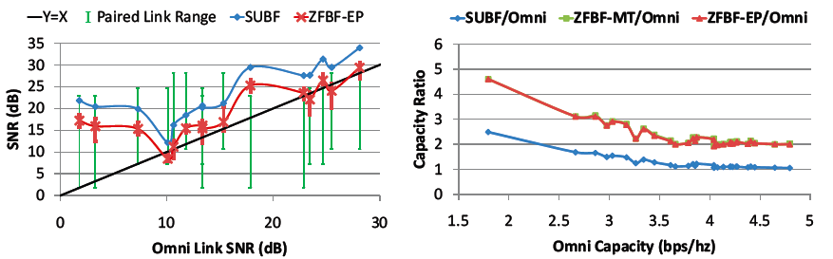
User Selection (Link Quality Difference)
Q: How do link quality differences between receivers affect system performance?
A: Link quality differences between concurrently served users do not affect each user’s SINR.
Notes:
Same CMC lab setup
Question:
This question may provide insight for scheduling algorithms. If I am going to concurrently serve two users out of a larger set, should I be sure to schedule high quality links together? Low quality links together? Mix and match?
Graph:
-As before, we take measurements round-robin style of all combinations of a transmitter and a pair of receivers (links).
- For SUBF, each point is simply the SUBF SNR of a particular link
- For ZFBF, each point represents the average SINR of a particular link when paired with all possible other links and is also graphed against its Omni link SNR
ZFBF is lower than SUBF because w/ SUBF, full transmit power is used to serve a single user w/ SUBF while that transmit power is split amongst the pair for ZFBF
-On ZFBF – the Red bars indicate the full range of that link’s SNR when paired with all possible other links.
-The Green bars indicate the full range of all other paired link qualities (the Omni SNR)
-We see that even through the SNR range for the paired link is very large for each main link, the range of the resulting SINR is negligible

Slide 34
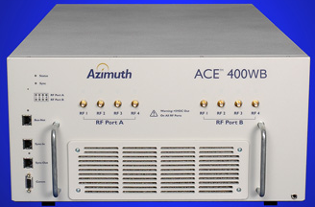
Environmental Variation
Aggregate Capacity
802.11n Task Group model for indoor residential environment
  (T) : Typical –Fading rate of 1.157 Hz
  (R) : Rapid –Fading rate of 2.778 Hz
Q: How does performance vary with channel update rate in typically/rapidly varying channels?
A: Assuming a link can suffer up to a 3dB decrease in SNR below Omni, 100ms and 50ms update rates are necessary for typically/rapidly varying channels, respectively.
Average Per-User SINR
Notes:
Describe channel estimate delay time
Very sensitive to Environmental variation
Rapidly changing environment, at omni CAP by 100 ms
Demonstrated that a maximum 10 ms channel update rate results in at most 3 db loss in SNR for individual links for receivers moving at pedestrian speed (3 mph)
Demonstrated that a maximum 500 ms update rate results in at most 3 db loss in SNR for individual links in a typical indoor non-mobile environment.
Fading rate is doppler fading rate

Slide 35
Interference Reduction (Location)
Q: How does MUBF’s interference reduction capability vary with the location of the unintended receiver?
A: The location of the unintended receiver does not affect the interference reduction performance of MUBF (when #Rx < DOF).
Interference at W
Notes:
Transmit to R, reduce interference at W
Similar to Recv Sep Dist

Slide 36
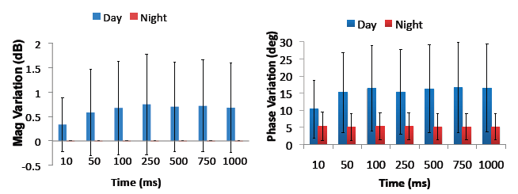
Channel Variation

Slide 37
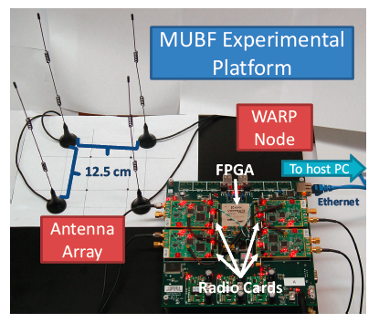
Testbed

Slide 38
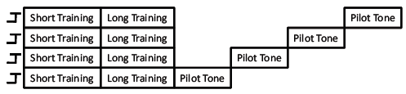
Channel Estimation

Slide 39
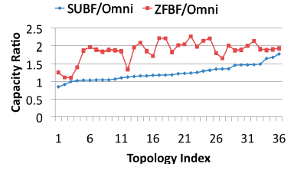
Network Throughput

