Slide 1
MU-MIMO WLANs in Diverse Bands and Environments
Naren Anand
Advisor: Dr. Edward Knightly
PhD Defense
4/20/2015

Slide 2
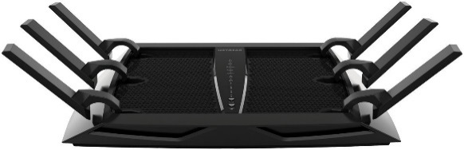

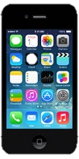
MU-MIMO WLANs
SISO
MIMO
Tx
Rx
Tx
Rx
Tx
Rx
Tx
Rx
increases throughput with antenna arrays at TX and RX
However, real world client devices have fewer antennas than APs due to cost and space
MU-MIMO
Tx
Rx A
Rx B
Rx C
NETGEAR
AC3200
allows APs to leverage antennas belonging to a group of nodes

Slide 3

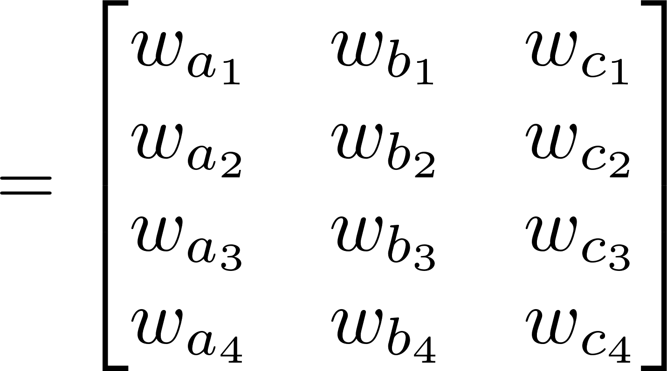
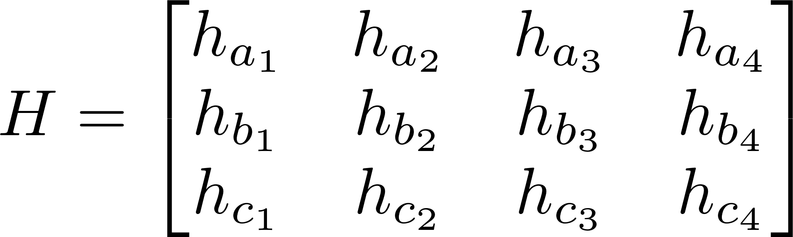
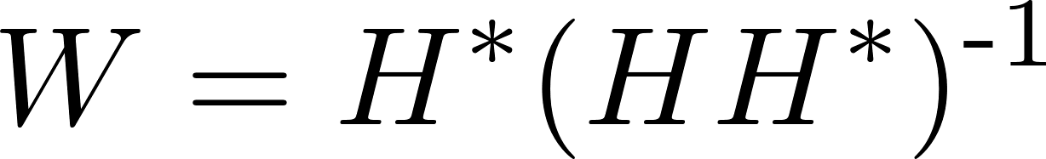



MU-MIMO Precoding
MU-MIMO: precoding method that allows a multi-antenna AP to transmit multiple parallel data streams to groups of clients
  Precoding: Applying complex magnitude and phase offsets (steering weights) to each data stream through the transmitting antenna array
  Steering Weights: W matrix computation based on measured magnitude and phase offsets for each Tx->Rx antenna path (CSI Matrix)
    e.g., Zero-forcing Beamforming
Rx A
Data-a
$W_{a}∙D_{a}$
Tx
$$W_{b}∙D_{b}$$
Data-b
Rx B
Data-c
${ W}_{c}∙D_{c}$
Rx C

Slide 4
MU-MIMO Transmission
temp
Basic process for MU-MIMO transmission protocol:
Rx A
Group Selection
  #Rx Ant. ≤ #Tx Ant
“Sound” channel
  Acquire measurements serially
Transmit in parallel
  TX based on channel sounding
Rx A
Rx A
∠
Tx
Rx B
Rx B
Rx A
∠
Transmission Considerations
Group Selection
  Must occur before sounding
  Ideally, select separable receivers
Sounding
  Significant protocol overhead
Transmit
  Performance drops if channel varies between sounding and TX
  Without enough aggregated data to transmit, overhead may overwhelm gains
Rx C
Rx C
TX Timeline
Tx
Pilots
Data
Data
CSIT D
CSIT E
CSIT F
CSIT …
CSIT X
CSI
ack
Rx A
CSIT A
ack
CSI
ack
Rx B
CSIT B
ack
CSI
ack
Rx C
CSIT C
ack

Slide 5

Protocol Performance
Considerations
Group Selection
  Must occur before sounding
  Ideally, select receivers with near orthogonal (furthest apart) channels
Sounding
  Significant protocol overhead
Transmit
  Performance drops if channel varies between sounding and TX
  Without enough aggregated data to transmit, overhead may overwhelm gains
Channel Variability
Receiver Separability
(over time)
∠
∠
?
Thesis Goal
Leverage characteristics of different MU-MIMO operating regimes w.r.t:
  Channel Variability
  Receiver Separability
to develop MU-MIMO protocols that leverage low channel variability and easily separable receivers in the appropriate regimes
Reduce Sounding Rate
Significant
Overhead
Increase System Throughput
Amortize Over
Data

Slide 6
Contributions
MU-MIMO Operating Regimes
High Variability
(fast fading)
802.11ac
(and existing MU-MIMO protocols)
Channel Variability
PUMA
802.11ac
(over time)
Higher Bands
(2.4/5.8 GHz)
Indoor
Measurement
Study
Outdoor
Lower Bands
(UHF)
∠
Low Variability
(slow fading)
FROZEN
∠
Easy to Separate
(uncorrelated)
Difficult to Separate
(correlated)
Receiver Separability

Slide 7
Outline
MU-MIMO Operating Regimes
High Variability
(fast fading)
PUMA
FROZEN
Implementation
Evaluation
MU-MIMO Measurement Study
PUMA
FROZEN
WURC Array
Software Frameworks
Easily separable, highly variable scenarios
Minimally variable scenarios
PUMA
802.11ac
Higher Bands
(2.4/5.8 GHz)
Indoor
Measurement
Study
Outdoor
Lower Bands
(UHF)
Low Variability
(slow fading)
FROZEN
Easy to Separate
(uncorrelated)
Difficult to Separate
(correlated)

Slide 8
PUMA
Presounding User and ModeSelection Algorithm
  Mode: Subset of TX antennas and number of receivers (Rx antennas)
    Overhead scales with #Tx and #Rx antennas
  User Selection: Chosen user subset
Designed for easily separable, highly variable regimes
For this operating regime, mode and user selection should occur before sounding
Tx
Pilots
Data
Data
CSIT D
CSIT E
CSIT F
CSIT …
CSIT X
CSI
ack
Rx A
CSIT A
ack
Rx
CSI
ack
Rx B
CSIT B
ack
Rx
CSI
ack
Rx C
CSIT C
ack

Slide 9
PUMA - Overview
Exploits theoretical properties of MU-MIMO system scaling with respect to mode
  How does performance scale due to #Tx and #Rx antennas?
Characterizes the relative cost of each potential mode
  Based on thorough analysis of protocol overhead (e.g., 802.11ac)
Estimates per-stream transmission rate and aggregate throughput in each mode for a potential user set
  Considering only per-user information available before sounding

Slide 10
Available Pre-Sounding Information
System State
  Max available Tx Antennas (M)
  Total number of associated users and receive antennas (K)
Queue State
  Available packets to transmit per client (backlog)
Link State
  Per-user Omnidirectional SNR gathered from periodic beacon messages and updated from received packets
Using more antennas results in increased data transmission and sounding overhead.
Higher backlog results in increased packet aggregation (b) further amortizing sounding overhead.
Omni SNR used to estimate per-user achievable datarate. Metric need not be instantaneous.

Slide 11
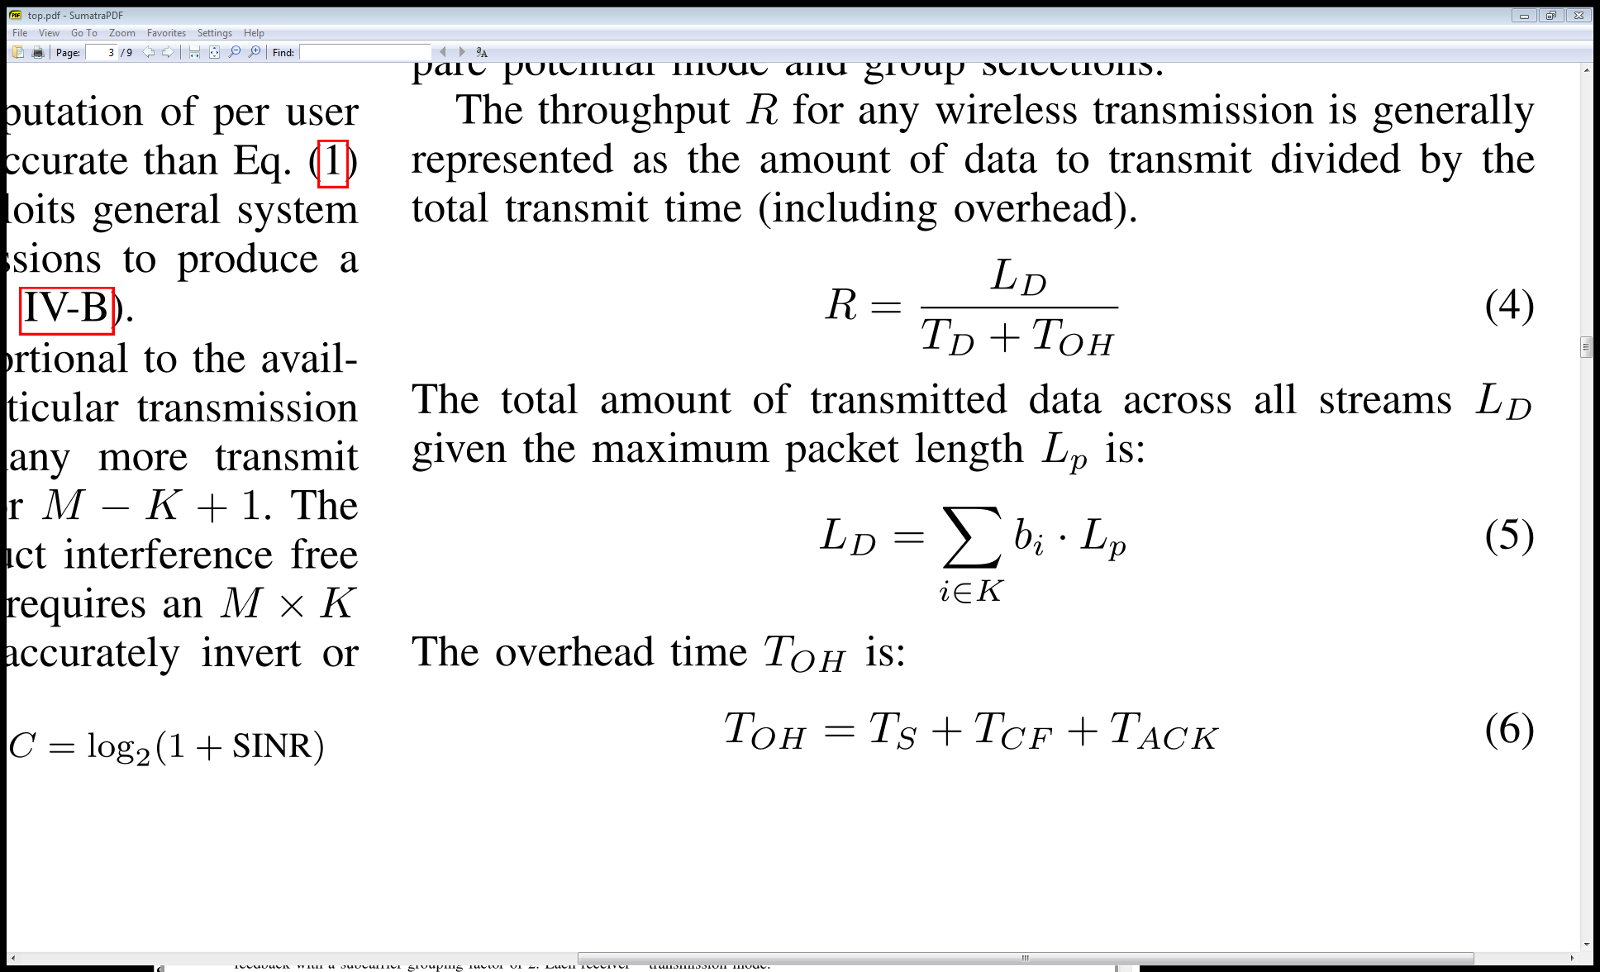
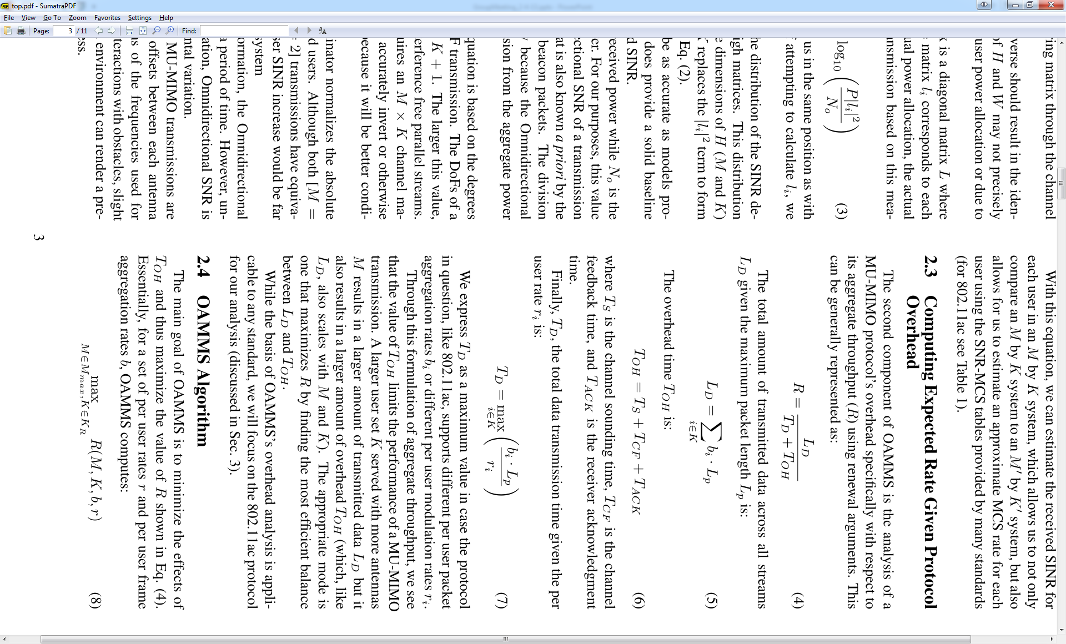
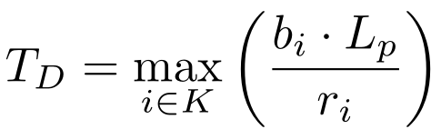
Computing Expected Aggregate Throughput
∴

Slide 12
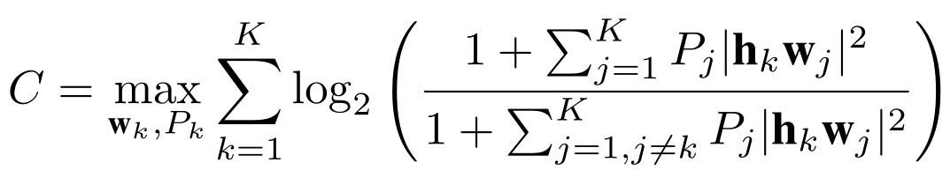
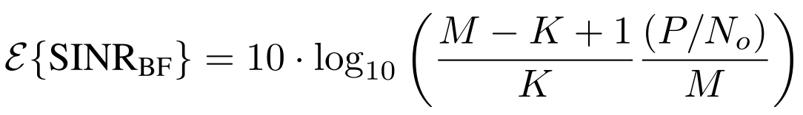
Predicting User Specific MU-MIMO Datarate
Full CSI Knowledge, Post-sounding method
Pre-Sounding (without H) – PUMA
  Exploit MU-MIMO system scaling
Shannon Capacity
Signal
Basis of prior work:
Jang ‘06
Tandai ‘09
Esslaoui ‘12
Interference
Per-User Omnidirectional SNR
Expected Per-User MU-MIMO SINR
Degrees of Freedom
Ratio to number of receive antennas
Split among transmit antennas

Slide 13
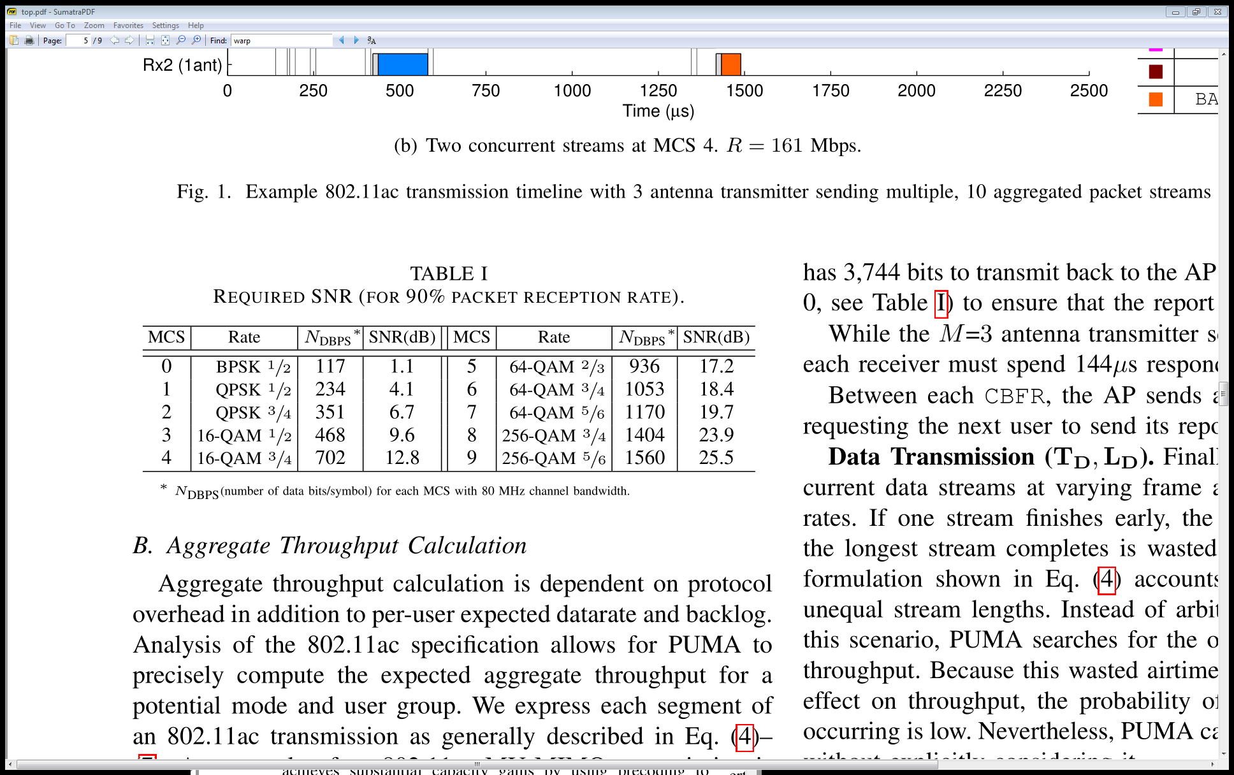
Per-User Datarate Inference
Per user Omni SNR
mode
≤
≤
Expected SINR allows for estimation of achievable modulation rate (and thus datarate).

Slide 14
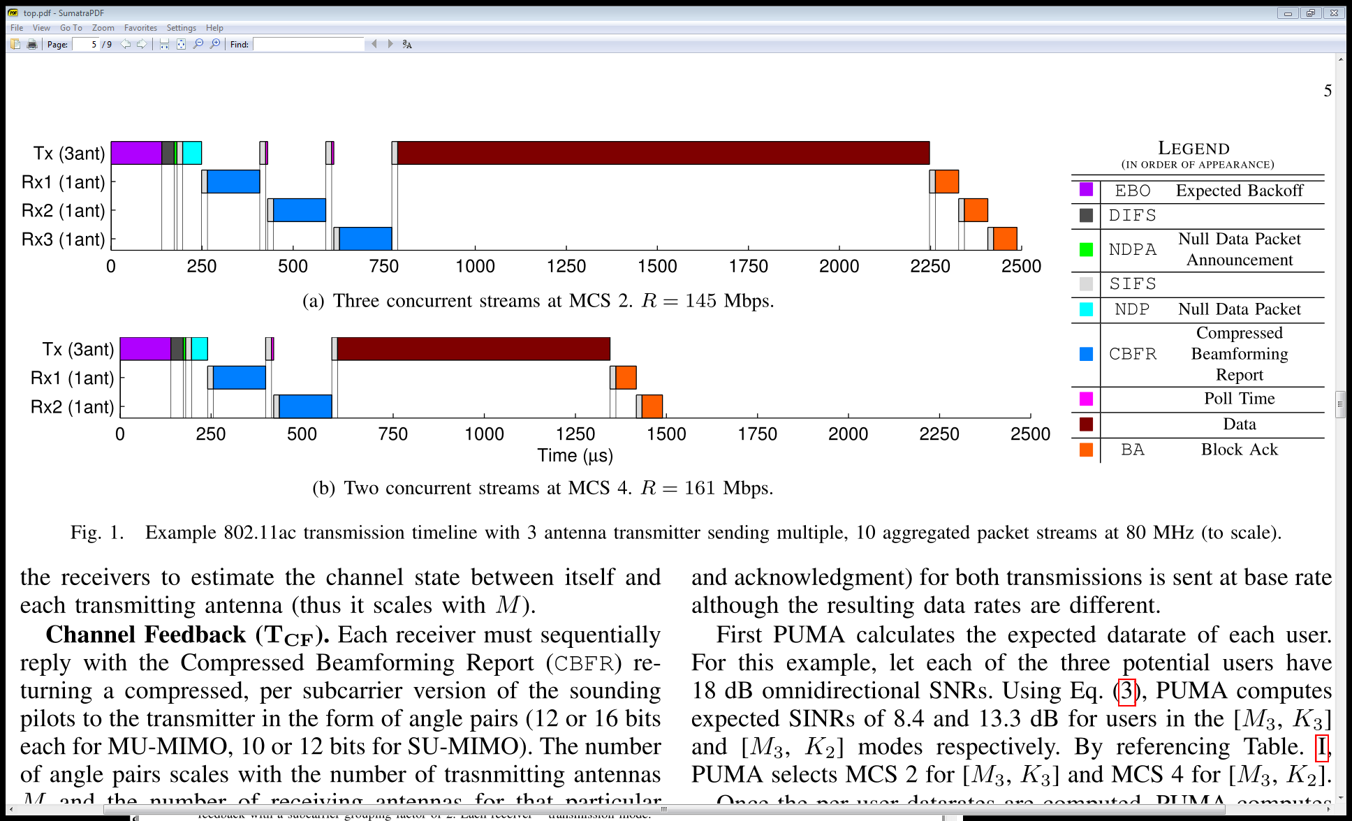
Aggregate Throughput Calculation
Model computes per-user SINR
  (a) 8.4 dB
  (b) 13.3 dB
Corresponding MCS:
  (a) 2 : QPSK ¾ - 351 DBPS
  (b) 4: 16-QAM ¾ - 702 DBPS
Counterintuitively, selection of maximum mode or user set size will not always increase throughput.

Slide 15

PUMA Recap
Protocol for easily separable, highly variable operating regimes.
  Leverages theoretical MU-MIMO system scaling properties to estimate potential mode and user group performance without relying on previous CSI collection
Selects mode and user group based solely on pre-sounding information
MU-MIMO system scaling properties
  without relying on previous CSI collection
Pre-sounding information:
Link State
System State
Queue State
Estimate per-user datarate
Quantify potential mode cost
Select group/mode which maximizes aggregate throughput

Slide 16
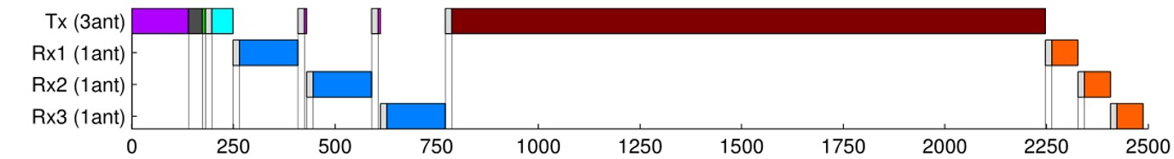
PUMA Summary
Protocol for easily separable, highly variable operating regimes.
  Leverages theoretical MU-MIMO system scaling properties to estimate potential mode and user group performance without relying on previous CSI collection
Selects mode and user group based solely on pre-sounding information
Would PUMA be beneficial in regimes of low variability?
  Yes, of course.
  Would it be the most efficient type of solution?
PUMA overcomes high variability by leveraging easy user separability
Low variability regime: characteristic to leverage, not overcome
MU-MIMO system scaling properties
  without relying on previous CSI collection
  No.
  Previously collected CSI can now reliably be used
SOUND
(560us)
TRANSMIT
(1300us)

Slide 17
Outline
MU-MIMO Operating Regimes
High Variability
(fast fading)
PUMA
FROZEN
Implementation
Evaluation
MU-MIMO Measurement Study
PUMA
FROZEN
WURC Array
Software Frameworks
Easily separable, highly variable scenarios
Minimally variable scenarios
PUMA
802.11ac
Higher Bands
(2.4/5.8 GHz)
Indoor
Measurement
Study
Outdoor
Lower Bands
(UHF)
Low Variability
(slow fading)
FROZEN
Easy to Separate
(uncorrelated)
Difficult to Separate
(correlated)

Slide 18
FROZEN
Feedback Removal with Opportunistic Zero-overhead channel EstimatioN
Designed for low variability regimes
User Separability is irrelevant
  Offline MAC decisions ->
  Temporally Stable Channel
    Can use previously collected CSI
    MAC Decisions can be done “offline”
  Channel is not stable forever
    When is a user’s CSI invalid?
    Accurate tracking method required
Passive
Implicit
MU-MIMO
Explicit MU-MIMO
Implicit
MU-MIMO

Slide 19
Enabling Passive Implicit Sounding
Leverage all uplink transmissions for CSI collection
  OFDM Transmission methods contain channel training sequence for equalization
    802.11ac: VHT-LTF
  Uplink OFDM Channel training sequence + Reciprocal Calibration [Shepard ‘12] = User’s CSI Estimate
  Every uplink transmission (data, ack, etc) is an NDP
IF user CSI is determined to be stale:
  “Sound” channel without deliberate sounding sequence
  Trigger “indirect” sounding by dequeing single-user packet to force acknowledgement
How do we know if user CSI is stale?
  ICSIQLE: Implicit CSI QuaLity Estimate
Passive
Implicit
MU-MIMO

Slide 20
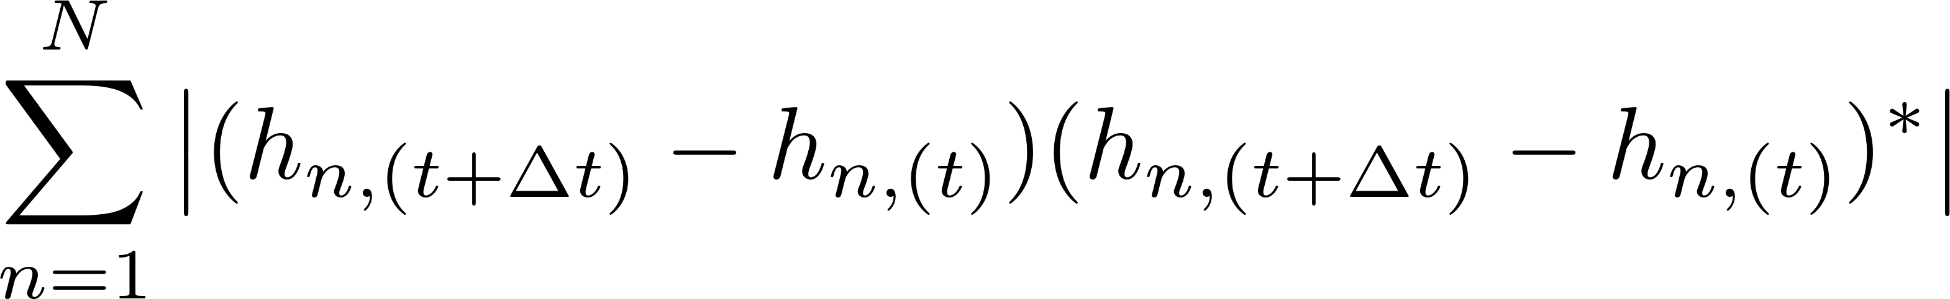
CSI Tracking Methods
How to track a particular user’s CSI over time? Simple element by element comparison through time of h?
Absolute phase tracking CNo from AFC [Xie ‘13]
PHASE WRAPS
  e.g., 359º to 1º -> 358º or 2º change?
Phase affected by AGC and other clocking/hardware impairments
802.11ac Task Group Acknowledges this! [Breit ‘09]
  Need channel tracking metrics that provide “Phase Immunity”
Instead, consider relative phase between AP antennas

Slide 21
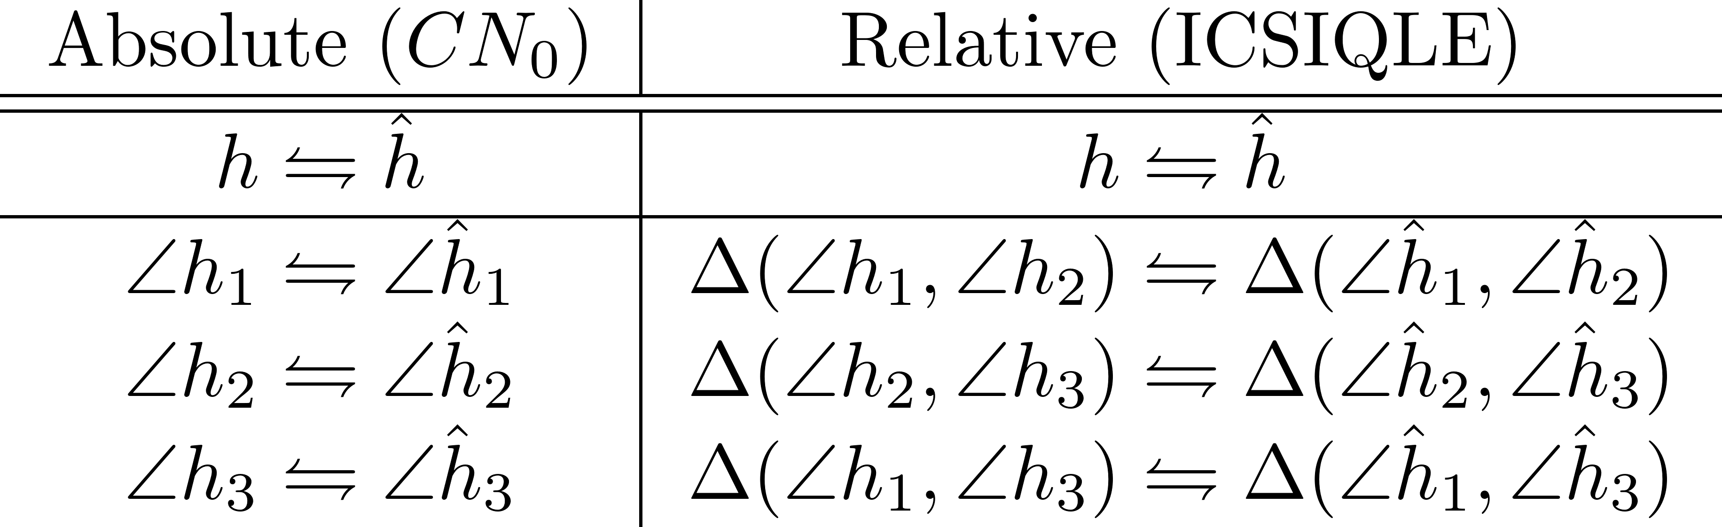
Relative Phase Tracking
Relative Phases between AP Antennas:

Slide 22
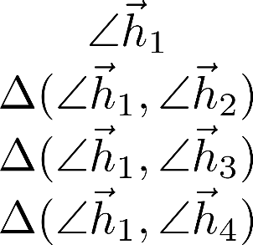
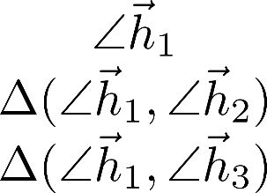
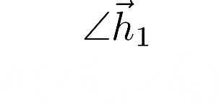
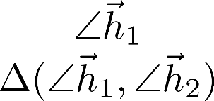
Relative Phase Measurement
Static lab environment
  ** Absolute phase varies greatly (due to wrapping and hardware impairments)
  ** Relative phase remains stable

Slide 23
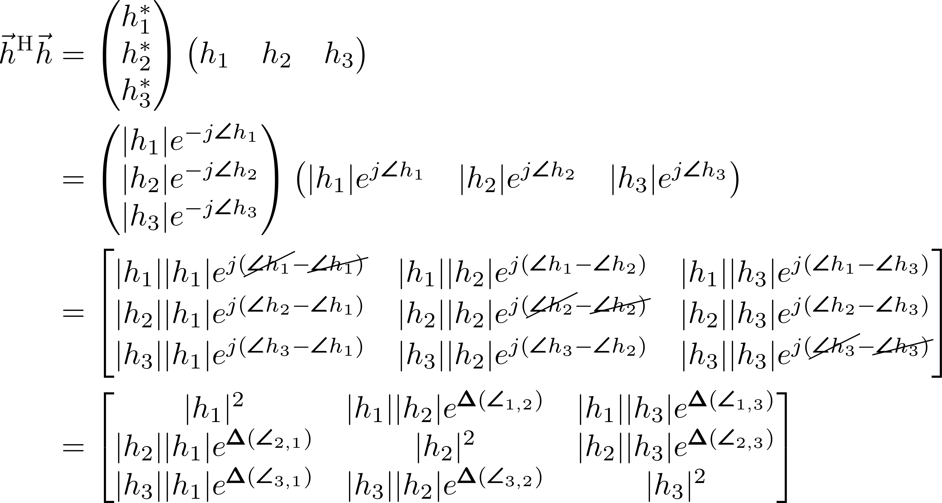
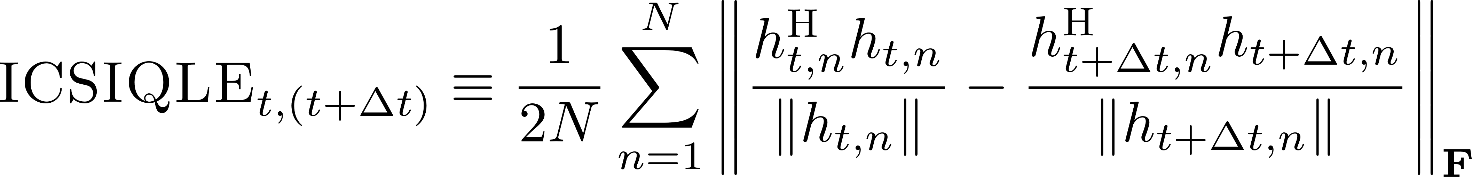
Preparing per-user CSI
Preparing per-user h vector for relative angle tracking
  Tracking w.r.t one specific antenna will bias results
  Taking angle differences removes magnitude effect
Solution: element-by-element tracking of h^{H}h
Relative angles w.r.t each antenna
Magnitude information intact

Slide 24
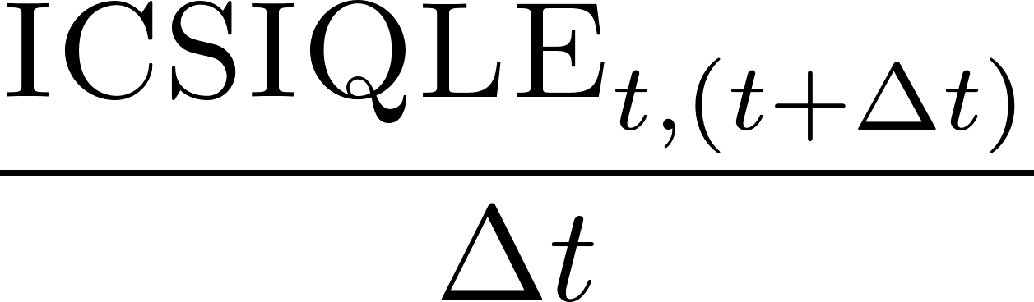
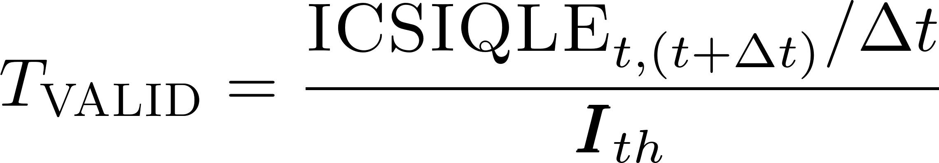
Tracking ICSIQLE
ICSIQLE’s T_{VALID} - Estimate for how long h will stay valid
  Track ICSIQLE/Δt
  Divide ICSIQLE/Δt by ICSIQLE threshold (I_{th}) = an h estimate’s Valid time
    Maximum allowable change in h
  Transmission event -> Compare latest T_{VALID} value to Δt (age) of latest estimate
    If Δt > T_{VALID} force passive update via single-user packet
Every additional measurement allows continuous updating of T_{VALID}
ICSIQLE threshold requires hardware calibration w.r.t. Reciprocal Calibration error, EVM/Noise Variance
Threshold based on target EVM (and allowable EVM variance) and number of concurrent users (see per-user performance degradation based on DoF as shown in PUMA)

Slide 25
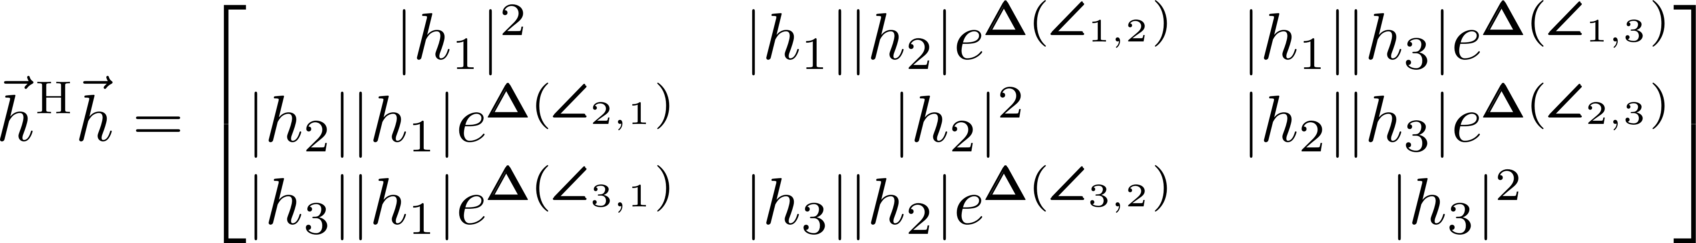
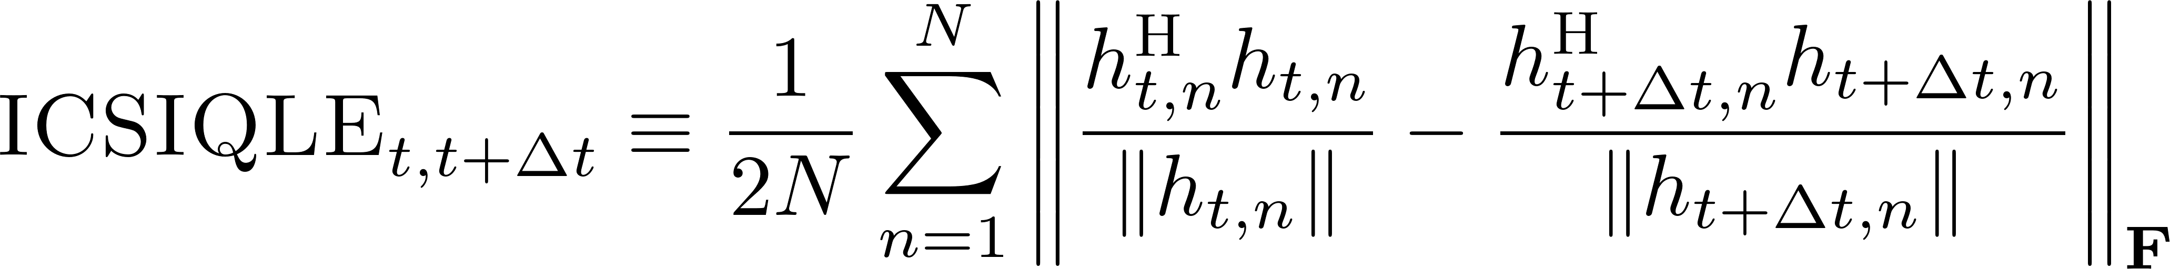
FROZEN Summary
Protocol for low variability regimes, regardless of user separability
  Utilizes implicit, previously collected CSI for MU-MIMO transmissions. Stored channel state allows for “offline” MAC decisions
Opportunistically refreshes CSI using passive implicit MU-MIMO
  previously collected CSI
“offline” MAC decisions
Passive Implicit MU-MIMO
Leverage uplink transmissions to refresh CSI (force single-user transmission if necessary)
Determine validity of CSI with ICSIQLE
  Relative angle-based metric (h^{H}h)
  Compute between subsequent measured h vectors
  Generate T_{VALID} from I_{th}
  Δt > T_{VALID} force passive update

Slide 26
Outline
MU-MIMO Operating Regimes
High Variability
(fast fading)
PUMA
FROZEN
Implementation
Evaluation
MU-MIMO Measurement Study
PUMA
FROZEN
WURC Array
Software Frameworks
Easily separable, highly variable scenarios
Minimally variable scenarios
PUMA
802.11ac
Higher Bands
(2.4/5.8 GHz)
Indoor
Measurement
Study
Outdoor
Lower Bands
(UHF)
Low Variability
(slow fading)
FROZEN
Easy to Separate
(uncorrelated)
Difficult to Separate
(correlated)

Slide 27
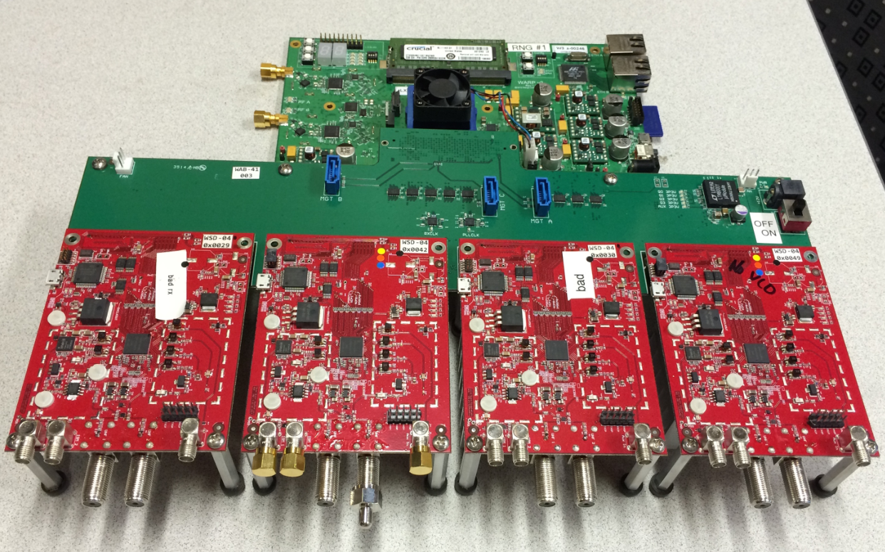
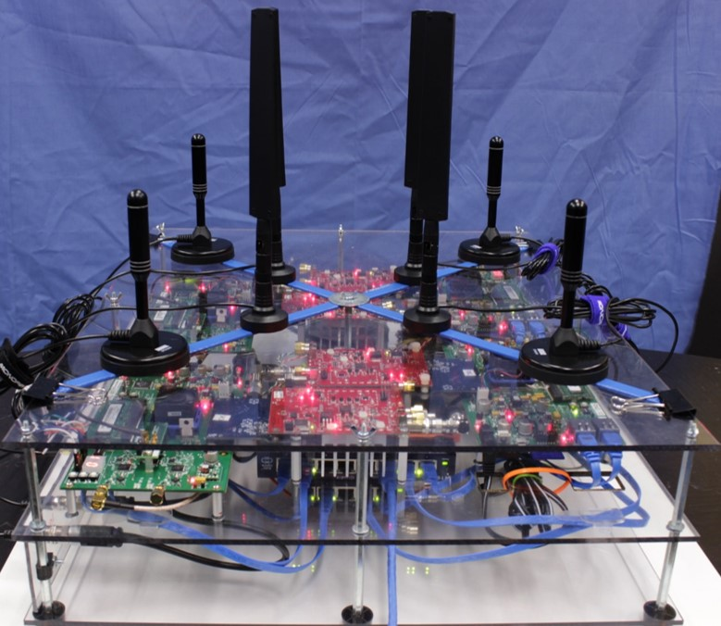
WURC Array
Open UHF MU-MIMO development platform
  d
Side by side comparisons of 2.4/5Ghz and UHF band
4 WARP + 4 WURC
  Wideband UHF Radio Card
  1 W transmitter allows for long distance, at-scale transmissions
UHF Antenna
Dual-Band WiFi Antenna
λ/2=6cm
λ/2=30cm
WURC Array v2

Slide 28

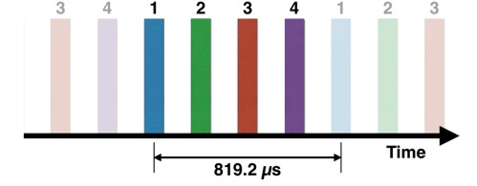
Software Measurement Frameworks
Zero-forcing Beamformer
  Based on WARPLab design flow
    [9] Aryafar 2010, Shepard 2012, Anand 2012
  MATLAB Centric PHY layer prototyping platform
  Allows for less complex implementation of Zero-forcer
    measure SINR -> Aggregate Shannon Capacity
    **NEW ADDITION -> Wideband (OFDM) EVM Measurement
  High communication latency.
  Topology restricted by cabling.
High speed WARP-based channel sounder
  Based on WARP-802.11 Reference Design
    Allows for MU-MIMO channel sounding
    with a relatively low cost set of SDRs
  LTS for OFDM channel estimation
  Provides high speed channel snapshots
  not actual beamforming

Slide 29
Outline
MU-MIMO Operating Regimes
High Variability
(fast fading)
PUMA
FROZEN
Implementation
Evaluation
MU-MIMO Measurement Study
PUMA
FROZEN
WURC Array
Software Frameworks
Easily separable, highly variable scenarios
Minimally variable scenarios
PUMA
802.11ac
Higher Bands
(2.4/5.8 GHz)
Indoor
Measurement
Study
Outdoor
Lower Bands
(UHF)
Low Variability
(slow fading)
FROZEN
Easy to Separate
(uncorrelated)
Difficult to Separate
(correlated)

Slide 30
Measurement Study
Determine MU-MIMO Operating Regimes
Channel Variability
(over time)
Band
UHF
2.4/5.8 GHz
Environment
Indoor
?
?
Outdoor
?
?
∠
∠
Receiver Separability

Slide 31
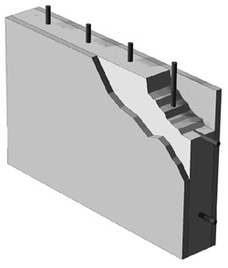


Receiver Separability
How close are the users’ channels?
  Linear dependence of H matrix rows
  NOT necessarily dependent on physical location
2.4 GHz
How to Quantify?
Demmel Condition Number
  [35] C. Zhong, et. al. 2011
  Based on Linear dependence
  Thus, invertibility
  Reliably predicts performance
    eg., use for MCS
  [1,∞] : 1 -> perfectly separable (orthogonal) channels
?
5.8 GHz
UHF?
Rx A
∠
∠
∠
Tx
∠
Rx B
∠
∠
?
Rx C

Slide 32







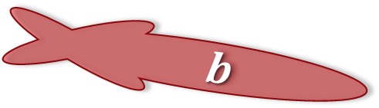


Channel Variability
How much do the users (or their environments) move?
  Between SOUNDING and TRANSMISSION
  How “fast” is the user/environment changing?
SOUNDING
and
TRANSMISSION
m/s
λ/s
Rx A
13m/s
$a$
How to Quantify?
elem(H) autocorrelation
  Measures change of each antenna path
  [0,1] : 1-> identical for given lag
  Rate of decay w.r.t. lag:
    Slow decay, sound less
    Fast Decay, sound more
Tx
$$b$$
Rx B
$c$
1.5m/s
Rx C
4.5m/s
λ
X
UHF
60cm
x
2.5
7.5
21
2.4 GHz
12cm
5x
λ/s
13
38
108
5.8 GHz
5cm
12x
30
90
260

Slide 33
Experiments and Analysis Summary
Channel Model Analysis
Channel Variability
Indoor 5.8 GHz
Outdoor 300 MHz
Receiver Separability
Indoor UHF vs 2.4/5.8 GHz
Outdoor UHF vs 2.4/5.8 GHz
Indoor UHF vs 2.4/5.8 GHz
Outdoor UHF vs 2.4/5.8 GHz
Band
UHF
2.4/5.8 GHz
Environment
Indoor
?
?
Outdoor
?
?

Slide 34


Indoor Scenario
Indoor Environment
  Pedestrian mobility from office
  Non-Line of Sight
  Close colocation of receivers
How stable is the UHF channel compared to 2.4/5.8 GHz?
  Order of magnitude λ difference
  This isn’t freespace! Multi-path environments reduce distance relative to λ for new channel [Aryfar, Anand ‘10]
  Multi-path -> Fast time scale?
Rx
Rx
Rx
Rx
Rx
Rx
Walkway
Concrete
Tx

Slide 35
Indoor Scenario
Comparison of UHF MU-MIMO channel variability to 2.4/5.8 GHz
  Verify with Temporal Correlation
  UHF: low channel variability even at 802.11 Beacon Interval
Implications for protocol design:
  Increased stability of UHF MU-MIMO channel allows for use of previously collected CSI
  Significantly reduce sounding overhead (sounding rate)
  FROZEN
UHF
2.4GHz
5.8GHz

Slide 36
Experiments and Analysis Summary
Channel Model Analysis
Channel Variability
Indoor 5.8 GHz
Outdoor 300 MHz
Receiver Separability
Indoor UHF vs 2.4/5.8 GHz
Outdoor UHF vs 2.4/5.8 GHz
Indoor UHF vs 2.4/5.8 GHz
Outdoor UHF vs 2.4/5.8 GHz
Band
Band
UHF
UHF
2.4/5.8 GHz
2.4/5.8 GHz
Environment
Environment
Higher Bands
(2.5/5.8 GHz)
Indoor
Indoor
?
Less Variable
Easier to Separate
?
More Variable
Easier to Separate
Indoor
Measurement
Study
Outdoor
Outdoor
Outdoor
?
Less Variable
Harder to Separate
?
Lower Bands
(UHF)
More Variable
Harder to Separate

Slide 37
Outline
MU-MIMO Operating Regimes
High Variability
(fast fading)
PUMA
FROZEN
Implementation
Evaluation
MU-MIMO Measurement Study
PUMA
FROZEN
WURC Array
Software Frameworks
Easily separable, highly variable scenarios
Minimally variable scenarios
PUMA
802.11ac
Higher Bands
(2.4/5.8 GHz)
Indoor
Measurement
Study
Outdoor
Lower Bands
(UHF)
Low Variability
(slow fading)
FROZEN
Easy to Separate
(uncorrelated)
Difficult to Separate
(correlated)

Slide 38
PUMA Recap
Protocol for easily separable, highly variable operating regimes.
  Leverages theoretical MU-MIMO system scaling properties to estimate potential mode and user group performance without relying on previous CSI collection
Selects mode and user group based solely on pre-sounding information
MU-MIMO system scaling properties
  without relying on previous CSI collection
Pre-sounding information:
Link State
System State
Queue State
Estimate per-user datarate
Quantify potential mode cost
Select group/mode which maximizes aggregate throughput

Slide 39
Experiments and Analysis Summary
Numerical Analysis
SINR Estimation Error
PUMA vs. Post-sounding method
PUMA vs. Fixed Modes
Expected throughput - Mode vs. SNR
Distribution of error from DoF based estimator
Comparison to best case, full CSI knowledge search
Comparison of dynamic mode selection vs. Fixed
Modes with larger MK require high omnidirectional SNR (e.g., K=4 only feasible at 20dB)
N~(0.36, 2.43) dB
Error is on the order of jumps in MCS table
Model error effectively truncated by jumps in MCS table (only 5-7% estimation error)
PUMA’s dynamic selection surpasses max of any fixed mode (30% at saturation)

Slide 40
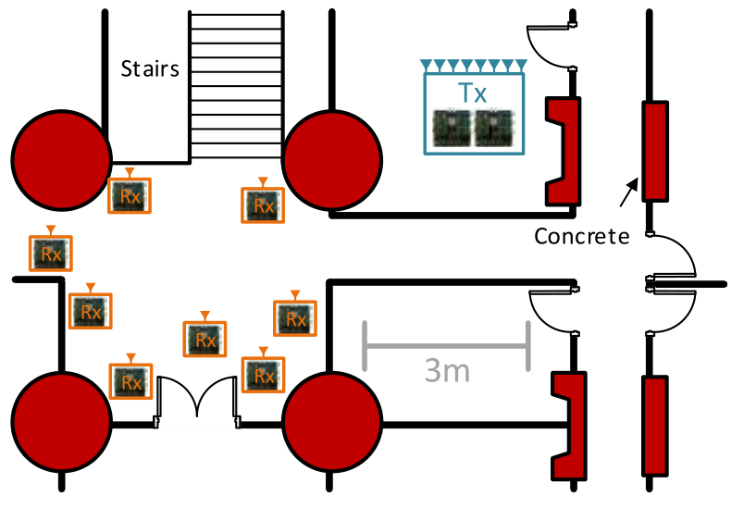
Evaluation Methodology
OTA Experimentation
  WARPLab MU-MIMO Testbed
  8 antenna transmitter, 8 single antenna receivers
  Nodes placed in varying locations (LOS and NLOS)
  Every combination of M=1:8 and K=1:8 transmission measured
  Measurement database consisting of MU-MIMO SINRs and Omni SNRs
Channel-Trace Driven Simulation
  Model incoming packets as Poisson process
  For simplicity with 11ac standard, M=4, K=1:4 subset of 8
  Simultaneous channel traces for comparison
    Post-sounding: Measured MU-MIMO SINR
    Pre-sounding: Model with Omnidirectional SNR

Slide 41
PUMA vs. Fixed Modes
Comparison of PUMA (dynamic mode selection) and fixed modes.
Does larger MK result in higher throughput?
For this scenario, 3 tx antennas achieves highest throughput—fix the mode?
PUMA’s dynamic mode selection is key to throughput gain
  In certain instances, selecting largest mode or user set will not always result in higher throughput
  PUMA’s selection of the correct mode at the correct time results in throughput that surpasses the maximum of any fixed mode (30% at saturation)

Slide 42
Experiments and Analysis Summary
Numerical Analysis
SINR Estimation Error
PUMA vs. Post-sounding method
PUMA vs. Fixed Modes
Expected throughput - Mode vs. SNR
Distribution of error from DoF based estimator
Comparison to best case, full CSI knowledge search
Comparison of dynamic mode selection vs. Fixed
Modes with larger MK require high omnidirectional SNR (e.g., K=4 only feasible at 20dB)
N~(0.36, 2.43) dB
Error is on the order of jumps in MCS table
Model error effectively truncated by jumps in MCS table (only 5-7% estimation error)
PUMA’s dynamic selection surpasses max of any fixed mode (30% at saturation)

Slide 43
Outline
MU-MIMO Operating Regimes
High Variability
(fast fading)
PUMA
FROZEN
Implementation
Evaluation
MU-MIMO Measurement Study
PUMA
FROZEN
WURC Array
Software Frameworks
Easily separable, highly variable scenarios
Minimally variable scenarios
PUMA
802.11ac
Higher Bands
(2.4/5.8 GHz)
Indoor
Measurement
Study
Outdoor
Lower Bands
(UHF)
Low Variability
(slow fading)
FROZEN
Easy to Separate
(uncorrelated)
Difficult to Separate
(correlated)

Slide 44
FROZEN Summary
Protocol for low variability regimes, regardless of user separability
  Utilizes implicit, previously collected CSI for MU-MIMO transmissions. Stored channel state allows for “offline” MAC decisions
Opportunistically refreshes CSI using passive implicit MU-MIMO
  previously collected CSI
“offline” MAC decisions
Passive Implicit MU-MIMO
Leverage uplink transmissions to refresh CSI (force single-user transmission if necessary)
Determine validity of CSI with ICSIQLE
  Relative angle-based metric (h^{H}h)
  Compute between subsequent measured h vectors
  Generate T_{VALID} from I_{th}
  Δt > T_{VALID} force passive update

Slide 45
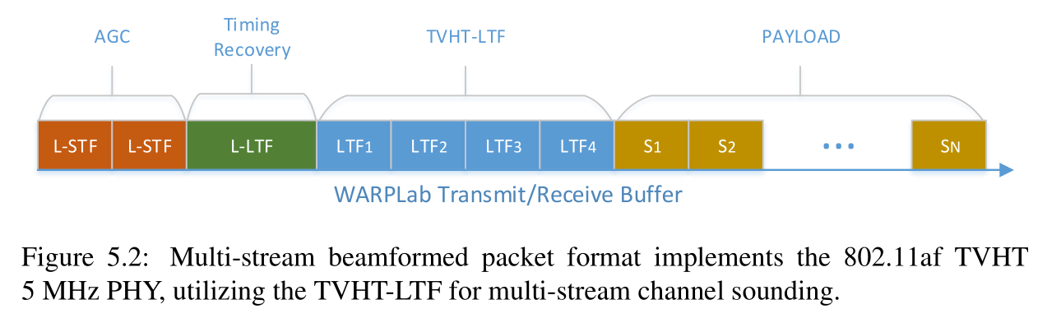
Measurement Methodology
Wideband EVM based method
  Non-beamformed training sequence inserted into preamble for channel re-measurement during beamformed transition
  Process:
    Sound -> H_{(t)}
    Beamform -> H_{(t+Δt1)}, EVM
    Beamform -> H_{(t+Δt2)}, EVM
    …
    GOTO 1

Slide 46
ICSIQLE – Tracking Performance
4x1 SUBF transmissions to test EVM tracking performance of CSI metrics
  ** Relative angle required to track performance
  ** ICSIQLE tracks performance and performance variance

Slide 47
ICSIQLE Tracking Channel Variability
Static -> Mobile -> Static 4x2 Experiment
Can ICSIQLE track differences between static and mobile environments?
** Relative Angle is required to track channel variability
Corresponding T_{VALID} for threshold of 0.25

Slide 48
Numerical Analysis of FROZEN
Comparison between 802.11ac Explicit and FROZEN (Passive Implicit sounding)
  Example modulation rates: QPSK ¾ and 64 QAM ¾ for 4x4 MU-MIMO Transmission
  Will show operating regions for each:
    Explicit: Dependent on size of fedback beamforming report
    FROZEN: Dependent on rate of CSI passive implicit sounding
  Lower Bound
    Explicit: Lowest SC grouping, Highest # Feedback Bits per SC
    FROZEN: Indirectly sound each user with a single-user packet (assume equivalent MCS to MU-MIMO)
  Upper Bound
    Explicit: Highest SC grouping, Lowest # Feedback Bits per SC
    FROZEN: CSI always up to date from previous ACK

Slide 49
Numerical Analysis of FROZEN
The effect of FROZEN’s opportunistic overhead reduction results in increased throughput compared to explicit especially at lower aggregation rates
  Users are not fully backlogged and MU-MIMO can be overwhelmed by overhead
  Lower aggregation rates have less data to amortize the sounding overhead, thus the increase in FROZEN’s performance over 802.11ac Explicit
Higher modulation rates also result in higher FROZEN throughput gains
  Higher MCS -> less airtime spent sending data -> effect of sounding overhead is more pronounced

Slide 50
Prior Work Summary
MU-MIMO Hardware Platform
  Not high power, frequency agile, and/or open for research
    WARP (alone), USRP, Adaptrum, SORA, Nutaq
Measurement study
  MU-MIMO 2.4/5 GHz Characterization
    Aryafar ‘10, Poutanen ‘11
  SISO UHF Characterization
    Collings ‘12, Hampton ‘05, Pham ‘07, Ying ‘13
  MIMO UHF Characterization
    Boyer ‘07, Eriksson ‘08, Hammons ‘08, Jung ‘11, Parviainen ‘09
All-purpose MU-MIMO Protocols
  Frame Aggregation Protocols
    Bellalta ‘12, Bellalta ‘09
  User grouping and selection (which require CSI)
    Esslaoui ‘12, Jang ‘06, Shen ‘05, Tandai ’09
  Overhead amortization through CSI tracking
    Xie ‘14, Bejarano ‘14

Slide 51
Conclusion
FROZEN and PUMA improve MU-MIMO performance by leveraging low channel variability and easily separable receivers respectively in the appropriate operating regimes.
Our MU-MIMO measurement study comparatively evaluates the specific effects of band and environment on these operating regimes.
All-purpose solutions must target the pathological case and thus will not allow MU-MIMO systems to reach their full potential
PUMA
802.11ac
Higher Bands
(2.4/5.8 GHz)
Indoor
Measurement
Study
Outdoor
Lower Bands
(UHF)
FROZEN

