Slide 1
Augmenting Wireless Security using Zero-Forcing Beamforming
Masters Defense
Narendra Anand
Advisor: Dr. Edward Knightly
4/8/11

Slide 2


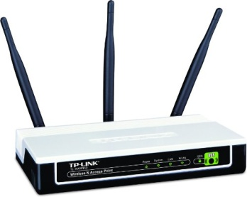
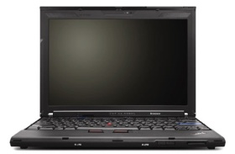
Motivation
Omnidirectional
E
Problem:
Omnidirectional Transmissions broadcast signal energy everywhere allowing any user in range to overhear the transmission.
E
AP
WEP/WPA
IU
Indoors (eg. Coffee Shop)

Slide 3
Motivation
Potential Solution:
Keep signal away from E with
Single-User Beamforming or
Directional Antenna
E
Multi-Path
Problem:
Single Target directional methods are agnostic to user locations other than IU. Multi-path effects and knowledge of IU location can be used to compromise the transmission.
E
AP
IU
**Beampatterns for
Illustration purposes only.
E
LOS
Indoors (eg. Coffee Shop)

Slide 4
Solution
Problem: How can we reliably keep eavesdroppers from decoding the IU’s data?
Solution: Simultaneously Blind (actively interfere) Eavesdroppers while serving the IU.
How: By leveraging the multi-stream/user abilities of recent multi-antenna technologies (802.11n/ac)
  AP creates simultaneous streams
  Use one for IU
  Use remaining to Blind Eavesdroppers
S
TR
O
B
E
imultaneous
ansmission with
rthogonally
linded
avesdroppers

Slide 5
STROBE Overview
STROBE
E
STROBE:
Leverages existing multi-stream capabilities
Cross-layer approach but requires minimal hardware modification (11n/ac compatible)
Coexists with existing security protocols
Blinding
Streams
AP
IU
**Beampatterns for
Illustration purposes only.
E
Indoors (eg. Coffee Shop)

Slide 6
Orthogonal Blinding
802.11n/ac use Zero-Forcing Beamforming (ZFBF) for multiple stream creation
  Requires CSI for each antenna path to each user (row vector in H matrix)
Coping with Limited CSI
  STROBE only has CSI for IU
  Fills other rows with orthogonal h vectors

Slide 7
Background
Zero Forcing Beamforming (ZFBF)
Assume 4 Tx Antennas and 3 single-antenna receivers
hk's – H for each recv.
Calculate weights with pseudo-inverse
wj's
“Zero Interference” Condition

Slide 8
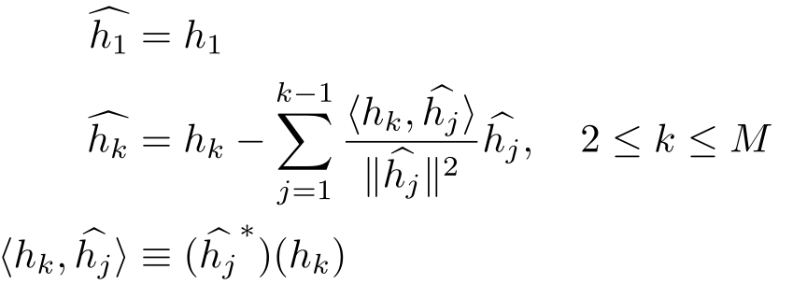
Orthogonal Blinding
Limited Channel State Information (CSI)
  Only know IU’s channel (h vector)
  Generate orthogonal h vectors using Gram-Schmidt Orthonormalization process
  New H matrix is unitary (pseudo-inverse is complex conjugate transpose)
  Intended user’s steering weight is equivalent to SUBF
Ease of implementation/integration
  ZFBF systems can use QR-decomposition (followed by backsubstitution) to calculate pseudo-inverse
  QR is used to implement Gram-Schmidt (existing silicon can be re-used for STROBE)

Slide 9
Prior Work
Beamforming-based multiple AP cooperation
  J. Carey and D. Grunwald. Enhancing WLAN security with smart antennas: a physical layer response for information assurance. In Proc. IEEE Vehicular Technology Conference, September 2004.
  S. Lakshmanan, C. Tsao, R. Sivakumar, and K. Sundaresan. Securing Wireless Data Networks against Eavesdropping using Smart Antennas. In The 28th International Conference on Distributed Computing Systems, Beijing, China, June 2008.
Information theoretic multi-antenna security
  S. Goel and R. Negi. Guaranteeing secrecy using artificial noise. IEEE Transactions on Communications, 7(6):2180–2189, June 2008.
  L. Dong, Z. Han, A. Petropulu, and V. Poor. Improving wireless physical layer security via cooperating relays. IEEE Transactions on Signal Processing, 58(3):1875–1888, March 2010.

Slide 10
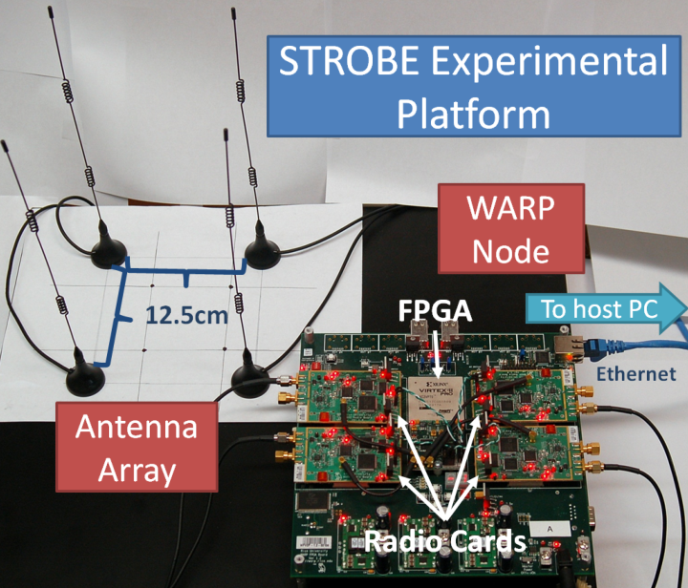
Experimental Methodology
STROBE implemented in WARPLab using ZFBF testbed developed in:
  E. Aryafar, N. Anand, T. Salonidis, and E. Knightly. Design and experimental evaluation of multi-user beamforming in Wireless LANs. In Proc. ACM MobiCom, Chicago, Illinois, September 2010
Performance Metric: Received signal strength (dB)

Slide 11
Experimental Methodology
Scheme Comparisons
Non-Directional
Omnidirectional
(Omni)
Single-Target Directional
Single-User Beamforming
(SUBF)
Directional Antenna
(DA)
Multi-Target Directional
Cooperating Eavesdropper
(CE)
STROBE
    Unrealistic scenario in which Eavesdroppers provide AP with their CSI to be precisely blinded.

Slide 12
Experimental Methodology
Scheme Comparisons
Non-Directional
Omnidirectional
(Omni)
Single-Target Directional
Single-User Beamforming
(SUBF)
Directional Antenna
(DA)
Multi-Target Directional
Cooperating Eavesdropper
(CE)
STROBE
    Fairness
      Net transmit power equivalent for all schemes

Slide 13
Experiments
Baseline
  How does STROBE perform in a typical, indoor, wireless scenario?
Relative Eavesdropper location
  How does STROBE cope with varying eavesdropper proximity to IU?
  How does STROBE handle eavesdroppers in-line with IU?
Verifying necessity of multi-path (outdoor)
  How dependent is STROBE on multi-path scattering characteristic of indoor WLAN environments?
Nomadic Eavesdropper
  Is it possible for an eavesdropper to exhaustively traverse an environment to find a location where STROBE’s performance diminishes?

Slide 14
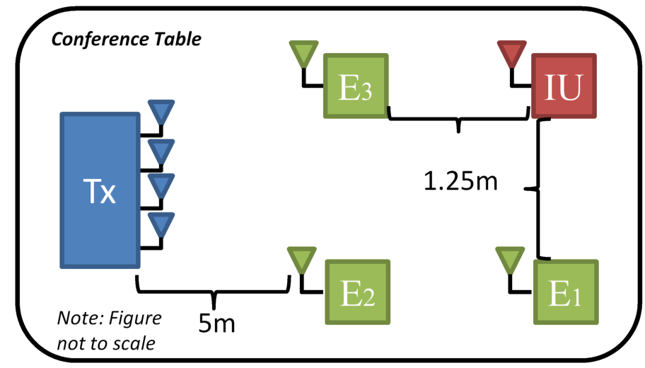
Baseline

Slide 15
Baseline
Omni - In range clients receive transmission with high SINR, distance from transmitter is not always a good predictor

Slide 16
Baseline
Omni - In range clients receive transmission with high SINR, distance from transmitter is not always a good predictor
SUBF – Maximizes SINR at IU but agnostic to signal energy afterwards

Slide 17
Baseline
Omni - In range clients receive transmission with high SINR, distance from transmitter is not always a good predictor
SUBF – Maximizes SINR at IU but agnostic to signal energy afterwards
STROBE – Serves IU with high SINR, restricts E SINR to < 4dB

Slide 18
Baseline
Omni - In range clients receive transmission with high SINR, distance from transmitter is not always a good predictor
SUBF – Maximizes SINR at IU but agnostic to signal energy afterwards
STROBE – Serves IU with high SINR, restricts E SINR to < 4dB
CE – Precise blinding of E comes at the cost of SINR served to IU

Slide 19
Experiments
Baseline
  How does STROBE perform in a typical, indoor, wireless scenario?
Relative Eavesdropper location
  How does STROBE cope with varying eavesdropper proximity to IU?
  How does STROBE handle eavesdroppers in-line with IU?
Verifying necessity of multi-path (outdoor)
  How dependent is STROBE on multi-path scattering characteristic of indoor WLAN environments?
Nomadic Eavesdropper
  Is it possible for an eavesdropper to exhaustively traverse an environment to find a location where STROBE’s performance diminishes?

Slide 20
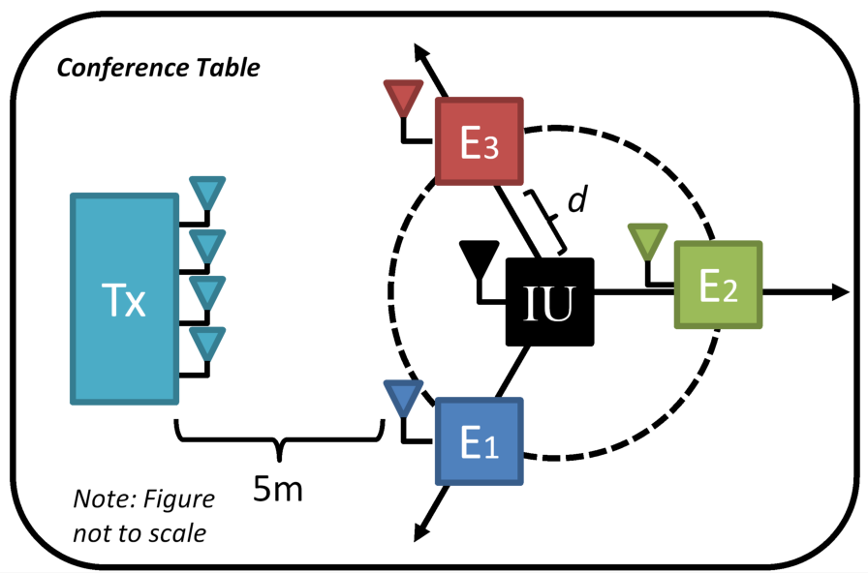
Relative E Location: Proximity

Slide 21
Relative E Location: Proximity
Omni - High SINR variability indicator of multipath effects

Slide 22
Relative E Location: Proximity
Omni/SUBF - High SINR variability indicator of multipath effects

Slide 23
Relative E Location: Proximity
Omni/SUBF - High SINR variability indicator of multipath effects
CE – Precise blinding regardless of distance, consistent results regardless of multi-path

Slide 24
Relative E Location: Proximity
Omni/SUBF - High SINR variability indicator of multipath effects
CE – Precise blinding regardless of distance, consistent results regardless of multi-path
STROBE – Mildly affected at close distances, consistent results regardless of multi-path, provides far greater SINR to IU than CE

Slide 25
Experiments
Baseline
  How does STROBE perform in a typical, indoor, wireless scenario?
Relative Eavesdropper location
  How does STROBE cope with varying eavesdropper proximity to IU?
  How does STROBE handle eavesdroppers in-line with IU?
Verifying necessity of multi-path (outdoor)
  How dependent is STROBE on multi-path scattering characteristic of indoor WLAN environments?
Nomadic Eavesdropper
  Is it possible for an eavesdropper to exhaustively traverse an environment to find a location where STROBE’s performance diminishes?

Slide 26
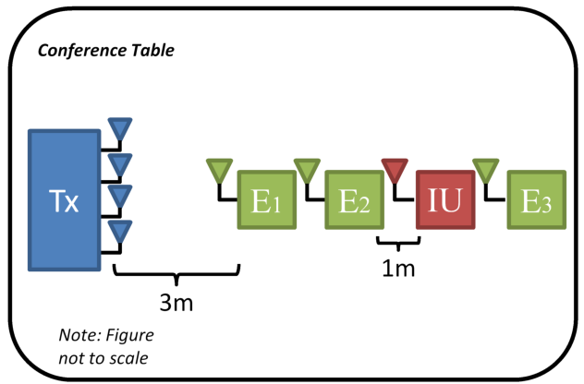
Relative E Location: In-Line

Slide 27
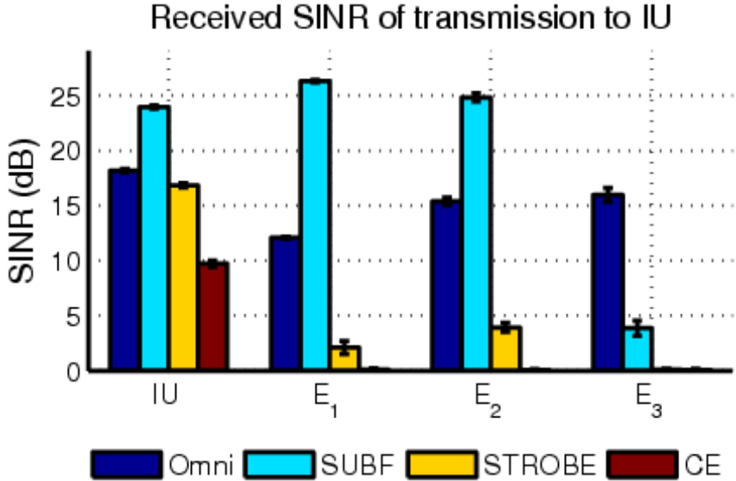
Relative E Location: In-Line
Omni – SINR not predicted by location in line
SUBF – Single-target directional scheme; to defeat, get in LOS
STROBE – Multiple eavesdroppers in direct LOS between IU and Tx are successfully blinded
CE – Precise blinding comes at a price.

Slide 28
Experiments
Baseline
  How does STROBE perform in a typical, indoor, wireless scenario?
Relative Eavesdropper location
  How does STROBE cope with varying eavesdropper proximity to IU?
  How does STROBE handle eavesdroppers in-line with IU?
Verifying necessity of multi-path (outdoor)
  How dependent is STROBE on multi-path scattering characteristic of indoor WLAN environments?
Nomadic Eavesdropper
  Is it possible for an eavesdropper to exhaustively traverse an environment to find a location where STROBE’s performance diminishes?

Slide 29
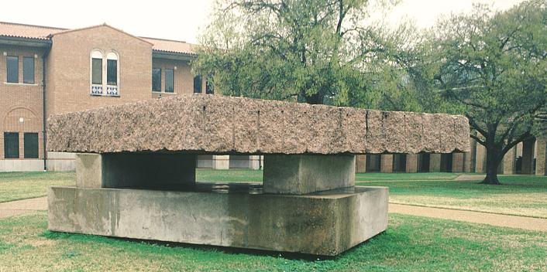
Verifying necessity of Multi-Path

Slide 30
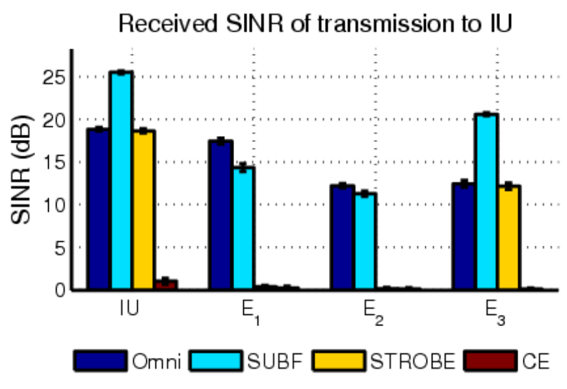
Verifying necessity of Multi-Path
Outdoors
Multi-Stream methods fail outdoors
  STROBE becomes directional
  CE completely fails

Slide 31
Experiments
Baseline
  How does STROBE perform in a typical, indoor, wireless scenario?
Relative Eavesdropper location
  How does STROBE cope with varying eavesdropper proximity to IU?
  How does STROBE handle eavesdroppers in-line with IU?
Verifying necessity of multi-path (outdoor)
  How dependent is STROBE on multi-path scattering characteristic of indoor WLAN environments?
Nomadic Eavesdropper
  Is it possible for an eavesdropper to exhaustively traverse an environment to find a location where STROBE’s performance diminishes?

Slide 32
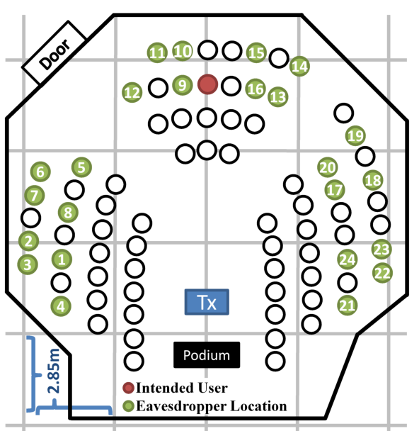
Nomadic Eavesdropper

Slide 33
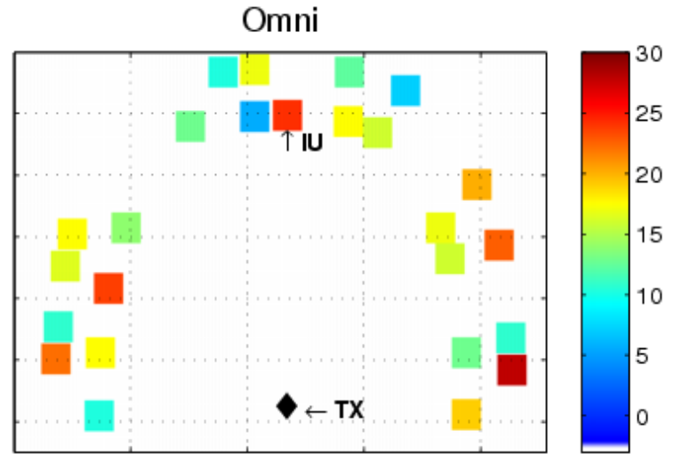
Nomadic Eavesdropper

Slide 34
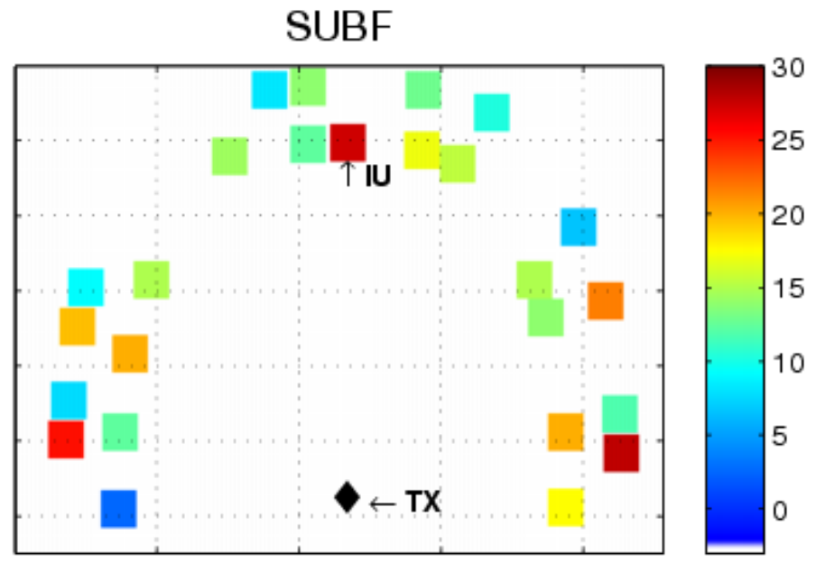
Nomadic Eavesdropper

Slide 35
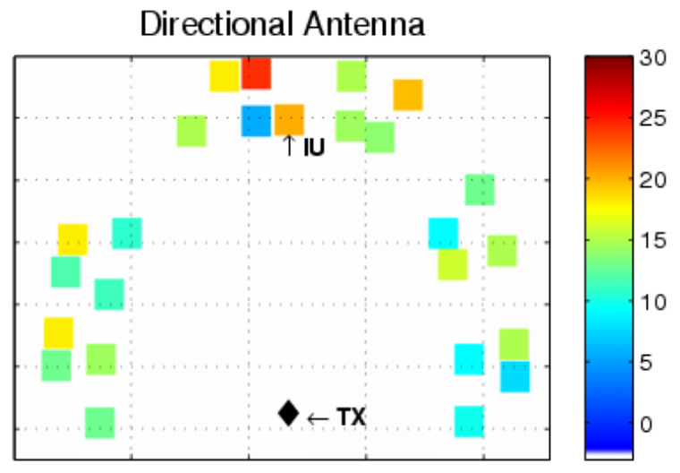
Nomadic Eavesdropper

Slide 36
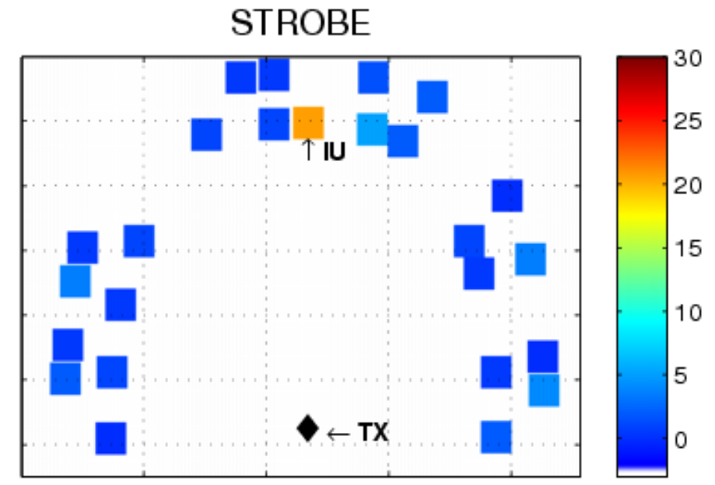
Nomadic Eavesdropper

Slide 37
Conclusion
Verified STROBE’s performance in indoor environments
  Functionality does not degrade with relative eavesdropper position
STROBE’s performance is due to indoor multi-path effects
  Verified by outdoor testing
STROBE successfully withstands attacks from a nomadic eavesdropper
On average, STROBE provides the IU with a 15 dB stronger signal than the eavesdropper

