Slide 1



Argos
Practical Many-Antenna Base Stations
Clayton W. Shepard
Hang Yu, Narendra Anand, Li Erran Li,
Thomas Marzetta, Richard Yang, Lin Zhong

Slide 2
Motivation
Spectrum is scarce
Hardware is cheap
Notes:
Looking at wireless today, we see that
-Spectrum is scarce, and demand is growing exponentially.
-Hardware is cheap, and getting cheaper.

Slide 3
MU-MIMO Theory
More antennas = more capacity
  Multiplexing
  Power
  Orthogonality

Slide 4


Data 2
Data 3
Data 1
Data 4
Data 6
Data 5

Slide 5
Why not?
  Nothing scales with the number of antennas
  CSI Acquisition
  Computation
  Data Transportation

Slide 6
Background: Beamforming
Destructive Interference
=
Constructive Interference
?
=

Slide 7
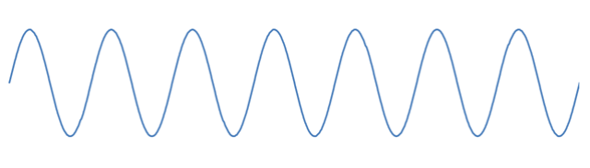
Background: Channel Estimation
Due to environment and terminal
mobility estimation has to occur
quickly and periodically
Measured channels are not
reciprocal due to differences
in the Tx and Rx hardware!
Path Effects (Walls)
The CSI is then calculated at the
terminal and sent back to the BS
Align the phases at the receiver to
ensure constructive interference
For uplink, send a pilot from the
terminal then calculate CSI at BS
Uplink?
A pilot is sent from each BS antenna
BS
Tx
Rx
+
=
Tx
Tx
Rx
+
Rx
Tx
Rx

Slide 8
Background: Multi-User Beamforming
Data 1

Slide 9
Background: Multi-User Beamforming
Data 2

Slide 10
Background: Null Steering
Null
Null
Data 1
Null
Null
Null

Slide 11
Background: Null Steering
Data 2
Null
Null
Null
Null
Null

Slide 12
Background: Multi-User Beamforming
Data 2
Data 3
Data 1
Data 4
Data 6
Data 5

Slide 13
Background: Scaling Up
Data 1

Slide 14
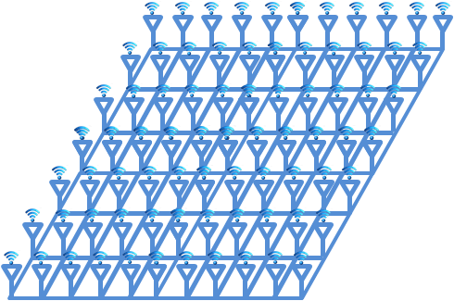
Background: Scaling Up
Data 1

Slide 15
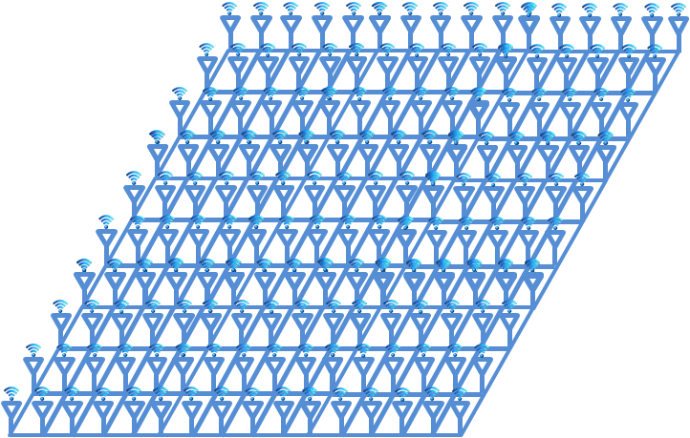
Background: Scaling Up
Data 1

Slide 16
Background: Scaling Up
Data 2
Data 3
Data 1
Data 4
Data 5
Data 6

Slide 17
Background: Linear Precoding
Calculate beamweights
  Every antenna has a beamweight for each terminal
Multiply symbols by weight, then add together:

Slide 18
Recap
Acquire CSI
Calculate Weights
Apply Linear Precoding

Slide 19
Scalability Challenges
Acquire CSI
  M+K pilots, then M•K feedback
Calculate Weights
  O(M•K²), non-parallelizable, centralized data
Apply Linear Precoding
  O(M•K), then O(M) data transport

Slide 20
Argos’ Solutions
Acquire CSI
  New reciprocal calibration method
Calculate Weights
  Novel distributed beamforming method
Apply Linear Precoding
  Carefully designed scalable architecture
O(M•K) → O(K)
O(M•K²) → O(K)*
O(M•K) → O(K) *

Slide 21
Solutions
Reciprocal Calibration
Distributed Beamforming
Scalable Architecture

Slide 22
Channel Reciprocity
Pilot transmission source?
  Basestation
  Terminal
Base station pilot transmission
  Requires feedback
  M pilots (M ≥ K)
Terminal pilot transmission
  No feedback
  K pilots

Slide 23
Channel Reciprocity
Tx_{A}+Rx_{C}-Tx_{C}-Rx_{A}
Tx_{A}
Tx_{A}+C+Rx_{C}-Tx_{C}-C-Rx_{A}
Tx/Rx Chain differences require calibration
Can we do this without terminal involvement?
Rx_{A}
Tx_{C}
Rx_{C}
Tx_{B}
Tx_{B}+Rx_{C}-Tx_{C}-Rx_{B}
Rx_{B}
Channel Estimation
Transmission

Slide 24
Key Idea
=
Any constant phase shift results
in same beampattern!
=

Slide 25
Channel Reciprocity
Tx_{A}+Rx_{C}-Tx_{C}-Rx_{A}
Tx_{A}
Tx_{A}-Rx_{A}
Rx_{A}
Tx_{C}
Rx_{C}
Tx_{B}-Rx_{B}
Tx_{B}
Tx_{B}+Rx_{C}-Tx_{C}-Rx_{B}
Rx_{B}
Channel Estimation
Transmission

Slide 26
Internal Reciprocal Calibration
Find phase difference between A and B
Tx from A:
  Phase offset = Tx_{A}-Rx_{A}
Tx from B:
  (Tx_{B}-Rx_{B} )
Tx_{A}
Tx_{A}+C+Rx_{B}
Tx_{B}+C+Rx_{A}
Rx_{A}
Tx_{A}+Rx_{B} - Tx_{B}-Rx_{A}
Tx_{B}
  add phase difference
  + (Tx_{A}+Rx_{B} - Tx_{B}-Rx_{A}) =
Rx_{B}
Tx_{A}-Rx_{A}

Slide 27
Solutions
Reciprocal Calibration
Distributed Beamforming
Scalable Architecture

Slide 28
Problems with Existing Methods
Central data dependency
Transport latency causes capacity loss
Can not scale
  Becomes exorbitantly expensive then infeasible

Slide 29

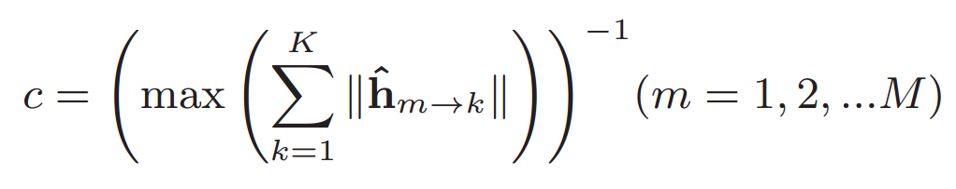
Conjugate Beamforming
Requires global power scaling by constant:
Where, e.g.:
This creates a central data dependency

Slide 30
Conjugate Beamforming Power
Bad Channel
BS
Good Channel
Okay Channel

Slide 31
Conjugate Beamforming Power
Low Power
BS
High Power
Normal Power

Slide 32
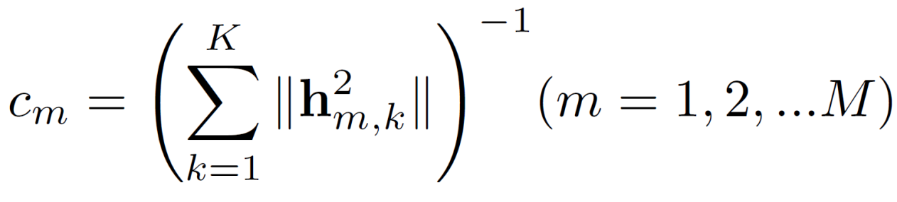
Distributed Conjugate Beamforming
Scale power at each antenna:
Maximizes utilization of every radio
  More appropriate for real-world deployments
Quickly approaches optimal as K increases
  Channels are independent and uncorrelated

Slide 33
Distributed Conjugate Beamforming
High Power
BS
High Power
High Power

Slide 34
Solutions
Reciprocal Calibration
Distributed Beamforming
Scalable Architecture

Slide 35
Architectural Design Goals
?
Scalable
  Support thousands of BS antennas
Cost-effective
  Cost scales linearly with # of antennas
Data
…

Slide 36
Linear Precoding
…
K
…
…
K
…
K
M
…
K

Slide 37
Scalable Linear Precoding
…
K
…
…
K
…
K
M
…
K

Slide 38
Scalable Linear Precoding
Common Databus!
…
K
…
…
K
…
K
M
…
K

Slide 39
MUBF Linear Precoding: Uplink
…
K
…
…
K
…
K
M
…
K

Slide 40
Scalable Linear Precoding
Constant
Bandwidth!
…
K
…
…
K
…
K
M
…
K

Slide 41
Partition Ramifications
CSI and weights are computed and applied locally at each BS radio
  No overhead for additional BS radios
No central data dependency
  No latency from data transport
  Constant data rate common bus (no switching!)
Unlimited scalability!

Slide 42
How do we design it?
Daisy-chain (series)
  Unreliable
  Large end to end latency
Token-ring | Interconnected
  Not amenable to linear precoding
  Variable Latency
  Routing overhead
…
Flat structure
  Unscalable
  Expensive, with large fixed cost
…
…

Slide 43
Solution: Argos Architecture
Central Controller
Data Backhaul
…
Argos Hub
Argos Hub
Argos Hub
…
Module
Module
Module
Module
Module
…
…
Module
Radio
Radio
Radio

Slide 44
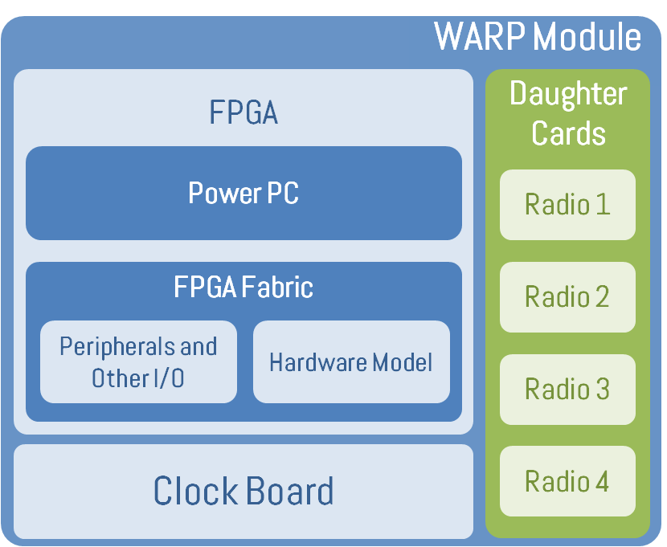
Argos Implementation
WARP Module
…
…
Central Controller
(PC with MATLAB)
Central Controller
FPGA
Daughter Cards
WARP Module
WARP Module
FPGA
Daughter Cards
Ethernet
Power PC
FPGA
Daughter Cards
Radio 1
Argos Hub
Power PC
Argos Hub
Power PC
Radio 1
FPGA Fabric
Radio 1
Radio 2
Ethernet
Peripherals and Other I/O
Hardware Model
Argos
Interconnect
FPGA Fabric
Radio 2
Argos
Interconnect
Radio 3
Module
FPGA Fabric
Radio 2
Peripherals and Other I/O
Hardware Model
Sync Pulse
Peripherals and Other I/O
Hardware Model
Radio 3
Module
Clock Board
Radio 4
Radio 3
…
Clock Board
Radio 4
Clock Distribution
Clock Board
Radio 4
…
Module
16

Slide 45
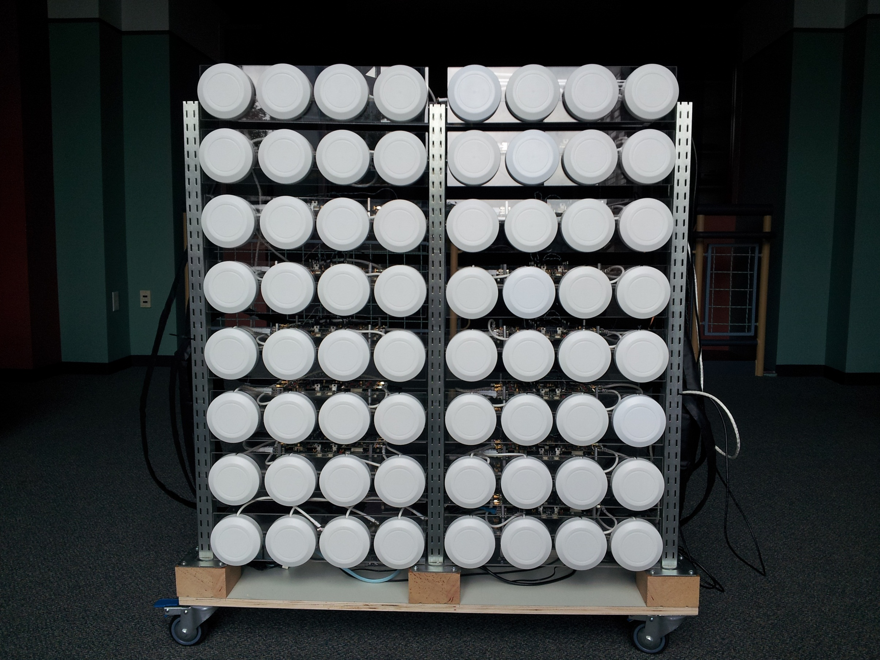

Slide 46
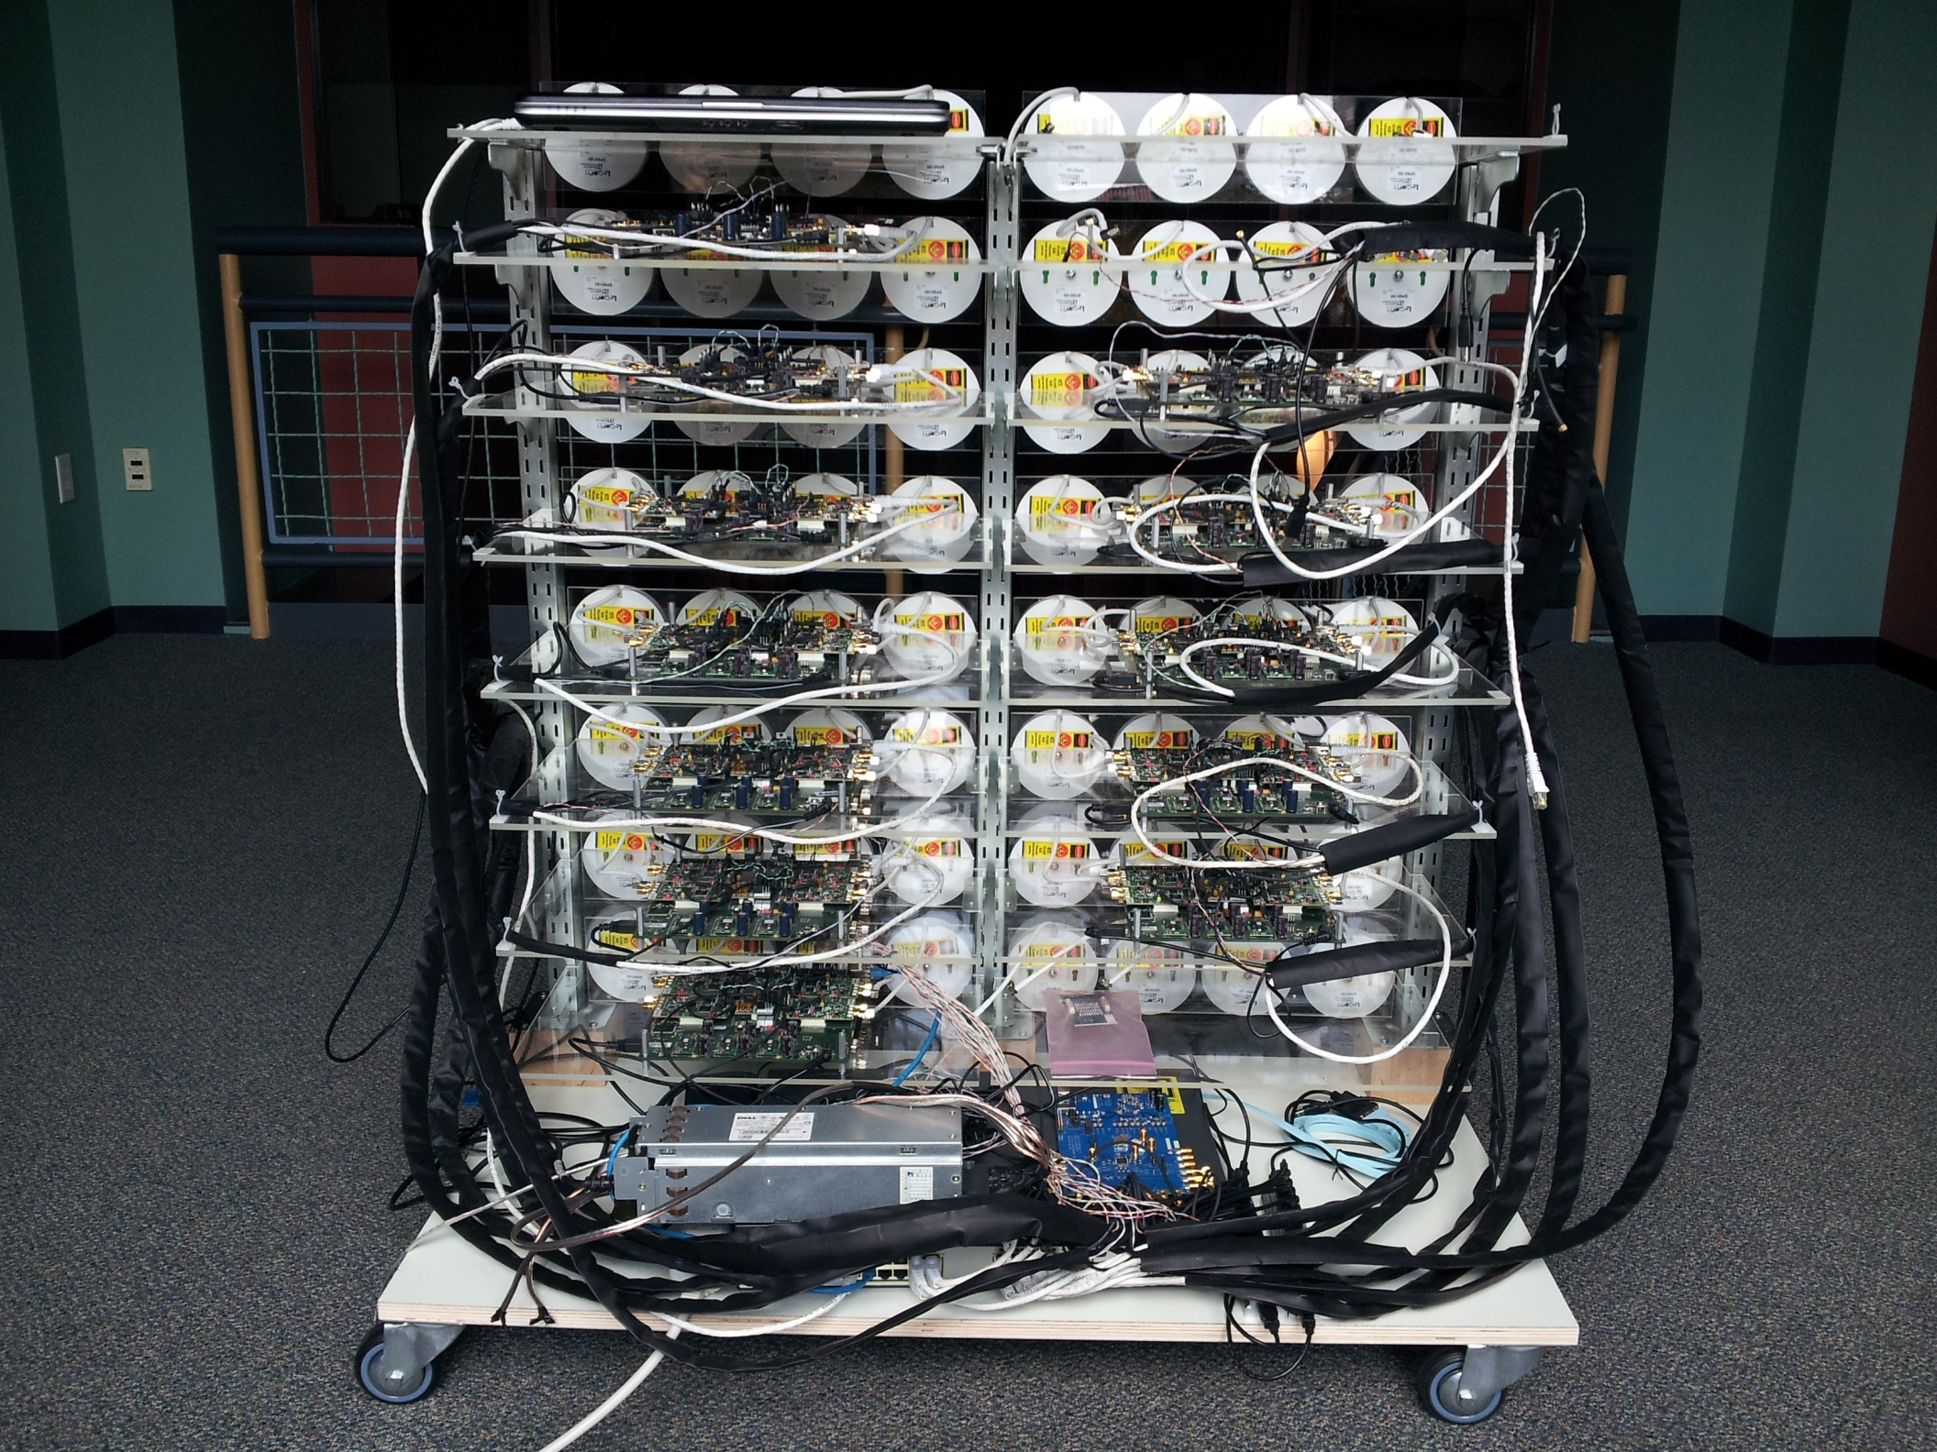
Central Controller
WARP Modules
Argos Interconnects
Sync
Distribution
Clock Distribution
Argos Hub
Ethernet Switch

Slide 47
System Performance

Slide 48
Linear Gains as # BS Ant. Increases
Capacity vs. M, with K = 15

Slide 49
Linear Gains as # of Users Increases
Capacity vs. K, with M = 64

Slide 50
Scaling # of Users with 16 BS Ant.
Capacity vs. K, with M = 16

Slide 51
Zero-forcing is not always better!
Capacity vs. K, with M = 16 | Low Power

Slide 52
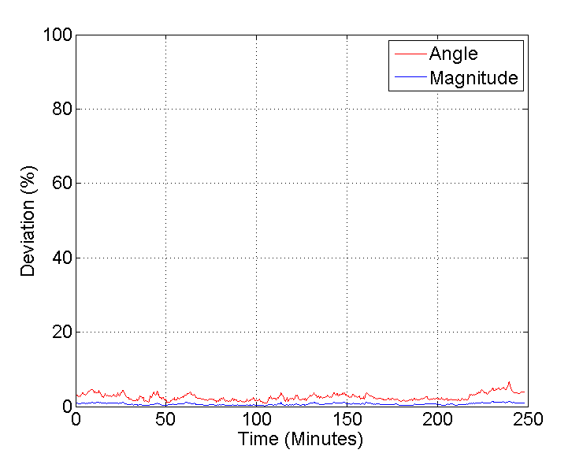
Calibration is stable for hours!

Slide 53
Conclusion
First many-antenna beamforming platform
  Real-world demonstration of manyfold capacity increase
Devised novel techniques and architecture
  Unlimited Scalability
http://argos.rice.edu
http://recg.rice.edu

