Slide 1


STROBE
Actively Securing Wireless Communications using Zero-Forcing Beamforming
Narendra Anand
Rice University
Sung-Ju Lee
HP Labs
Edward Knightly
Rice University
Notes:
Motivate
Prior work/limitations to existing work
This is coop, this is what is out there, this is what Im missing, this is what I do
Contributiuons
Experiments – methods, experiments, conclusion

Slide 2

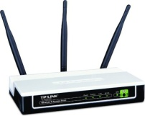
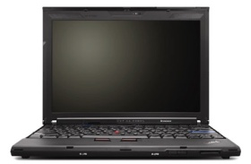
Motivation
AP
Indoors (eg. Coffee Shop)

Slide 3
Motivation
AP
IU
Indoors (eg. Coffee Shop)

Slide 4
Motivation
E
E
AP
IU
Indoors (eg. Coffee Shop)

Slide 5
Motivation
E
E
AP
IU
Indoors (eg. Coffee Shop)

Slide 6
Motivation
E
E
AP
WEP/WPA
IU
Indoors (eg. Coffee Shop)

Slide 7
Motivation
Omnidirectional
E
E
AP
WEP/WPA
IU
Indoors (eg. Coffee Shop)

Slide 8

Motivation
Omnidirectional
E
E
AP
WEP/WPA
IU
Indoors (eg. Coffee Shop)

Slide 9
Motivation
Omnidirectional
E
E
AP
WEP/WPA
IU
Indoors (eg. Coffee Shop)

Slide 10
Motivation
Omnidirectional
E
Problem:
Omnidirectional Transmissions broadcast signal energy everywhere allowing any user in range to overhear the transmission.
E
AP
WEP/WPA
IU
Indoors (eg. Coffee Shop)

Slide 11
Motivation
E
E
AP
IU
Indoors (eg. Coffee Shop)

Slide 12
Motivation
Potential Solution:
Keep signal away from E with
Single-User Beamforming or
Directional Antenna
E
E
AP
IU
Indoors (eg. Coffee Shop)

Slide 13
Motivation
Potential Solution:
Keep signal away from E with
Single-User Beamforming or
Directional Antenna
E
E
AP
IU
Indoors (eg. Coffee Shop)

Slide 14
Motivation
Potential Solution:
Keep signal away from E with
Single-User Beamforming or
Directional Antenna
E
E
AP
IU
**Beampatterns for
Illustration purposes only.
Indoors (eg. Coffee Shop)

Slide 15
Motivation
Potential Solution:
Keep signal away from E with
Single-User Beamforming or
Directional Antenna
E
AP
IU
**Beampatterns for
Illustration purposes only.
E
LOS
Indoors (eg. Coffee Shop)

Slide 16
Motivation
Potential Solution:
Keep signal away from E with
Single-User Beamforming or
Directional Antenna
E
Multi-Path
AP
IU
**Beampatterns for
Illustration purposes only.
E
LOS
Indoors (eg. Coffee Shop)

Slide 17
Motivation
Potential Solution:
Keep signal away from E with
Single-User Beamforming or
Directional Antenna
E
Multi-Path
Problem:
Single Target directional methods are agnostic to user locations other than IU. Multi-path effects and knowledge of IU location can be used to compromise the transmission.
AP
IU
**Beampatterns for
Illustration purposes only.
E
LOS
Indoors (eg. Coffee Shop)

Slide 18
Solution
Notes:
Mitigate effects of inherent broadcast nature of wireless communication

Slide 19
Solution
Problem: How can we reliably keep eavesdroppers from decoding the IU’s data?
Notes:
Mitigate effects of inherent broadcast nature of wireless communication

Slide 20
Solution
Problem: How can we reliably keep eavesdroppers from decoding the IU’s data?
Solution: Simultaneously Blind (actively interfere) Eavesdroppers while serving the IU.
Notes:
Mitigate effects of inherent broadcast nature of wireless communication

Slide 21
Solution
Problem: How can we reliably keep eavesdroppers from decoding the IU’s data?
Solution: Simultaneously Blind (actively interfere) Eavesdroppers while serving the IU.
How: By leveraging the multi-stream/user abilities of recent multi-antenna technologies (802.11n/ac)
Notes:
Mitigate effects of inherent broadcast nature of wireless communication

Slide 22
Solution
Problem: How can we reliably keep eavesdroppers from decoding the IU’s data?
Solution: Simultaneously Blind (actively interfere) Eavesdroppers while serving the IU.
How: By leveraging the multi-stream/user abilities of recent multi-antenna technologies (802.11n/ac)
  AP creates simultaneous streams
Notes:
Mitigate effects of inherent broadcast nature of wireless communication

Slide 23
Solution
Problem: How can we reliably keep eavesdroppers from decoding the IU’s data?
Solution: Simultaneously Blind (actively interfere) Eavesdroppers while serving the IU.
How: By leveraging the multi-stream/user abilities of recent multi-antenna technologies (802.11n/ac)
  AP creates simultaneous streams
  Use one for IU
Notes:
Mitigate effects of inherent broadcast nature of wireless communication

Slide 24
Solution
Problem: How can we reliably keep eavesdroppers from decoding the IU’s data?
Solution: Simultaneously Blind (actively interfere) Eavesdroppers while serving the IU.
How: By leveraging the multi-stream/user abilities of recent multi-antenna technologies (802.11n/ac)
  AP creates simultaneous streams
  Use one for IU
  Use remaining to Blind Eavesdroppers
Notes:
Mitigate effects of inherent broadcast nature of wireless communication

Slide 25
Solution
Problem: How can we reliably keep eavesdroppers from decoding the IU’s data?
Solution: Simultaneously Blind (actively interfere) Eavesdroppers while serving the IU.
How: By leveraging the multi-stream/user abilities of recent multi-antenna technologies (802.11n/ac)
  AP creates simultaneous streams
  Use one for IU
  Use remaining to Blind Eavesdroppers
S
TR
O
B
E
Notes:
Mitigate effects of inherent broadcast nature of wireless communication

Slide 26
Solution
Problem: How can we reliably keep eavesdroppers from decoding the IU’s data?
Solution: Simultaneously Blind (actively interfere) Eavesdroppers while serving the IU.
How: By leveraging the multi-stream/user abilities of recent multi-antenna technologies (802.11n/ac)
  AP creates simultaneous streams
  Use one for IU
  Use remaining to Blind Eavesdroppers
S
TR
O
B
E
imultaneous
ansmissions with
Notes:
Mitigate effects of inherent broadcast nature of wireless communication

Slide 27
Solution
Problem: How can we reliably keep eavesdroppers from decoding the IU’s data?
Solution: Simultaneously Blind (actively interfere) Eavesdroppers while serving the IU.
How: By leveraging the multi-stream/user abilities of recent multi-antenna technologies (802.11n/ac)
  AP creates simultaneous streams
  Use one for IU
  Use remaining to Blind Eavesdroppers
S
TR
O
B
E
imultaneous
ansmissions with
rthogonally
linded
avesdroppers
Notes:
Mitigate effects of inherent broadcast nature of wireless communication

Slide 28
STROBE Overview
STROBE
E
AP
IU
**Beampatterns for
Illustration purposes only.
E
Indoors (eg. Coffee Shop)

Slide 29
STROBE Overview
STROBE
E
Blinding
Streams
AP
IU
**Beampatterns for
Illustration purposes only.
E
Indoors (eg. Coffee Shop)

Slide 30
STROBE Overview
STROBE
E
Blinding
Streams
AP
IU
**Beampatterns for
Illustration purposes only.
E
Indoors (eg. Coffee Shop)

Slide 31
STROBE Overview
STROBE
E
STROBE:
Blinding
Streams
AP
IU
**Beampatterns for
Illustration purposes only.
E
Indoors (eg. Coffee Shop)

Slide 32
STROBE Overview
STROBE
E
STROBE:
Leverages existing multi-stream capabilities
Blinding
Streams
AP
IU
**Beampatterns for
Illustration purposes only.
E
Indoors (eg. Coffee Shop)

Slide 33
STROBE Overview
STROBE
E
STROBE:
Leverages existing multi-stream capabilities
Cross-layer approach but requires minimal hardware modification (11n/ac compatible)
Blinding
Streams
AP
IU
**Beampatterns for
Illustration purposes only.
E
Indoors (eg. Coffee Shop)

Slide 34
STROBE Overview
STROBE
E
STROBE:
Leverages existing multi-stream capabilities
Cross-layer approach but requires minimal hardware modification (11n/ac compatible)
Coexists with existing security protocols
Blinding
Streams
AP
IU
**Beampatterns for
Illustration purposes only.
E
Indoors (eg. Coffee Shop)

Slide 35
Background
Zero Forcing Beamforming (ZFBF)
Assume 4 Tx Antennas and 3 single-antenna receivers
hk's – H for each recv.
Calculate weights with pseudo-inverse
wj's
“Zero Interference” Condition
Notes:
***Single user – Hconj/Norm(H)
Zero Interference
This is a mathematical representation of the zero-interference condition—ensures that if I have weights for R1, the resulting gain of stream 1 at R2 and R3 is zero.
Now, lets move on to how we implemented this in hardware.

Slide 36
Orthogonal Blinding

Slide 37
Orthogonal Blinding
Limited Channel State Information (CSI)

Slide 38
Orthogonal Blinding
Limited Channel State Information (CSI)
  Only know IU’s channel (h vector)

Slide 39
Orthogonal Blinding
Limited Channel State Information (CSI)
  Only know IU’s channel (h vector)
  Generate orthogonal h vectors using Gram-Schmidt

Slide 40
Orthogonal Blinding
Limited Channel State Information (CSI)
  Only know IU’s channel (h vector)
  Generate orthogonal h vectors using Gram-Schmidt
  New H matrix is unitary (pseudo-inverse is complex conjugate transpose)

Slide 41
Orthogonal Blinding
Limited Channel State Information (CSI)
  Only know IU’s channel (h vector)
  Generate orthogonal h vectors using Gram-Schmidt
  New H matrix is unitary (pseudo-inverse is complex conjugate transpose)
  Intended user’s steering weight is equivalent to SUBF

Slide 42
Orthogonal Blinding
Limited Channel State Information (CSI)
  Only know IU’s channel (h vector)
  Generate orthogonal h vectors using Gram-Schmidt
  New H matrix is unitary (pseudo-inverse is complex conjugate transpose)
  Intended user’s steering weight is equivalent to SUBF
Ease of implementation/integration

Slide 43
Orthogonal Blinding
Limited Channel State Information (CSI)
  Only know IU’s channel (h vector)
  Generate orthogonal h vectors using Gram-Schmidt
  New H matrix is unitary (pseudo-inverse is complex conjugate transpose)
  Intended user’s steering weight is equivalent to SUBF
Ease of implementation/integration
  ZFBF systems can use QR-decomposition (followed by backsubstitution) to calculate pseudo-inverse

Slide 44
Orthogonal Blinding
Limited Channel State Information (CSI)
  Only know IU’s channel (h vector)
  Generate orthogonal h vectors using Gram-Schmidt
  New H matrix is unitary (pseudo-inverse is complex conjugate transpose)
  Intended user’s steering weight is equivalent to SUBF
Ease of implementation/integration
  ZFBF systems can use QR-decomposition (followed by backsubstitution) to calculate pseudo-inverse
  QR is used to implement Gram-Schmidt (existing silicon can be re-used for STROBE)

Slide 45
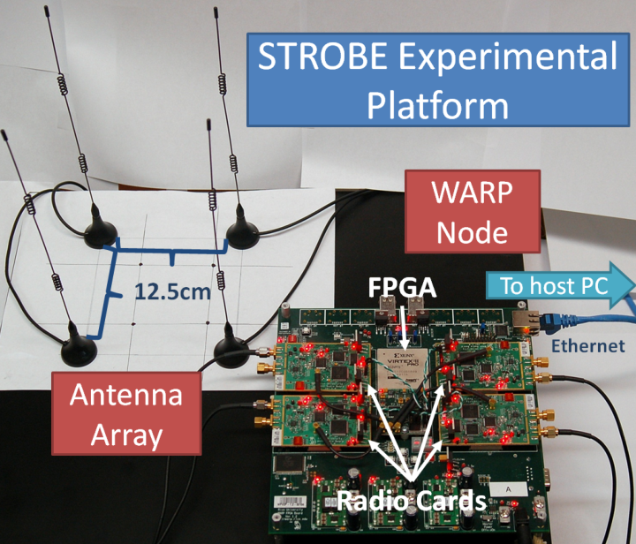
Experimental Methodology
STROBE implemented in WARPLab using ZFBF testbed developed in:
  E. Aryafar, N. Anand, T. Salonidis, and E. Knightly. Design and experimental evaluation of multi-user beamforming in Wireless LANs. In Proc. ACM MobiCom, Chicago, Illinois, September 2010
Performance Metric: Received signal strength (dB)
Notes:
WARPLab – interfaces FPGA based WARP platform with MATLAB allowing for rapid prototyping of PHY layer algorithms

Slide 46
Experimental Methodology
Scheme Comparisons
Non-Directional
OMNI
(Omni-directional)
Single-Target Directional
SUBF
(Single-User Beamforming)
DA
(Directional Antenna)
Multi-Target Directional
CE
(Cooperating Eavesdropper)
STROBE

Slide 47
Experimental Methodology
Scheme Comparisons
Non-Directional
OMNI
(Omni-directional)
Single-Target Directional
SUBF
(Single-User Beamforming)
DA
(Directional Antenna)
Multi-Target Directional
CE
(Cooperating Eavesdropper)
STROBE
    Unrealistic scenario in which Eavesdroppers provide AP with their CSI to be precisely blinded.

Slide 48
Experimental Methodology
Scheme Comparisons
Non-Directional
OMNI
(Omni-directional)
Single-Target Directional
SUBF
(Single-User Beamforming)
DA
(Directional Antenna)
Multi-Target Directional
CE
(Cooperating Eavesdropper)
STROBE
    Fairness
      Net transmit power equivalent for all schemes
Notes:
Omni and DA get X power, 1 antenna
SUBF, X power split across 4 antennas
CE and STROBE X power split across 4 streams -> Weight equivalent for Strobe and SUBF so we expect a 4x SINR decrease (6dB) at IU for

Slide 49
Experiments
Baseline
How does STROBE perform in a typical, indoor, wireless scenario?
Relative Eavesdropper location
How does STROBE cope with varying eavesdropper proximity to IU?
How does STROBE handle eavesdroppers in-line with IU?
Verifying necessity of multi-path (outdoor)
How dependent is STROBE on multi-path scattering characteristic of indoor WLAN environments?
Nomadic Eavesdropper
Is it possible for an eavesdropper to exhaustively traverse an environment to find a location where STROBE’s performance diminishes?
Notes:
Functions as outline

Slide 50
Experiments
Baseline
How does STROBE perform in a typical, indoor, wireless scenario?
Relative Eavesdropper location
How does STROBE cope with varying eavesdropper proximity to IU?
How does STROBE handle eavesdroppers in-line with IU?
Verifying necessity of multi-path (outdoor)
How dependent is STROBE on multi-path scattering characteristic of indoor WLAN environments?
Nomadic Eavesdropper
Is it possible for an eavesdropper to exhaustively traverse an environment to find a location where STROBE’s performance diminishes?
Notes:
Functions as outline

Slide 51
Experiments
Baseline
How does STROBE perform in a typical, indoor, wireless scenario?
Relative Eavesdropper location
How does STROBE cope with varying eavesdropper proximity to IU?
How does STROBE handle eavesdroppers in-line with IU?
Verifying necessity of multi-path (outdoor)
How dependent is STROBE on multi-path scattering characteristic of indoor WLAN environments?
Nomadic Eavesdropper
Is it possible for an eavesdropper to exhaustively traverse an environment to find a location where STROBE’s performance diminishes?
Notes:
Functions as outline

Slide 52
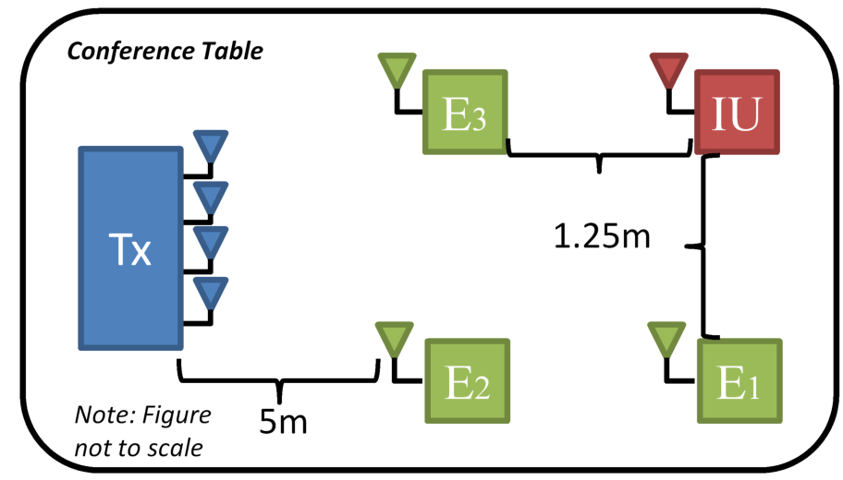
Baseline

Slide 53
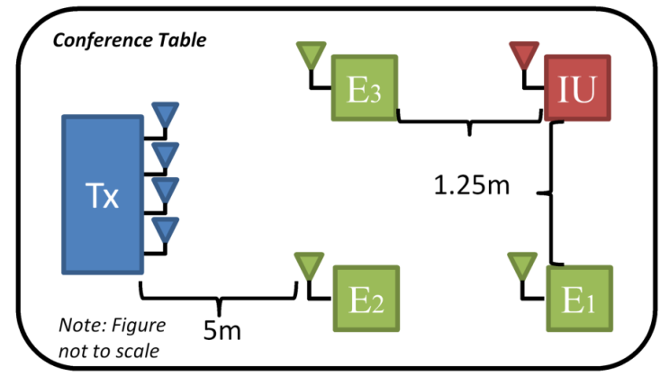
Baseline
Notes:
WORST CASE!!
Omni – Eavesdroppers got higher SINR, IU got lower bc of distance (presumably), E1 and E2 got similar evern though E1 is farther (chair position, wall position etc MULTIPATH), why else is there an industry in mapping out SINRs in building for AP placement
SUBF – Infact, E3 received higher SINR than IU!
STROBE – remember, steering weight to IU is equivalent to SUBF
CE – cost of blinding is to IU’s received SINR

Slide 54
Baseline
Notes:
WORST CASE!!
Omni – Eavesdroppers got higher SINR, IU got lower bc of distance (presumably), E1 and E2 got similar evern though E1 is farther (chair position, wall position etc MULTIPATH), why else is there an industry in mapping out SINRs in building for AP placement
SUBF – Infact, E3 received higher SINR than IU!
STROBE – remember, steering weight to IU is equivalent to SUBF
CE – cost of blinding is to IU’s received SINR

Slide 55
Baseline
Omni - In range clients receive transmission with high SINR, distance from transmitter is not always a good predictor
Notes:
WORST CASE!!
Omni – Eavesdroppers got higher SINR, IU got lower bc of distance (presumably), E1 and E2 got similar evern though E1 is farther (chair position, wall position etc MULTIPATH), why else is there an industry in mapping out SINRs in building for AP placement
SUBF – Infact, E3 received higher SINR than IU!
STROBE – remember, steering weight to IU is equivalent to SUBF
CE – cost of blinding is to IU’s received SINR

Slide 56
Baseline
Omni - In range clients receive transmission with high SINR, distance from transmitter is not always a good predictor
Notes:
WORST CASE!!
Omni – Eavesdroppers got higher SINR, IU got lower bc of distance (presumably), E1 and E2 got similar evern though E1 is farther (chair position, wall position etc MULTIPATH), why else is there an industry in mapping out SINRs in building for AP placement
SUBF – Infact, E3 received higher SINR than IU!
STROBE – remember, steering weight to IU is equivalent to SUBF
CE – cost of blinding is to IU’s received SINR

Slide 57
Baseline
Omni - In range clients receive transmission with high SINR, distance from transmitter is not always a good predictor
SUBF – Maximizes SINR at IU but agnostic to signal energy afterwards
Notes:
WORST CASE!!
Omni – Eavesdroppers got higher SINR, IU got lower bc of distance (presumably), E1 and E2 got similar evern though E1 is farther (chair position, wall position etc MULTIPATH), why else is there an industry in mapping out SINRs in building for AP placement
SUBF – Infact, E3 received higher SINR than IU!
STROBE – remember, steering weight to IU is equivalent to SUBF
CE – cost of blinding is to IU’s received SINR

Slide 58
Baseline
Omni - In range clients receive transmission with high SINR, distance from transmitter is not always a good predictor
SUBF – Maximizes SINR at IU but agnostic to signal energy afterwards
Notes:
WORST CASE!!
Omni – Eavesdroppers got higher SINR, IU got lower bc of distance (presumably), E1 and E2 got similar evern though E1 is farther (chair position, wall position etc MULTIPATH), why else is there an industry in mapping out SINRs in building for AP placement
SUBF – Infact, E3 received higher SINR than IU!
STROBE – remember, steering weight to IU is equivalent to SUBF
CE – cost of blinding is to IU’s received SINR

Slide 59
Baseline
Omni - In range clients receive transmission with high SINR, distance from transmitter is not always a good predictor
SUBF – Maximizes SINR at IU but agnostic to signal energy afterwards
STROBE – Serves IU with high SINR, restricts E SINR to < 4dB
Notes:
WORST CASE!!
Omni – Eavesdroppers got higher SINR, IU got lower bc of distance (presumably), E1 and E2 got similar evern though E1 is farther (chair position, wall position etc MULTIPATH), why else is there an industry in mapping out SINRs in building for AP placement
SUBF – Infact, E3 received higher SINR than IU!
STROBE – remember, steering weight to IU is equivalent to SUBF
CE – cost of blinding is to IU’s received SINR

Slide 60
Baseline
Omni - In range clients receive transmission with high SINR, distance from transmitter is not always a good predictor
SUBF – Maximizes SINR at IU but agnostic to signal energy afterwards
STROBE – Serves IU with high SINR, restricts E SINR to < 4dB
Notes:
WORST CASE!!
Omni – Eavesdroppers got higher SINR, IU got lower bc of distance (presumably), E1 and E2 got similar evern though E1 is farther (chair position, wall position etc MULTIPATH), why else is there an industry in mapping out SINRs in building for AP placement
SUBF – Infact, E3 received higher SINR than IU!
STROBE – remember, steering weight to IU is equivalent to SUBF
CE – cost of blinding is to IU’s received SINR

Slide 61
Baseline
Omni - In range clients receive transmission with high SINR, distance from transmitter is not always a good predictor
SUBF – Maximizes SINR at IU but agnostic to signal energy afterwards
STROBE – Serves IU with high SINR, restricts E SINR to < 4dB
CE – Precise blinding of E comes at the cost of SINR served to IU
Notes:
WORST CASE!!
Omni – Eavesdroppers got higher SINR, IU got lower bc of distance (presumably), E1 and E2 got similar evern though E1 is farther (chair position, wall position etc MULTIPATH), why else is there an industry in mapping out SINRs in building for AP placement
SUBF – Infact, E3 received higher SINR than IU!
STROBE – remember, steering weight to IU is equivalent to SUBF
CE – cost of blinding is to IU’s received SINR

Slide 62
Experiments
Baseline
How does STROBE perform in a typical, indoor, wireless scenario?
Relative Eavesdropper location
How does STROBE cope with varying eavesdropper proximity to IU?
How does STROBE handle eavesdroppers in-line with IU?
Verifying necessity of multi-path (outdoor)
How dependent is STROBE on multi-path scattering characteristic of indoor WLAN environments?
Nomadic Eavesdropper
Is it possible for an eavesdropper to exhaustively traverse an environment to find a location where STROBE’s performance diminishes?
Notes:
Functions as outline

Slide 63
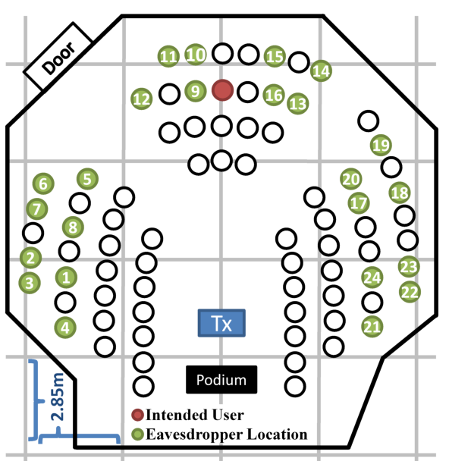
Nomadic Eavesdropper
Notes:
CE -> DA

Slide 64
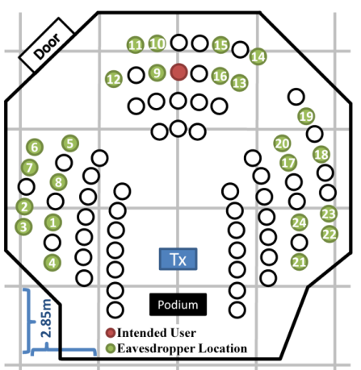
Nomadic Eavesdropper
Omni
(dB)
Notes:
Results here all mimic the previous findings—just at a larger scale (i.e. multipath randomness, directionality etc)

Slide 65
Nomadic Eavesdropper
SUBF
Omni
(dB)
Notes:
Results here all mimic the previous findings—just at a larger scale (i.e. multipath randomness, directionality etc)

Slide 66
Nomadic Eavesdropper
DA
Omni
SUBF
(dB)
Notes:
Results here all mimic the previous findings—just at a larger scale (i.e. multipath randomness, directionality etc)

Slide 67
Nomadic Eavesdropper
STROBE
Omni
SUBF
DA
(dB)
Notes:
Results here all mimic the previous findings—just at a larger scale (i.e. multipath randomness, directionality etc)

Slide 68
Conclusions
Verified STROBE’s performance in indoor environments
  Functionality does not degrade with relative eavesdropper position
STROBE’s performance depends on indoor multi-path effects
  Verified by outdoor testing
STROBE successfully withstands attacks from a nomadic eavesdropper
On average, STROBE provides the IU with a 15 dB stronger signal than the eavesdropper

Slide 69
All Experiments

Slide 70
Orthogonal Blinding

Slide 71
Orthogonal Blinding
Limited Channel State Information (CSI)

Slide 72
Orthogonal Blinding
Limited Channel State Information (CSI)
  Only know IU’s channel (h vector)

Slide 73
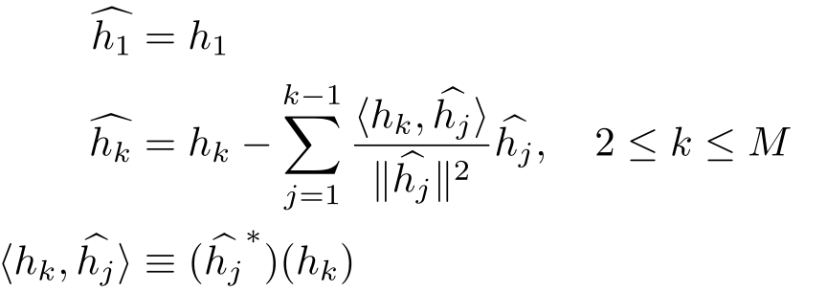
Orthogonal Blinding
Limited Channel State Information (CSI)
  Only know IU’s channel (h vector)
  Generate orthogonal h vectors using Gram-Schmidt Orthonormalization process

Slide 74
Orthogonal Blinding
Limited Channel State Information (CSI)
  Only know IU’s channel (h vector)
  Generate orthogonal h vectors using Gram-Schmidt Orthonormalization process
  New H matrix is unitary (pseudo-inverse is complex conjugate transpose)

Slide 75
Orthogonal Blinding
Limited Channel State Information (CSI)
  Only know IU’s channel (h vector)
  Generate orthogonal h vectors using Gram-Schmidt Orthonormalization process
  New H matrix is unitary (pseudo-inverse is complex conjugate transpose)
  Intended user’s steering weight is equivalent to SUBF

Slide 76
Orthogonal Blinding
Limited Channel State Information (CSI)
  Only know IU’s channel (h vector)
  Generate orthogonal h vectors using Gram-Schmidt Orthonormalization process
  New H matrix is unitary (pseudo-inverse is complex conjugate transpose)
  Intended user’s steering weight is equivalent to SUBF
Ease of implementation/integration

Slide 77
Orthogonal Blinding
Limited Channel State Information (CSI)
  Only know IU’s channel (h vector)
  Generate orthogonal h vectors using Gram-Schmidt Orthonormalization process
  New H matrix is unitary (pseudo-inverse is complex conjugate transpose)
  Intended user’s steering weight is equivalent to SUBF
Ease of implementation/integration
  ZFBF systems can use QR-decomposition (followed by backsubstitution) to calculate pseudo-inverse

Slide 78
Orthogonal Blinding
Limited Channel State Information (CSI)
  Only know IU’s channel (h vector)
  Generate orthogonal h vectors using Gram-Schmidt Orthonormalization process
  New H matrix is unitary (pseudo-inverse is complex conjugate transpose)
  Intended user’s steering weight is equivalent to SUBF
Ease of implementation/integration
  ZFBF systems can use QR-decomposition (followed by backsubstitution) to calculate pseudo-inverse
  QR is used to implement Gram-Schmidt (existing silicon can be re-used for STROBE)

Slide 79
Experiments
Baseline
How does STROBE perform in a typical, indoor, wireless scenario?
Relative Eavesdropper location
How does STROBE cope with varying eavesdropper proximity to IU?
How does STROBE handle eavesdroppers in-line with IU?
Verifying necessity of multi-path (outdoor)
How dependent is STROBE on multi-path scattering characteristic of indoor WLAN environments?
Nomadic Eavesdropper
Is it possible for an eavesdropper to exhaustively traverse an environment to find a location where STROBE’s performance diminishes?
Notes:
Functions as outline

Slide 80
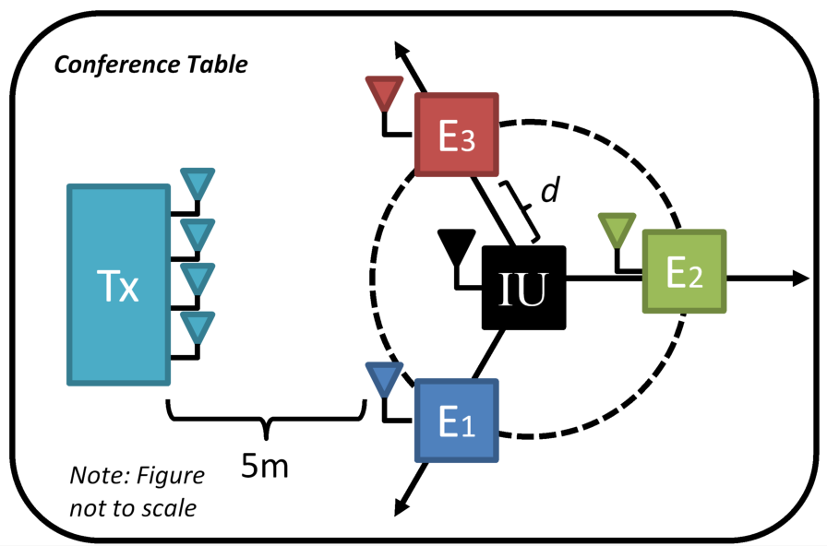
Relative E Location: Proximity

Slide 81

Relative E Location: Proximity
Notes:
Multipath here refers to random pockets of good/bad signal energy

Slide 82
Relative E Location: Proximity
Omni - High SINR variability indicator of multipath effects
Notes:
Multipath here refers to random pockets of good/bad signal energy

Slide 83
Relative E Location: Proximity
Omni/SUBF - High SINR variability indicator of multipath effects
Notes:
Discuss lam=5, re ran at same location, same results, nudged antenna, E1’s value rose (original results kept to show variablity)

Slide 84
Relative E Location: Proximity
Omni/SUBF - High SINR variability indicator of multipath effects
Notes:
CE results agree with previous work regarding receiver separation distance
Multipath variabliuty—same location/results for that 5lam drop point in SUBF

Slide 85
Relative E Location: Proximity
Omni/SUBF - High SINR variability indicator of multipath effects
CE – Precise blinding regardless of distance, consistent results regardless of multi-path
Notes:
CE results agree with previous work regarding receiver separation distance
Multipath variabliuty—same location/results for that 5lam drop point in SUBF

Slide 86
Relative E Location: Proximity
Omni/SUBF - High SINR variability indicator of multipath effects
CE – Precise blinding regardless of distance, consistent results regardless of multi-path
Notes:
Even at lam/4, we are still serving user with 10db.. That’s the CE’s norm served SINR to the IU -
This implies that it should be possible to put a listening device on the case of your laptop and still protect the intended user

Slide 87
Relative E Location: Proximity
Omni/SUBF - High SINR variability indicator of multipath effects
CE – Precise blinding regardless of distance, consistent results regardless of multi-path
STROBE – Mildly affected at close distances, consistent results regardless of multi-path, provides far greater SINR to IU than CE
Notes:
Even at lam/4, we are still serving user with 10db.. That’s the CE’s norm served SINR to the IU -
This implies that it should be possible to put a listening device on the case of your laptop and still protect the intended user

Slide 88
Experiments
Baseline
How does STROBE perform in a typical, indoor, wireless scenario?
Relative Eavesdropper location
How does STROBE cope with varying eavesdropper proximity to IU?
How does STROBE handle eavesdroppers in-line with IU?
Verifying necessity of multi-path (outdoor)
How dependent is STROBE on multi-path scattering characteristic of indoor WLAN environments?
Nomadic Eavesdropper
Is it possible for an eavesdropper to exhaustively traverse an environment to find a location where STROBE’s performance diminishes?
Notes:
Functions as outline

Slide 89
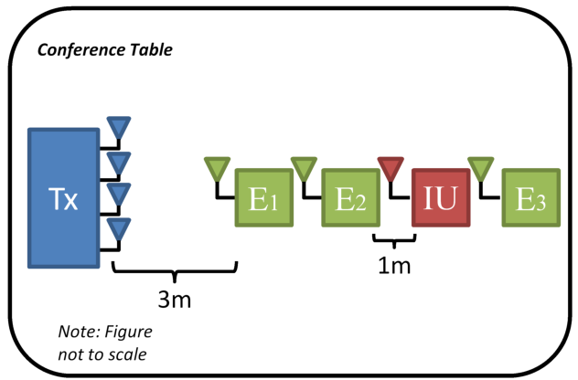
Relative E Location: In-Line

Slide 90
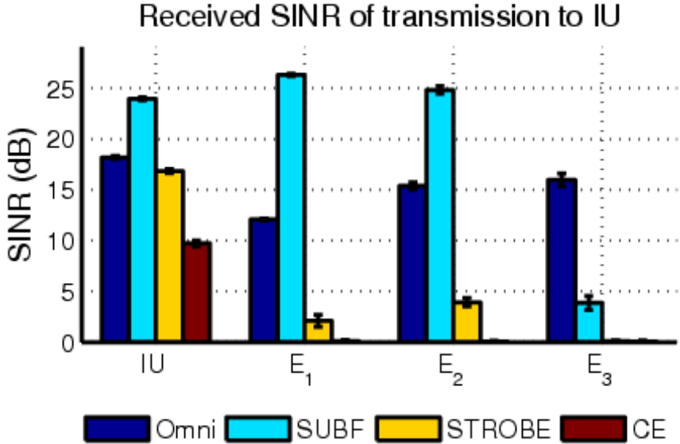
Relative E Location: In-Line
Notes:
Omni – SINR not predicted by location in line
SUBF – Single-target directional scheme; to defeat, get in LOS
STROBE – Multiple eavesdroppers in direct LOS between IU and Tx are successfully blinded
CE – Precise blinding comes at a price.

Slide 91
Relative E Location: In-Line
Omni – SINR not predicted by location in line
Notes:
Omni – SINR not predicted by location in line
SUBF – Single-target directional scheme; to defeat, get in LOS
STROBE – Multiple eavesdroppers in direct LOS between IU and Tx are successfully blinded
CE – Precise blinding comes at a price.

Slide 92
Relative E Location: In-Line
Omni – SINR not predicted by location in line
SUBF – Single-target directional scheme; to defeat, get in LOS
Notes:
Omni – SINR not predicted by location in line
SUBF – Single-target directional scheme; to defeat, get in LOS
STROBE – Multiple eavesdroppers in direct LOS between IU and Tx are successfully blinded
CE – Precise blinding comes at a price.

Slide 93
Relative E Location: In-Line
Omni – SINR not predicted by location in line
SUBF – Single-target directional scheme; to defeat, get in LOS
STROBE – Multiple eavesdroppers in direct LOS between IU and Tx are successfully blinded
Notes:
Omni – SINR not predicted by location in line
SUBF – Single-target directional scheme; to defeat, get in LOS
STROBE – Multiple eavesdroppers in direct LOS between IU and Tx are successfully blinded
CE – Precise blinding comes at a price.

Slide 94
Relative E Location: In-Line
Omni – SINR not predicted by location in line
SUBF – Single-target directional scheme; to defeat, get in LOS
STROBE – Multiple eavesdroppers in direct LOS between IU and Tx are successfully blinded
CE – Precise blinding comes at a price.
Notes:
Omni – SINR not predicted by location in line
SUBF – Single-target directional scheme; to defeat, get in LOS
STROBE – Multiple eavesdroppers in direct LOS between IU and Tx are successfully blinded
CE – Precise blinding comes at a price.

Slide 95
Experiments
Baseline
How does STROBE perform in a typical, indoor, wireless scenario?
Relative Eavesdropper location
How does STROBE cope with varying eavesdropper proximity to IU?
How does STROBE handle eavesdroppers in-line with IU?
Verifying necessity of multi-path (outdoor)
How dependent is STROBE on multi-path scattering characteristic of indoor WLAN environments?
Nomadic Eavesdropper
Is it possible for an eavesdropper to exhaustively traverse an environment to find a location where STROBE’s performance diminishes?
Notes:
Functions as outline

Slide 96
Verifying necessity of Multi-Path

Slide 97
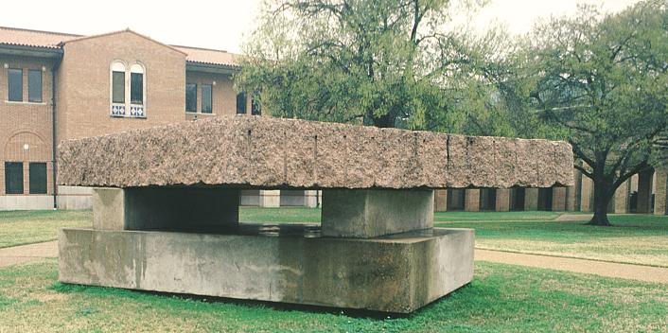
Verifying necessity of Multi-Path

Slide 98
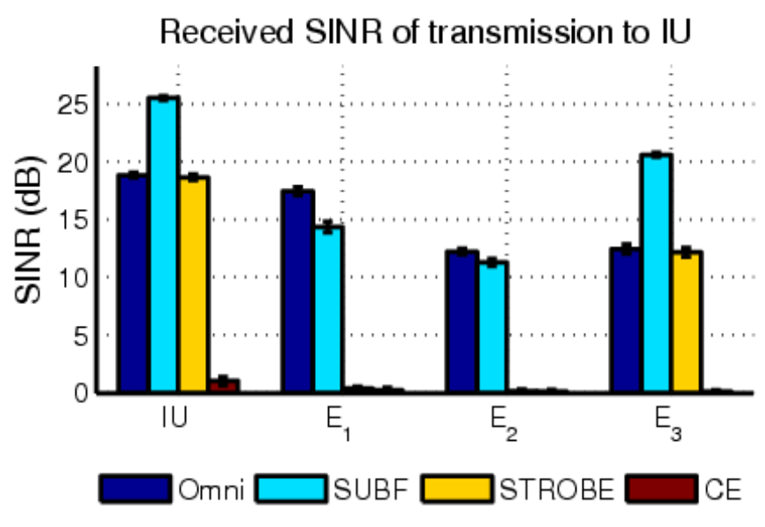
Verifying necessity of Multi-Path
Outdoors
Notes:
Multi-stream methods fail in outdoor environments
E2E3 omni SINR? Why lowst if in front?****

Slide 99
Verifying necessity of Multi-Path
Outdoors
Multi-Stream methods fail outdoors
Notes:
Multi-stream methods fail in outdoor environments
E2E3 omni SINR? Why lowst if in front?****

Slide 100
Verifying necessity of Multi-Path
Outdoors
Multi-Stream methods fail outdoors
  STROBE becomes directional
Notes:
Multi-stream methods fail in outdoor environments
E2E3 omni SINR? Why lowst if in front?****

Slide 101
Verifying necessity of Multi-Path
Outdoors
Multi-Stream methods fail outdoors
  STROBE becomes directional
  CE completely fails
Notes:
Multi-stream methods fail in outdoor environments
E2E3 omni SINR? Why lowst if in front?****

Slide 102
Backup Slides

Slide 103
Prior Work
Notes:
1. Using a set of phased arrays Aps to coordinate and send partial segments of data to an IU
2. Using Aps to put energy and an IU and away from an eavesdropper by having multiple Aps coordinate to send data and to null out others—weight pattern based on physical beam shape
- both methods would require custom hardware and major AP/Client modification
1. Attempt to quantify fundamental limits of secrecy capacity (wrt mod rate etc) – prove that you can always keep a secret from an eavesdropper given the proper weight is constructed
2. Eavesdropper can be thwarted by cooperative scheme
-both methods are theoretical

Slide 104
Prior Work
Beamforming-based multiple AP cooperation
Notes:
1. Using a set of phased arrays Aps to coordinate and send partial segments of data to an IU
2. Using Aps to put energy and an IU and away from an eavesdropper by having multiple Aps coordinate to send data and to null out others—weight pattern based on physical beam shape
- both methods would require custom hardware and major AP/Client modification
1. Attempt to quantify fundamental limits of secrecy capacity (wrt mod rate etc) – prove that you can always keep a secret from an eavesdropper given the proper weight is constructed
2. Eavesdropper can be thwarted by cooperative scheme
-both methods are theoretical

Slide 105
Prior Work
Beamforming-based multiple AP cooperation
Information theoretic multi-antenna security
Notes:
1. Using a set of phased arrays Aps to coordinate and send partial segments of data to an IU
2. Using Aps to put energy and an IU and away from an eavesdropper by having multiple Aps coordinate to send data and to null out others—weight pattern based on physical beam shape
- both methods would require custom hardware and major AP/Client modification
1. Attempt to quantify fundamental limits of secrecy capacity (wrt mod rate etc) – prove that you can always keep a secret from an eavesdropper given the proper weight is constructed
2. Eavesdropper can be thwarted by cooperative scheme
-both methods are theoretical

Slide 106
Prior Work
Beamforming-based multiple AP cooperation
  J. Carey and D. Grunwald. Enhancing WLAN security with smart antennas: a physical layer response for information assurance. In Proc. IEEE Vehicular Technology Conference, September 2004.
Information theoretic multi-antenna security
Notes:
1. Using a set of phased arrays Aps to coordinate and send partial segments of data to an IU
2. Using Aps to put energy and an IU and away from an eavesdropper by having multiple Aps coordinate to send data and to null out others—weight pattern based on physical beam shape
- both methods would require custom hardware and major AP/Client modification
1. Attempt to quantify fundamental limits of secrecy capacity (wrt mod rate etc) – prove that you can always keep a secret from an eavesdropper given the proper weight is constructed
2. Eavesdropper can be thwarted by cooperative scheme
-both methods are theoretical

Slide 107
Prior Work
Beamforming-based multiple AP cooperation
  J. Carey and D. Grunwald. Enhancing WLAN security with smart antennas: a physical layer response for information assurance. In Proc. IEEE Vehicular Technology Conference, September 2004.
  S. Lakshmanan, C. Tsao, R. Sivakumar, and K. Sundaresan. Securing Wireless Data Networks against Eavesdropping using Smart Antennas. In The 28th International Conference on Distributed Computing Systems, Beijing, China, June 2008.
Information theoretic multi-antenna security
Notes:
1. Using a set of phased arrays Aps to coordinate and send partial segments of data to an IU
2. Using Aps to put energy and an IU and away from an eavesdropper by having multiple Aps coordinate to send data and to null out others—weight pattern based on physical beam shape
- both methods would require custom hardware and major AP/Client modification
1. Attempt to quantify fundamental limits of secrecy capacity (wrt mod rate etc) – prove that you can always keep a secret from an eavesdropper given the proper weight is constructed
2. Eavesdropper can be thwarted by cooperative scheme
-both methods are theoretical

Slide 108
Prior Work
Beamforming-based multiple AP cooperation
  J. Carey and D. Grunwald. Enhancing WLAN security with smart antennas: a physical layer response for information assurance. In Proc. IEEE Vehicular Technology Conference, September 2004.
  S. Lakshmanan, C. Tsao, R. Sivakumar, and K. Sundaresan. Securing Wireless Data Networks against Eavesdropping using Smart Antennas. In The 28th International Conference on Distributed Computing Systems, Beijing, China, June 2008.
Information theoretic multi-antenna security
  S. Goel and R. Negi. Guaranteeing secrecy using artificial noise. IEEE Transactions on Communications, 7(6):2180–2189, June 2008.
Notes:
1. Using a set of phased arrays Aps to coordinate and send partial segments of data to an IU
2. Using Aps to put energy and an IU and away from an eavesdropper by having multiple Aps coordinate to send data and to null out others—weight pattern based on physical beam shape
- both methods would require custom hardware and major AP/Client modification
1. Attempt to quantify fundamental limits of secrecy capacity (wrt mod rate etc) – prove that you can always keep a secret from an eavesdropper given the proper weight is constructed
2. Eavesdropper can be thwarted by cooperative scheme
-both methods are theoretical

Slide 109
Prior Work
Beamforming-based multiple AP cooperation
  J. Carey and D. Grunwald. Enhancing WLAN security with smart antennas: a physical layer response for information assurance. In Proc. IEEE Vehicular Technology Conference, September 2004.
  S. Lakshmanan, C. Tsao, R. Sivakumar, and K. Sundaresan. Securing Wireless Data Networks against Eavesdropping using Smart Antennas. In The 28th International Conference on Distributed Computing Systems, Beijing, China, June 2008.
Information theoretic multi-antenna security
  S. Goel and R. Negi. Guaranteeing secrecy using artificial noise. IEEE Transactions on Communications, 7(6):2180–2189, June 2008.
  L. Dong, Z. Han, A. Petropulu, and V. Poor. Improving wireless physical layer security via cooperating relays. IEEE Transactions on Signal Processing, 58(3):1875–1888, March 2010.
Notes:
1. Using a set of phased arrays Aps to coordinate and send partial segments of data to an IU
2. Using Aps to put energy and an IU and away from an eavesdropper by having multiple Aps coordinate to send data and to null out others—weight pattern based on physical beam shape
- both methods would require custom hardware and major AP/Client modification
1. Attempt to quantify fundamental limits of secrecy capacity (wrt mod rate etc) – prove that you can always keep a secret from an eavesdropper given the proper weight is constructed
2. Eavesdropper can be thwarted by cooperative scheme
-both methods are theoretical

