Slide 1
Opportunistic Channel Estimation for Implicit 802.11af MU-MIMO
ITC’28 Wurzburg, Germany
Tuesday, September 13, 2016
Ryan E. Guerra
Rice University
ryan@guerra.rocks
Dr. Narendra Anand
Cisco Systems, Inc.
nareanan@cisco.com
Clayton Shepard
Rice University
cws@rice.edu
Dr. Edward Knightly
Rice University
knightly@rice.edu

Slide 2
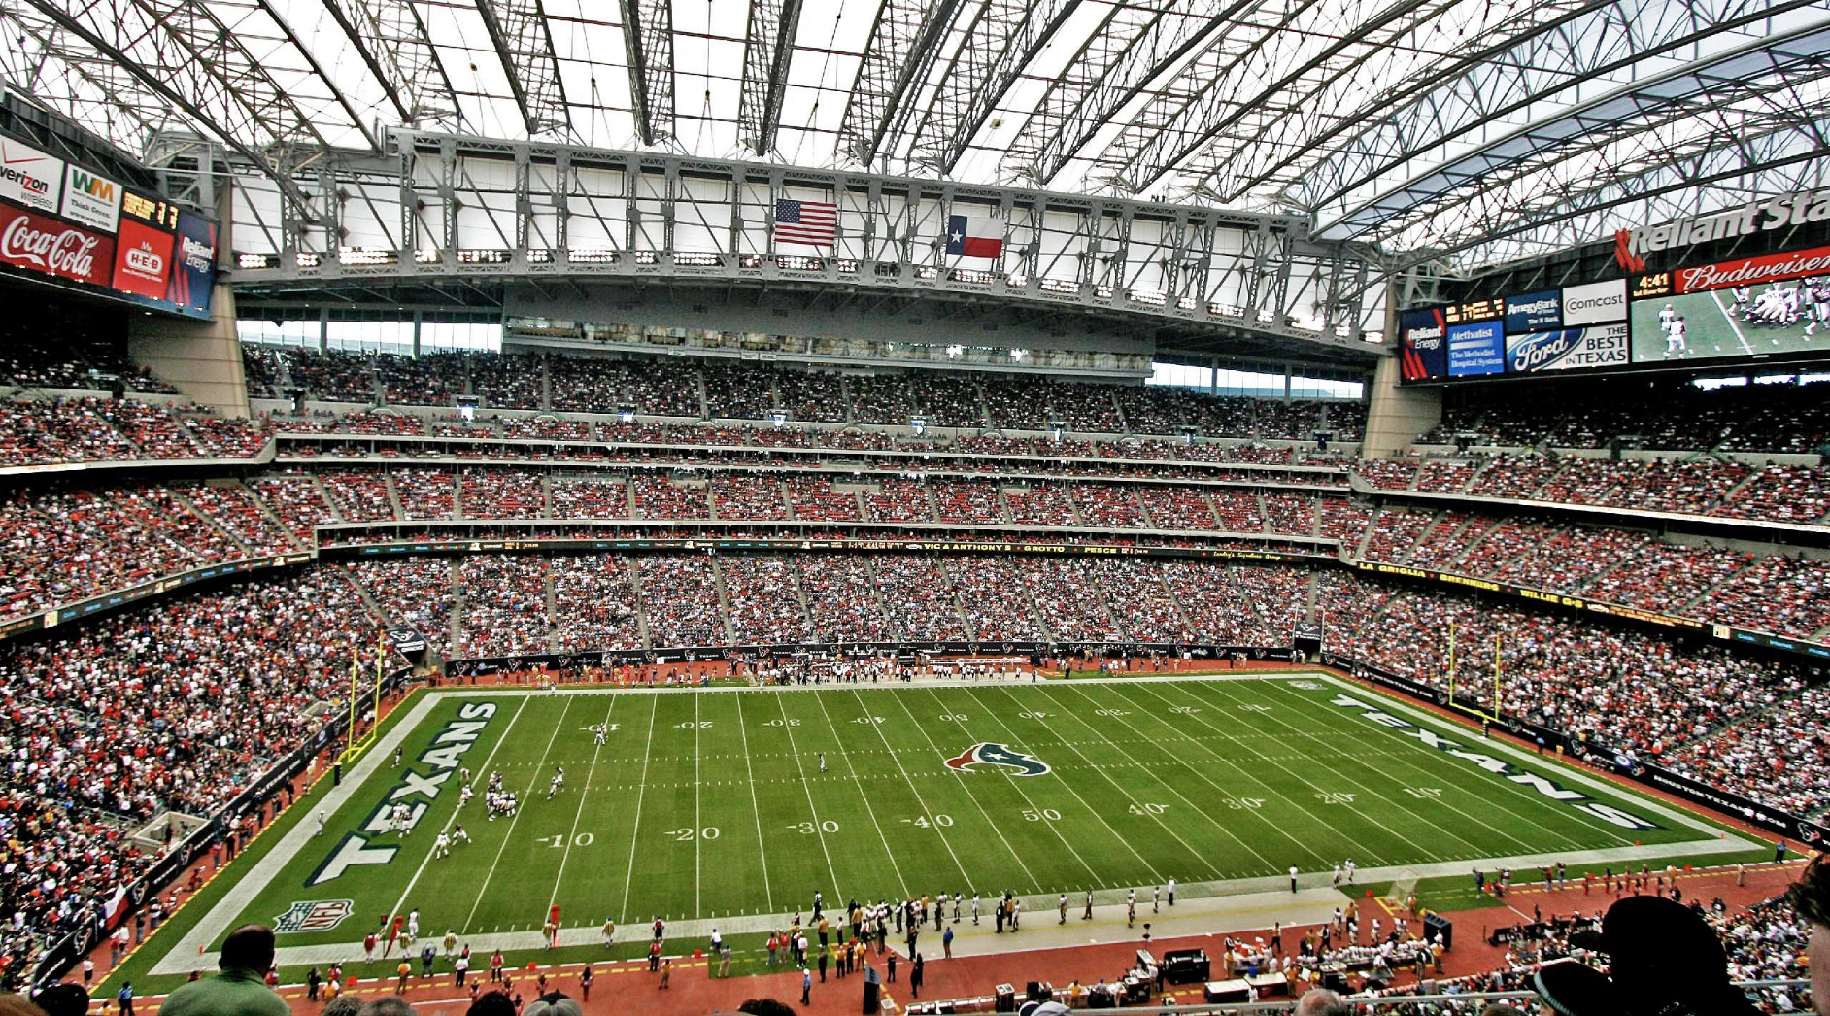
The Next Big Wireless Challenge
1000x Capacity
100x Clients
Notes:
So this is the kind of environment that keeps us wireless engineers up at night.
It’s a very challenging problem: how do you support thousands of clients with high-speed wireless links? Next-generation wireless systems are targeting orders-of-magnitude improvements in network capacity and number of simultaneous clients, but there are quite a few roadblocks in the way.
Today, we’re going to explore a WLAN solution that—while perhaps not completely solving this stadium problem—helps solve the capacity and user scaling problem for WLANs.

Slide 3

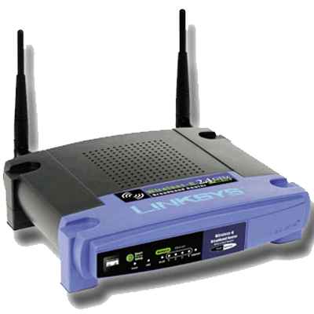
802.11n MIMO
Notes:
Our common WLAN standard, also known as Wi-Fi or 802.11, have relied on MIMO spatial multiplexing to reach higher and higher box speeds.
The 802.11n standard enables spatial multiplexing, improving data rates and link robustness, however when the clients have a small number of antennas (such in a mobile device), you’re forced to transmit to each of them sequentially—underutilizing the spatial resources available at the access point.

Slide 4
802.11n MIMO Beamforming
Notes:
We can increase the link SNR by coherently beamforming with the antennas at the base station, but we’re still limited to communications with one station at a time on a small number of spatial streams, again generally resulting in an underutilization of spatial resources.

Slide 5
802.11ac/af Multi-User MIMO
MU-MIMO Beamforming
Notes:
Multi-user beamforming was introduced these past few years, finally allowing full utilization of available spatial resources by allowing simultaneous transmissions to multiple stations on the same channel.
And while fantastic, the increased spectral efficiency doesn’t come for free….

Slide 6
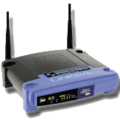


802.11ac/af Channel State Information (CSI)
(1) Sound Channel
(3) Transmit Data
Time
Overhead can consume up to 90% of airtime!
[Bejarano2013]
(2) Feedback Measurements
Notes:
The problem is that in order to beamform, the access point need to know the CSI in order to beamform correctly.
The way this currently works is that the access point will sound the channel with a known signal, allowing the stations to estimate the downlink channel.
Although I’m simplifying a little bit for brevity, the stations will then sequentially feedback their observations to the access point by transmitting short data packets.
At that point, the access point has full CSI and can then transmit a beamformed multi-user downlink packet.
As you can tell, the entire handshake before the downlink transmission is consumed by protocol overhead. In fact, previous work has show that this overhead can consume over 90% of the available airtime, eliminating any gains you could get from spatial multiplexing.
This standard approach is called “Explicit” beamforming, because the AP is explicitly sounding the downlink channel.

Slide 7
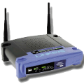
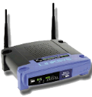

Implicit CSI Estimation
Sounding
Reports
Trigger
Sounding
Explicit 802.11ac/af CSI Sounding
Implicit CSI Sounding [Lou2013]
Can we eliminate CSI estimation overhead completely?
Notes:
An alternative to the explicit sounding is called IMplicit sounding.
Whereas in the standard an AP first sounds the channel in the downlink direction and the stations report their observations, an implicit system will trigger sounding that occurs in the UPlink direction, measuring the uplink channel and IMplicitly estimating the downlink.
Although it’s not to-scale in our picture here, this has the potential to significantly decrease the time spent on CSI overhead.
In this work, we go one step further to design a system that aims to completely eliminate CSI sounding overhead and achieve even greater protocol optimization.

Slide 8




Opportunistic Implicit Channel Estimation
System Design
Measurement Campaign
Protocol Emulation
Hardware Platform
Notes:
The rest of the talk, we’ll first present the design of what we’re calling “Opportunistic Implicit Channel Estimation.”
In order to test our design, we constructed a unique experimental hardware platform.
We’ll present the results from our measurement campaign with our custom hardware system, and then use those results to inform detailed protocol emulations, comparing our proposed design to several alternative approaches.

Slide 9
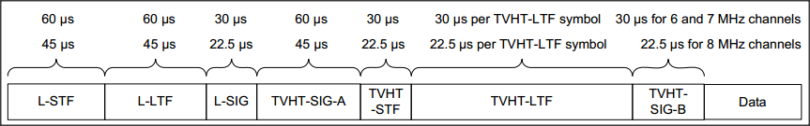
802.11 Channel Estimation
Each 802.11af packet already contains channel sounding symbols.
Notes:
Our key insight is that every standard 802.11 packet already contains a physical-layer header used for synchronization and channel equalization.
These known symbols, highlighted here [click] enable essentially every packet, whether it’s a DATA, ACK, or Control packet to serve as a sounding packet.
Our idea is to leverage this existing information in order to avoid adding additional sounding packets required by the standard.

Slide 10


Opportunistic Implicit Channel Sounding
Antenna
1
2
3
4
1
CSI =
2
Station
3
4
ACKs
…
CSI can be estimated opportunistically, without injecting protocol overhead.
Notes:
Here’s how it works: Let’s consider a timeline with one AP and four stations.
In order to form a multi-user downlink packet, the AP needs to know the channel state from each of its antennas to each of the stations. We’ve represented this information as this blank matrix here.
At some time [click], the first station will transmit an uplink packet. This could happen when it first associates or when a new data flow is started. This uplink transmission allows the AP to fill in one row of the CSI matrix, utilizing the physical layer header we mentioned earlier.
Some later time [click] another station will associate, filling in another row, and [click], [click] eventually the AP will have full CSI information and be able to [click] transmit a multi-user downlink packet.
What’s nice about this system is that once you bootstrap with associations or unicast uplink, the staggered ACK already specified in the 802.11 standard will refresh your known CSI, continually enabling this process so long as there is downlink data to send.

Slide 11

Implicit CSI Assumptions
Physical radio channels are reciprocal.
Hardware reciprocity calibration is possible. [Shepard2012, Guillaud2013]
Channel coherence time > sounding-transmit (S-T) interval. [Anand2014]
Time
S-T
Notes:
This systems relies on a few assumptions. The first is that in order to opportunistically estimate the downlink channel, the physical radio channel MUST be reciprocal. This means that knowing either the downlink channel or the uplink channel is equivalent.
In our previous work, and confirmed by others working with the same transceiver hardware, we showed that calibration of MIMO systems for channel reciprocity is both possible and stable.
Finally, we need to know that the channel coherence time is greater than the interval of time between opportunistic sounding and data transmission. To go back to that previous timeline, at some point the uplink channel is implicitly estimated. So long as the wireless channel has not changed much since then, it is possible to use that CSI for an accurate beamformed transmission. For the rest of the talk we’ll refer to this interval as the S-T interval.
We now have the pieces to enable our opportunistic implicit protocol, but one of our greatest concerns was with testing this third assumption, particularly when the stations are mobile. [click]

Slide 12
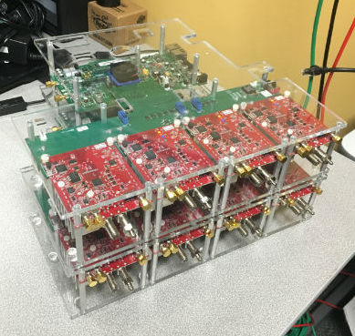
Platform: 8x8 MU-MIMO UHF (400-700 MHz)
Mobile Argos-WURC
Desktop Host
Wireless Bridge
Mobile Argos-WURC
Adaptor
WARPv3
4x1
WURC
Radio
Adaptor
WURC
MicroBlaze
Processor
FPGA
WURC
MicroBlaze
Processor
FPGA
WARPv3 Radio
Radio Bridge
Radio Bridge
WURC
WARPv3 Radio
WURC
Argos/Faros Drivers
Argos/Faros Drivers
Argos/Faros
Sounder
Argos/Faros
Sounder
WURC
WURC Drivers
WURC
WURC Drivers
WURC
Bridge
WURC
Bridge
FMC
FMC
FMC
WURC
WURC
Notes:
At the time, there were no platforms that existed to perform mobile multi-user experiments in the UHF bands utilized by the 802.11af standard. So we designed, manufactured and implemented a custom software-defined radio platform that allowed truly mobile stations with over-the-air synchronization and a wireless overlay control network. We also obtained an experimental license to operate this system on UHF channels. I don’t have time to go into more detail, please see our paper.

Slide 13
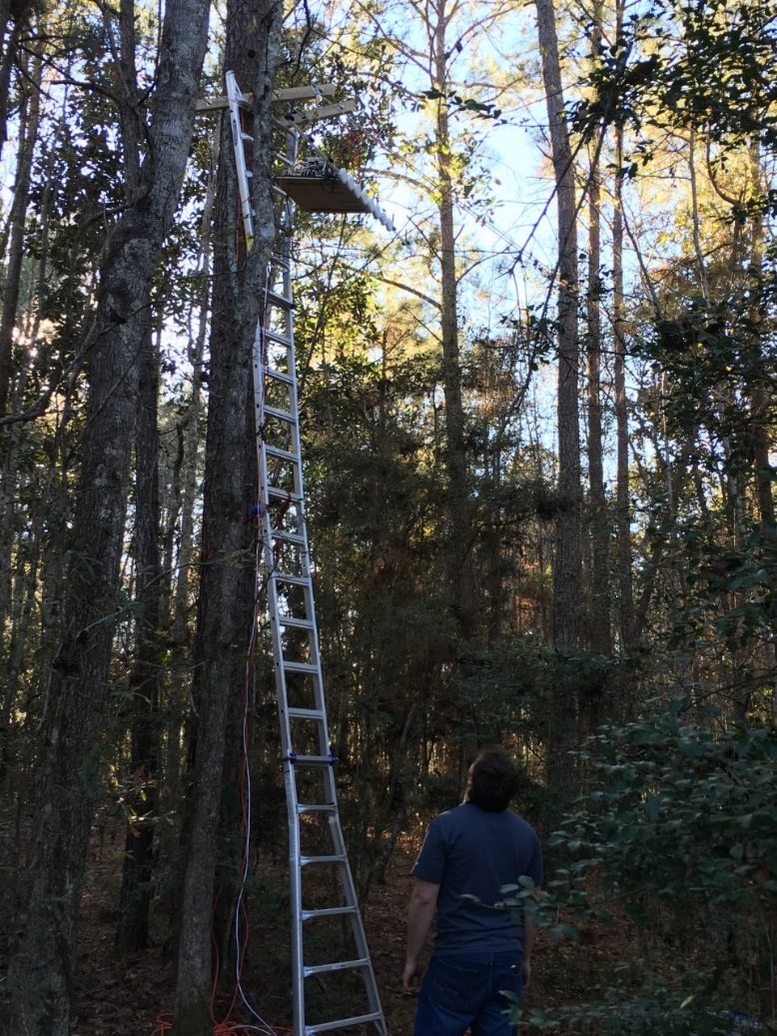
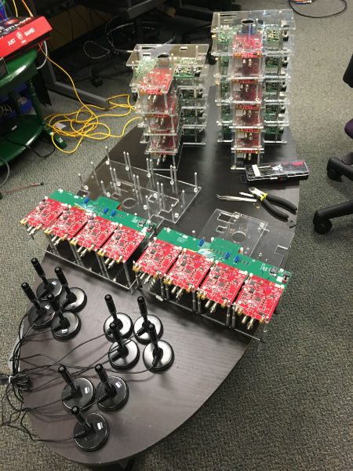
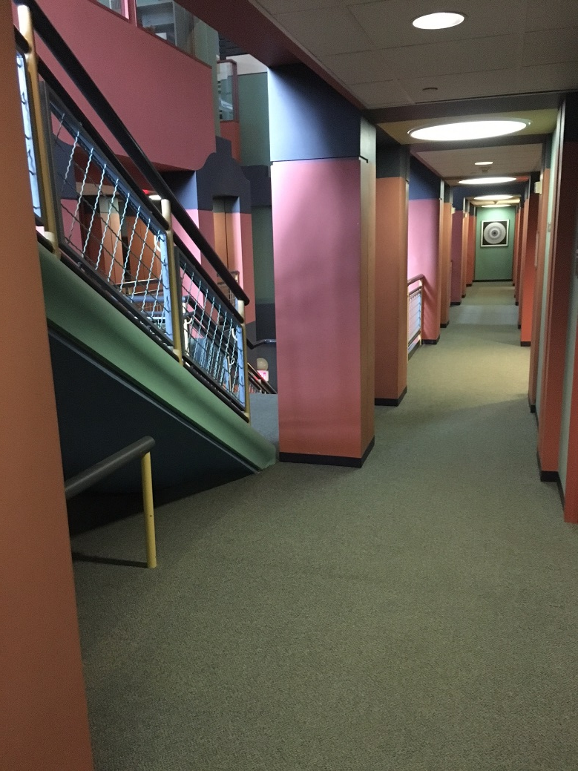
Experimental Setup
Outdoor Dense Trees
Indoor Hallway/Stairs
Example Nodes
Notes:
We investigated two target environments: the first was a challenging NLoS dense forest with mobiles up to 450m away through dense trees—here you can see us mounting the access point on a high tree with a linear antenna array.
The second environment was NLoS indoor with stations scattered throughout hallways and stairs.
Here’s a picture of the 8-radio access point and the various mobile nodes we used in these measurements, including omnidirectional antennas.
Within these two environments, we tested three different types of mobility… [click]

Slide 14


Types of Mobility
Environmental Motion
Nodal Mobility
Notes:
In the first case, we investigated a static environment, where nothing was intentially moving. This represents a multipath environment between the AP and the stationary STAs.
In the second case, motion in the environment changes the number and weight of paths to the stations, however the stations themselves don’t move. We call this “Environmental Motion.”
Finally, nodal mobility is when the stations themselves are physically moved.

Slide 15
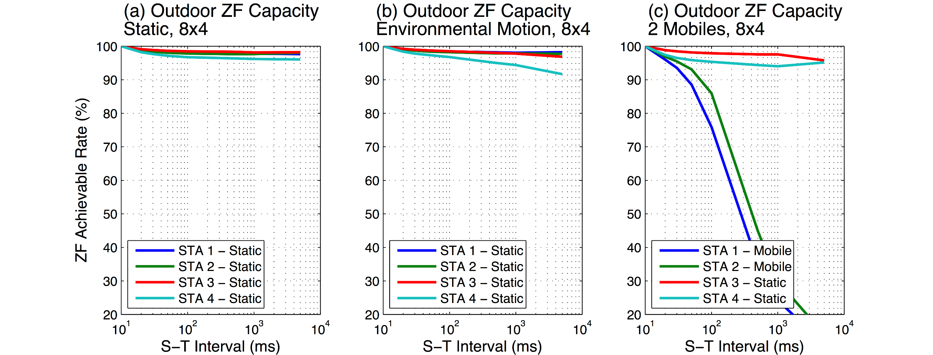
ZF Rate Degradation vs. CSI Staleness, 8x4 Outdoor
Static
Environmental Motion
Nodal Mobility
Stale channel capacity remains high for stationary nodes more than 1 second!
Notes:
Now, considering these three types of mobility, we measured the outdoor multi-user channels and calculated the supported achieveable rate as a function of the sounding-transmission interval we discussed before. Here’s we show a plot of the rate for 4 stations as it degrades from 100%, with no sounding-transmission interval on the left, to an interval up to 5 seconds in length. In this static environment, you can see that none of the stations experience any significant drop in multi-user capacity, even if we use CSI measured seconds ago.
Now, when there are pedestrians moving around the environment, waving their arms and trying to block the stations, there is a larger decay in capacity as the S-T interval increases, but performance remains above 90% of ideal.
Finally, we physically moved two of the stations while keeping two of them stationary. In this case, you see a rapid dropoff in capacity to those stations, while the other stations only experience environmental motion.
This means that when the nodes remain stationary, we are able to use stale CSI from up to seconds ago and maintain high performance. When they’re mobile, the timescales are obviously much shorter.

Slide 16
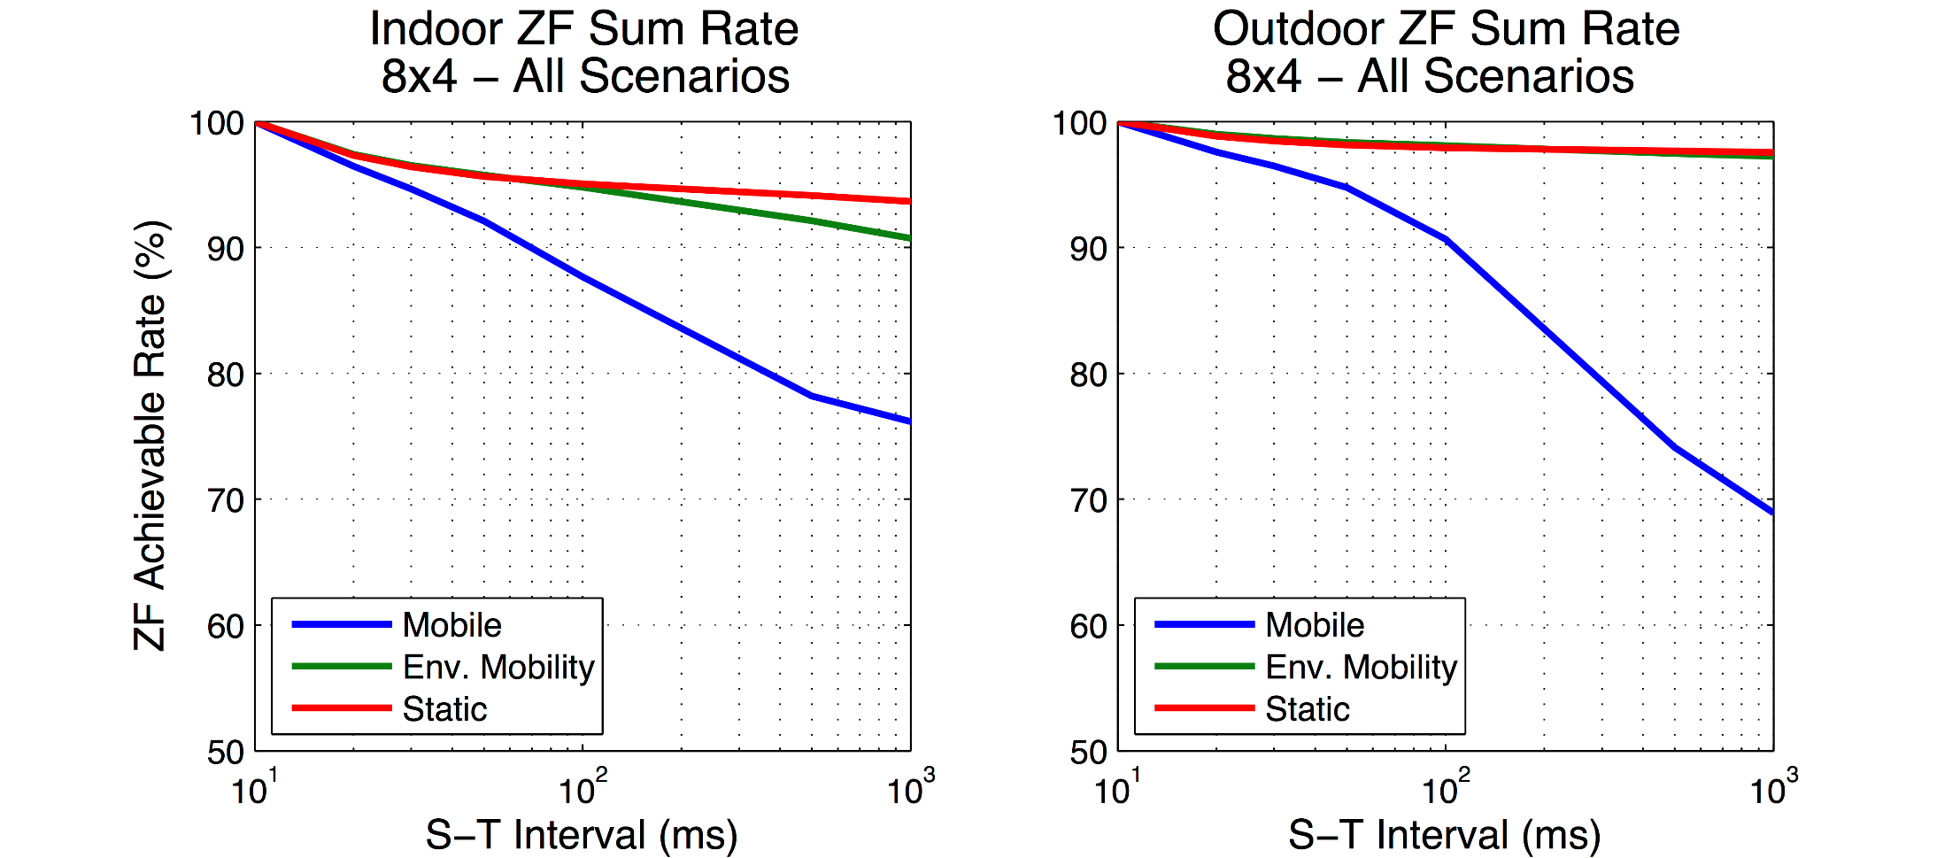
ZF Sum Achievable Rate vs. CSI Staleness, 8x4
Indoors
Outdoor
Stale CSI causes ~10% throughput degradation at 1 second for stationary nodes.
Notes:
We can summarize the results of our measurement campaign by plotting them sum-achievable rate for our system with three different types of mobility. Again, we show the rate as a function of the sounding-transmission interval.
In the indoor case, there is relatively little difference between the static and environmental mobility case. [click]
These are remarkably similar to our observations in the outdoor case.
What these measurements allow us to do is to select a protocol threshold for simulation. For the rest of our investigation, we’ll assume that in the worst case, the use of stale opportunistic CSI will result in no more than a 10% decrease in achievable rate, provided the nodes are stationary.

Slide 17
Emulation Parameters, 4x4 MU-MIMO
802.11af TVHT PHY
Single 6 MHz Channel
Backlogged traffic queues
Perfect rate adaptation
< 10% rate loss with stale CSI
1500 byte packets
Notes:
Finally, we move to the last part of our presentation, emulation of various approaches to channel sounding. We’ll first focus on a 4x4 MU-MIMO system, using the 802.11as standard physical layer over a single 6 MHz UHF channel. We’ll assume that downlink queues are backlogged the system implements perfect rate adaptation. We’ll also assume that the worst case, as observed, only results in 10% rate penalty for using stale CSI.

Slide 18
Emulated Protocols
Sounding
Sounding
Reports
Reports
Trigger
Trigger
Sounding
Sounding
Explicit 802.11af
Opportunistic Implicit – ideal
Explicit 802.11af
Implicit
Opportunistic Implicit – worst-case
Payload size is a dominating parameter when considering relative overhead.
Notes:
Today, we’ll compare four different protocols: the current standard explicit 802.11af beamforming, an implicit beamforming modification with smaller overhead packets, and our proposed opportunistic implicit protocol, both in the ideal case and with worse-case observed beamforming error.
It should be clear that the size of the data payload is critical when trading off sounding overhead with goodput. For instance, a smaller payload [click] would result in sounding overhead being more dominant since there is less chance to amortize overhead.
For that reason, we will present results as a function of payload size… [click]

Slide 19
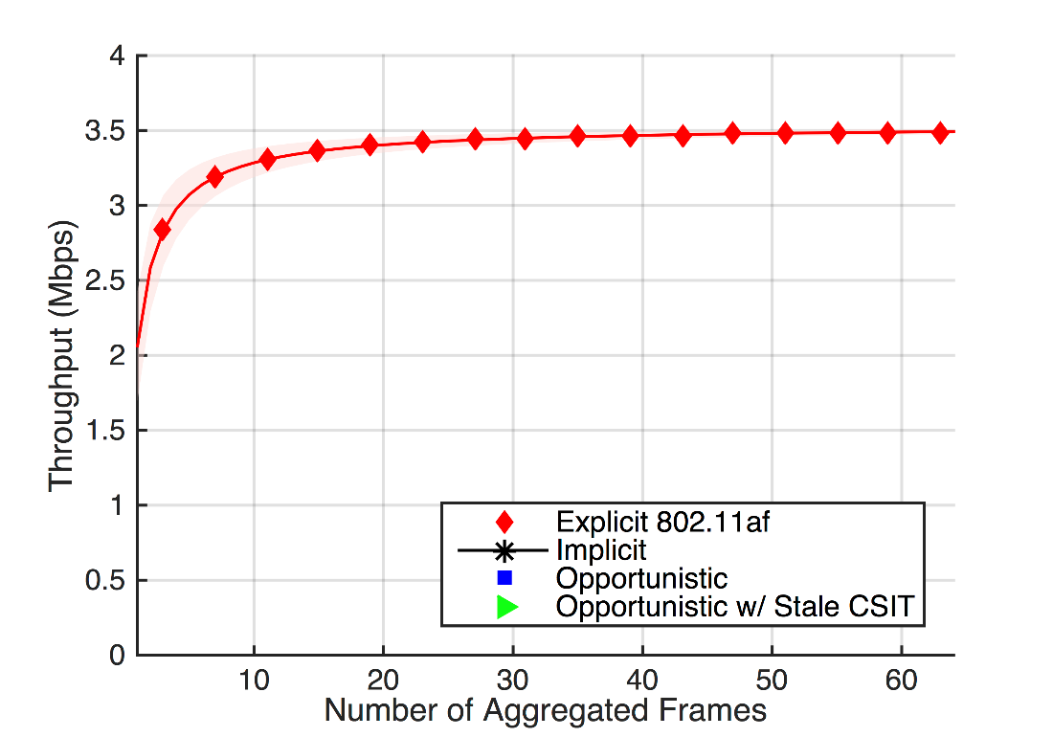
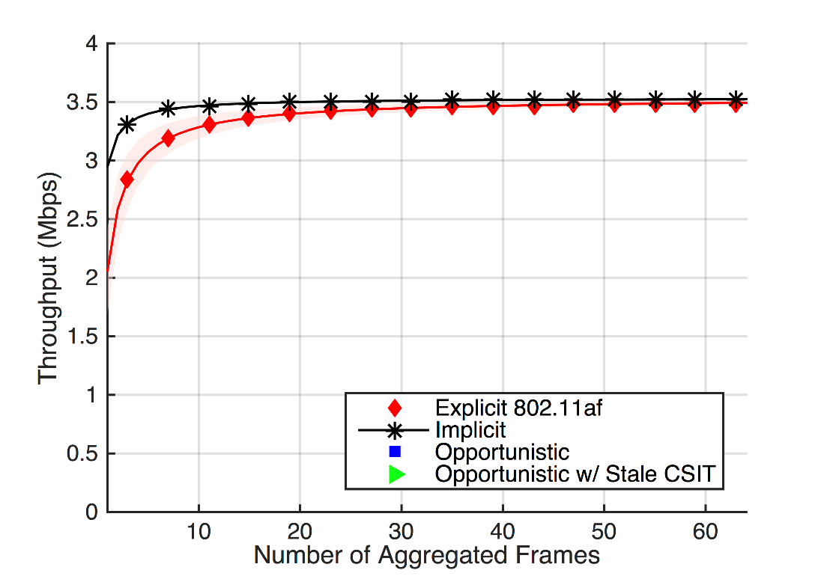
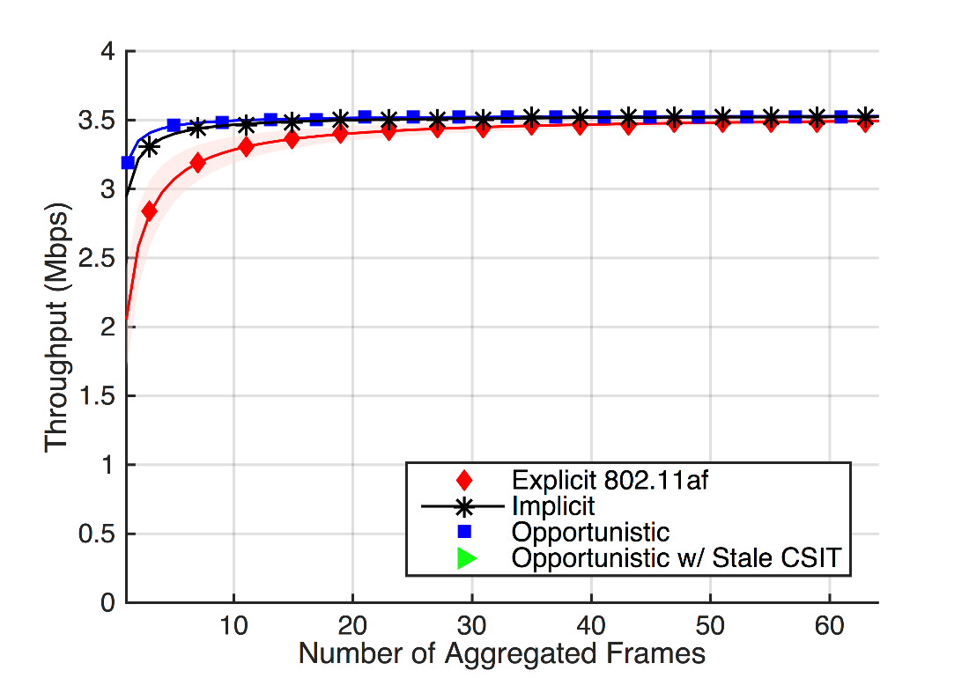
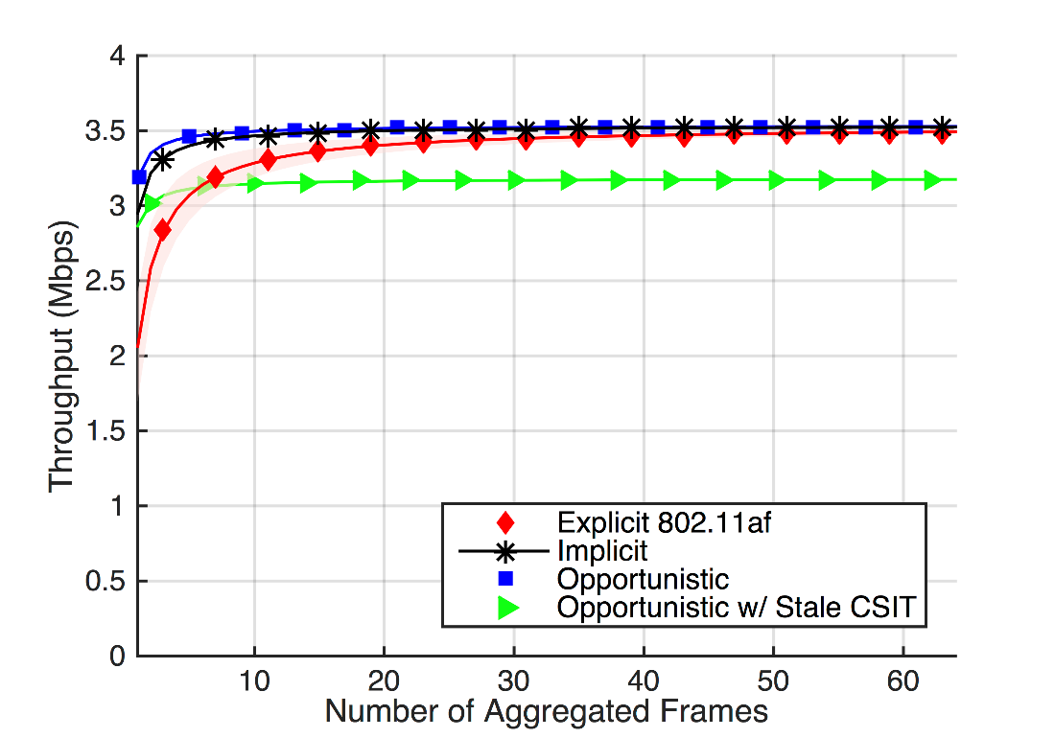
Emulated Protocol Performance, 4x4
MCS = 0, BPSK
At base rate, error in opportunistic CSI overwhelms protocol efficiency gains with any significant packet aggregation.
Notes:
So at base rate, it may only be a good idea to use opportunistic sounding when the packets to be sent are short, on the order of 3 kBytes.

Slide 20
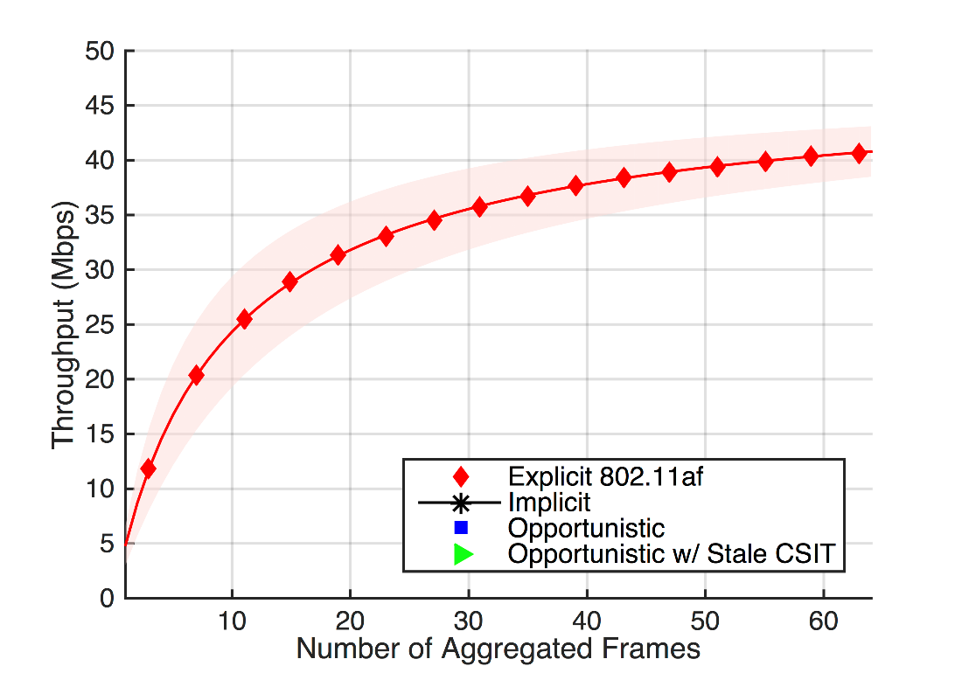
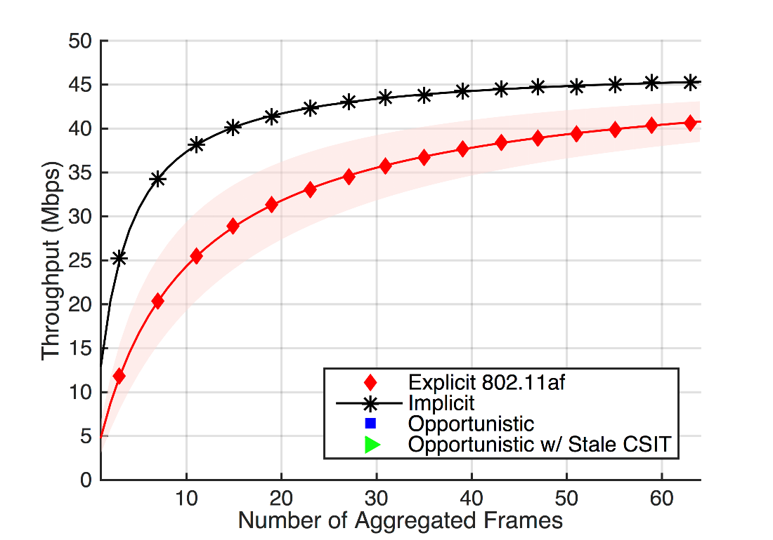
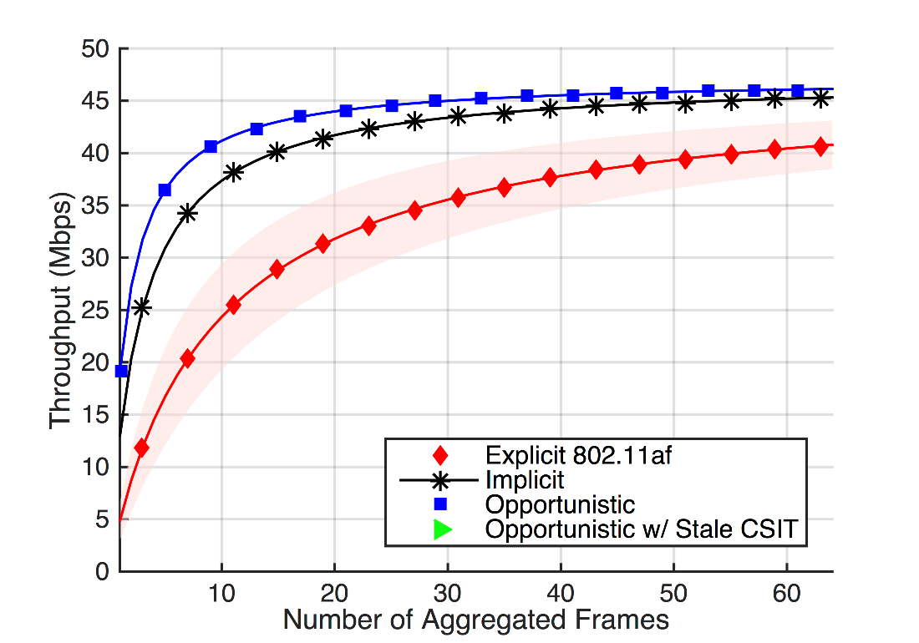
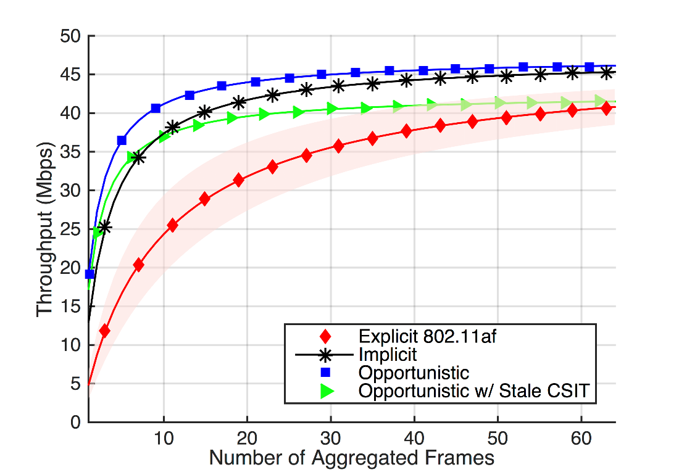
Emulated Protocol Performance, 4x4
MCS = 0, BPSK
MCS = 9, QAM-64
For short payloads, opportunistic implicit channel sounding is most efficient.
At high MCS, implicit channel sounding outperforms alternatives.
Notes:
Opportunistic provides 186% improvement, implicit provides 94% improvement over explicit.

Slide 21
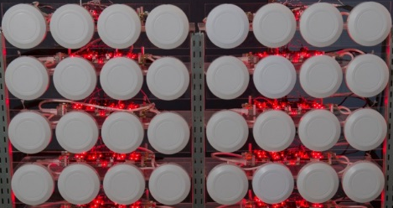
Emulation Parameters, 32x16 MU-MIMO
“802.11af-like” TVHT PHY
Single 6 MHz Channel
Backlogged traffic queues
Perfect rate adaptation
< 10% rate loss with stale CSI
1500 byte packets
Notes:
So for today’s 4x4 or 8x4 systems, while implicit and opportunistic sounding offer real efficiency gains, they’re relatively marginal except at high data rates.
But what we’re really interested in are next-generation MIMO systems, where the amount of radio resources is scaled to support orders-of-magnitude increases in clients. For that reason, we extended our emulation to the case with a 32x16 MIMO system. Keeping all other parameters, we extrapolate the overhead that would be required under the 802.11af standard if it were to support so many radios.

Slide 22
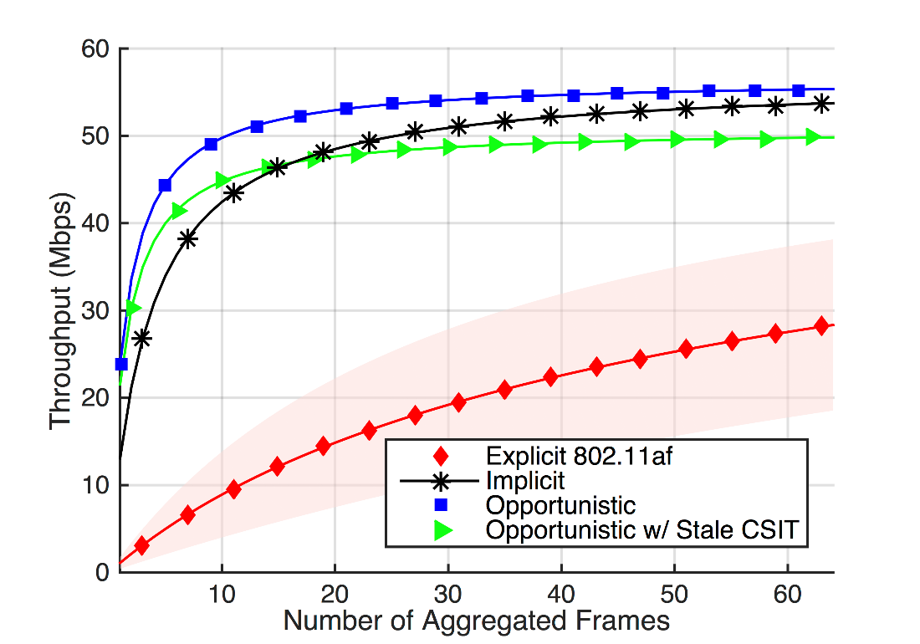
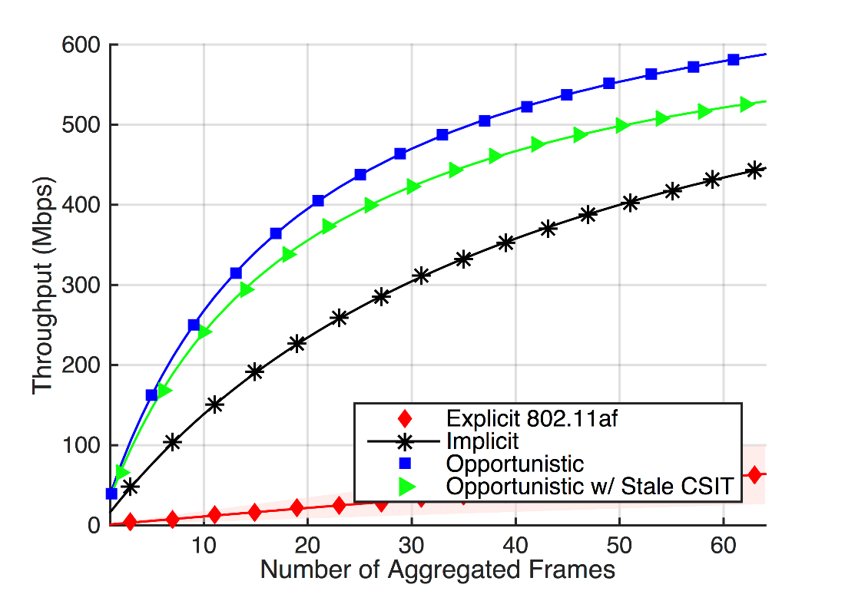
Simulated Protocol Performance, 32x16
MCS = 0, BPSK
MCS = 9, QAM-64
Standard 802.11af explicit channel sounding does not scale well.
Opportunistic implicit sounding is strictly better at high MCS.

Slide 23
Conclusion
For small MU-MIMO arrays, balance packet size, overhead, and transmission rate:
  Use implicit sounding for low-rate transmissions.
  Use opportunistic implicit sounding for short multi-user packets.
For large MU-MIMO arrays, implicit beamforming is necessary:
  Use opportunistic implicit sounding with stationary users.
We designed and evaluated an overhead-free Opportunistic Implicit channel sounding protocol, implemented a new MU-MIMO test platform for UHF-band mobile experiments, and recorded the first UHF-band mobile MU-MIMO outdoor measurements.
http://data.projectargos.org/dataset/ITC28-UHF-MUMIMO
Notes:
On the order of 30% increase in throughput using our opportunistic design.

